Slide 1
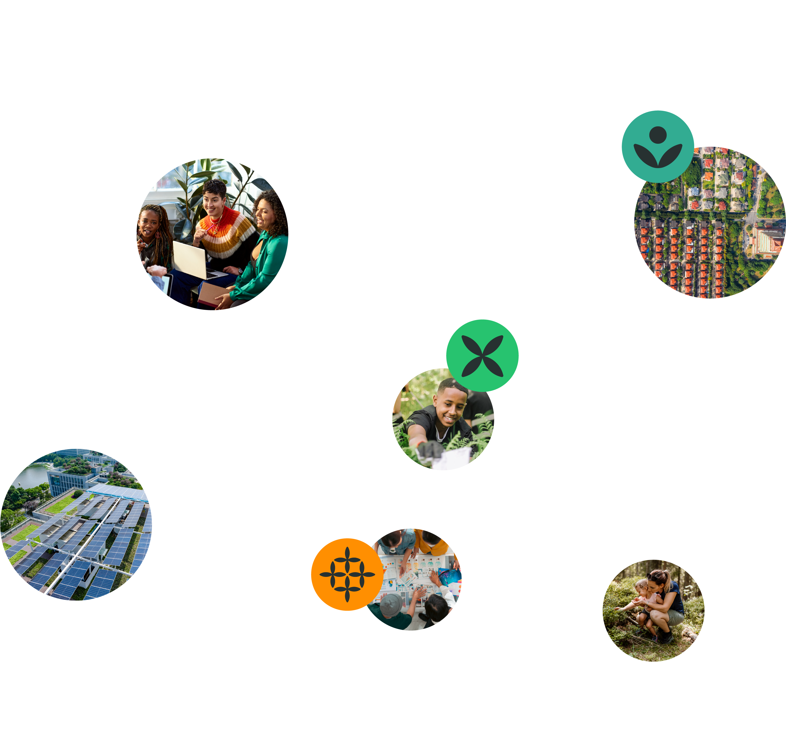
Test Your Impact
Learning Workshop 4
15 May 2025
Notes:
Welcome! [Say individuals names as they join – bring them into the space and make them feel seen.]
Ask that everyone turns on their video and makes their name visible so we can connect.
Remind participants that this session will be recorded.
Ask everyone at the session to introduce themselves and answer a playful prompt question in the chat.
Please introduce yourself in the chat and provide:
your name,
your learning institution or organisation,
where your feet are touching the ground today, and
answer our playful prompt:
Share a time when you tested an idea or assumption and adapted to feedback you received? This can be a simple one! For example, trying a new recipe and, because your friends commented that it was too spicy, reducing the amount of cayenne pepper when you next made it.

Slide 2
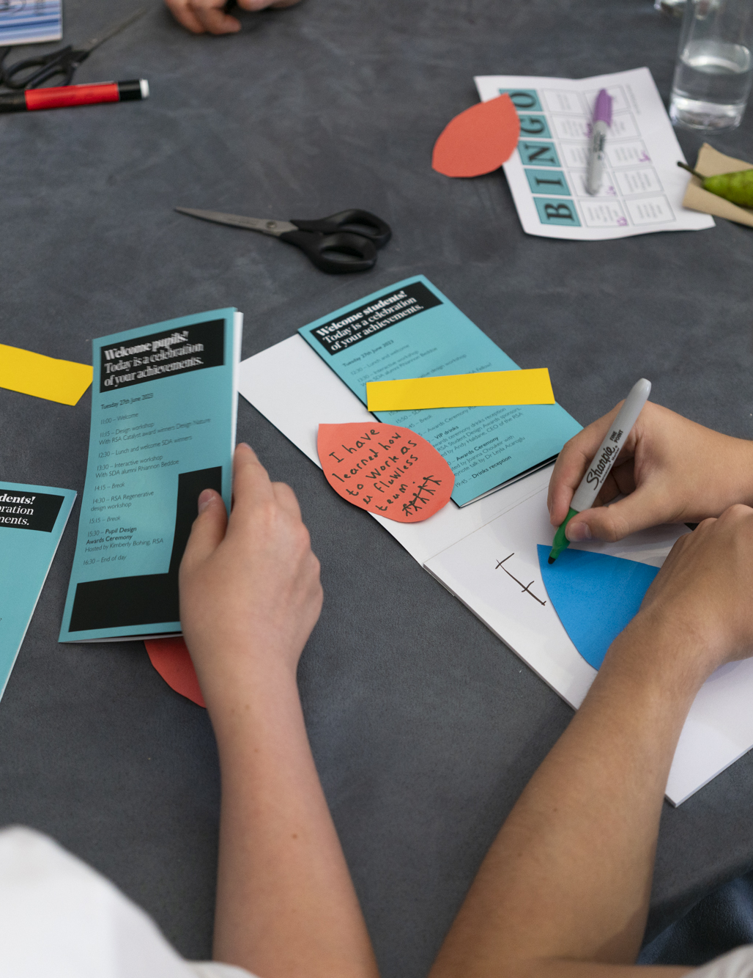
Agenda for today’s session
Agenda for today’s session
Introduction
Laying foundations, starting point & next steps
Mapping your impact
Creating & testing your prototype
Next steps
Assessing growth
Q&A
Notes:
You'll leave today's session with various resources, activities, and reflective prompts designed to guide you in making, testing, and sharing your ideas.

Slide 3
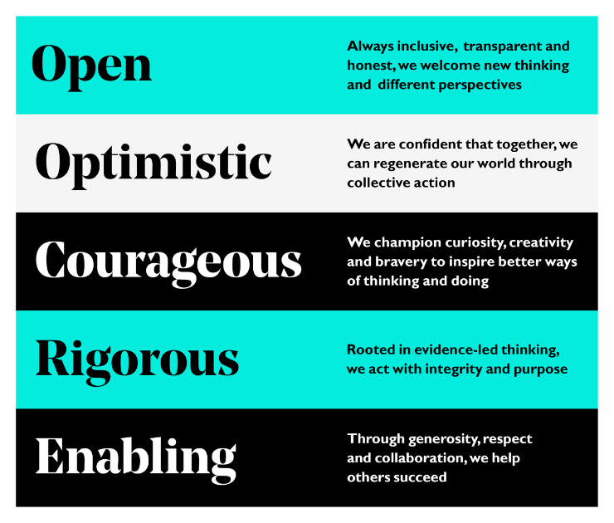
Terms of engagement
Agenda for today’s session
Notes:
Here are the terms of engagement that define this space.
The RSA values underpin how we engage with one another in our workshops. In the spirit of openness, courage and enabling others, we ask that you fully participate in this workshop today.
We request that you turn your cameras on, ensure that your name is visible, and engage with others.
To change your name in a Zoom meeting, click "Participants," hover over your name, click the ellipsis (three dots), select "Rename," enter your desired name, and click "Change"
We invite everyone to accept these by raising their hand visibly.
Answers to operational questions will be in briefing pack. We’ll do our best to answer any other questions in the chat.

Slide 4
RSA Spark
RSA Spark marks the beginning of a new chapter built on the foundations of 100 years of the Student Design Awards for greater impact.
We welcome students aged 18+ from across the globe to grow and apply their agency, skills and creativity to real-world briefs that do more good for people, places and the planet.
We partner with purpose-led organisations to co-create briefs that make a difference and to connect them with students with the brightest ideas and greatest potential.

Slide 5
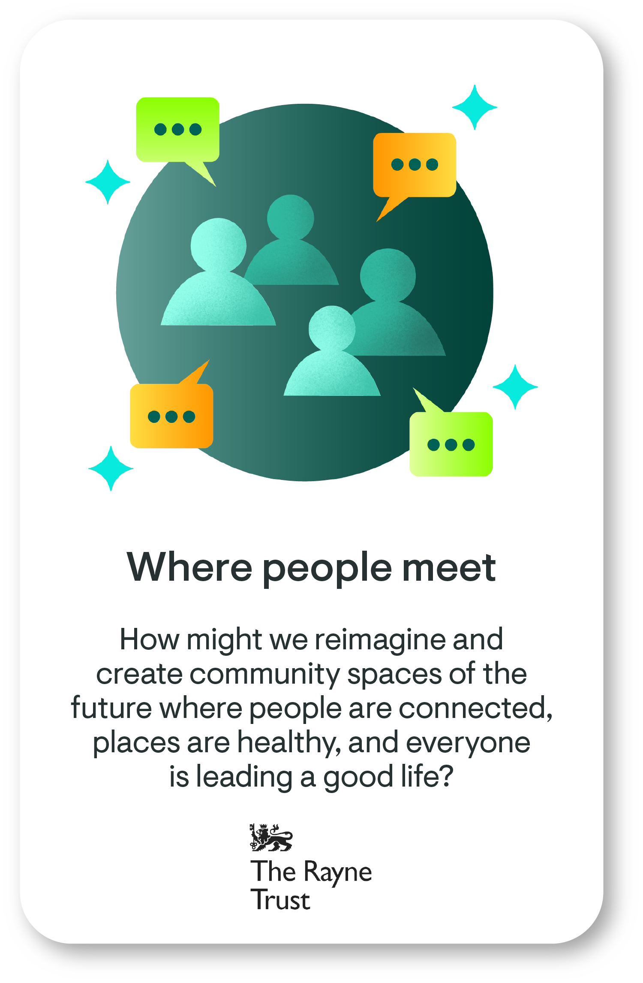
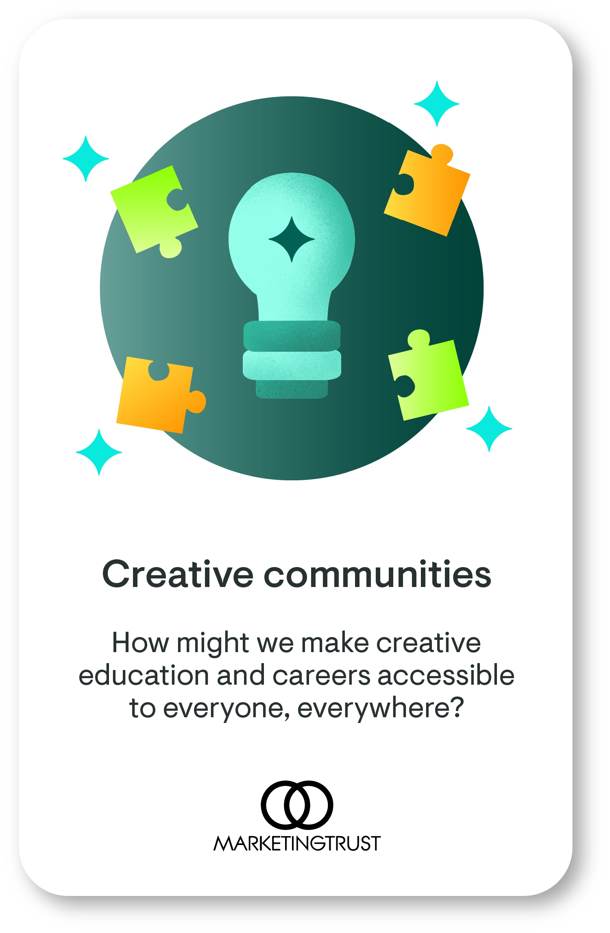
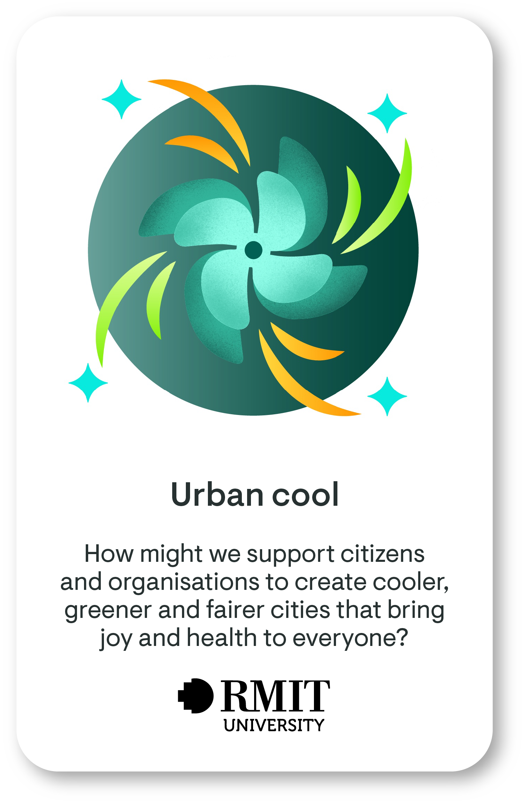
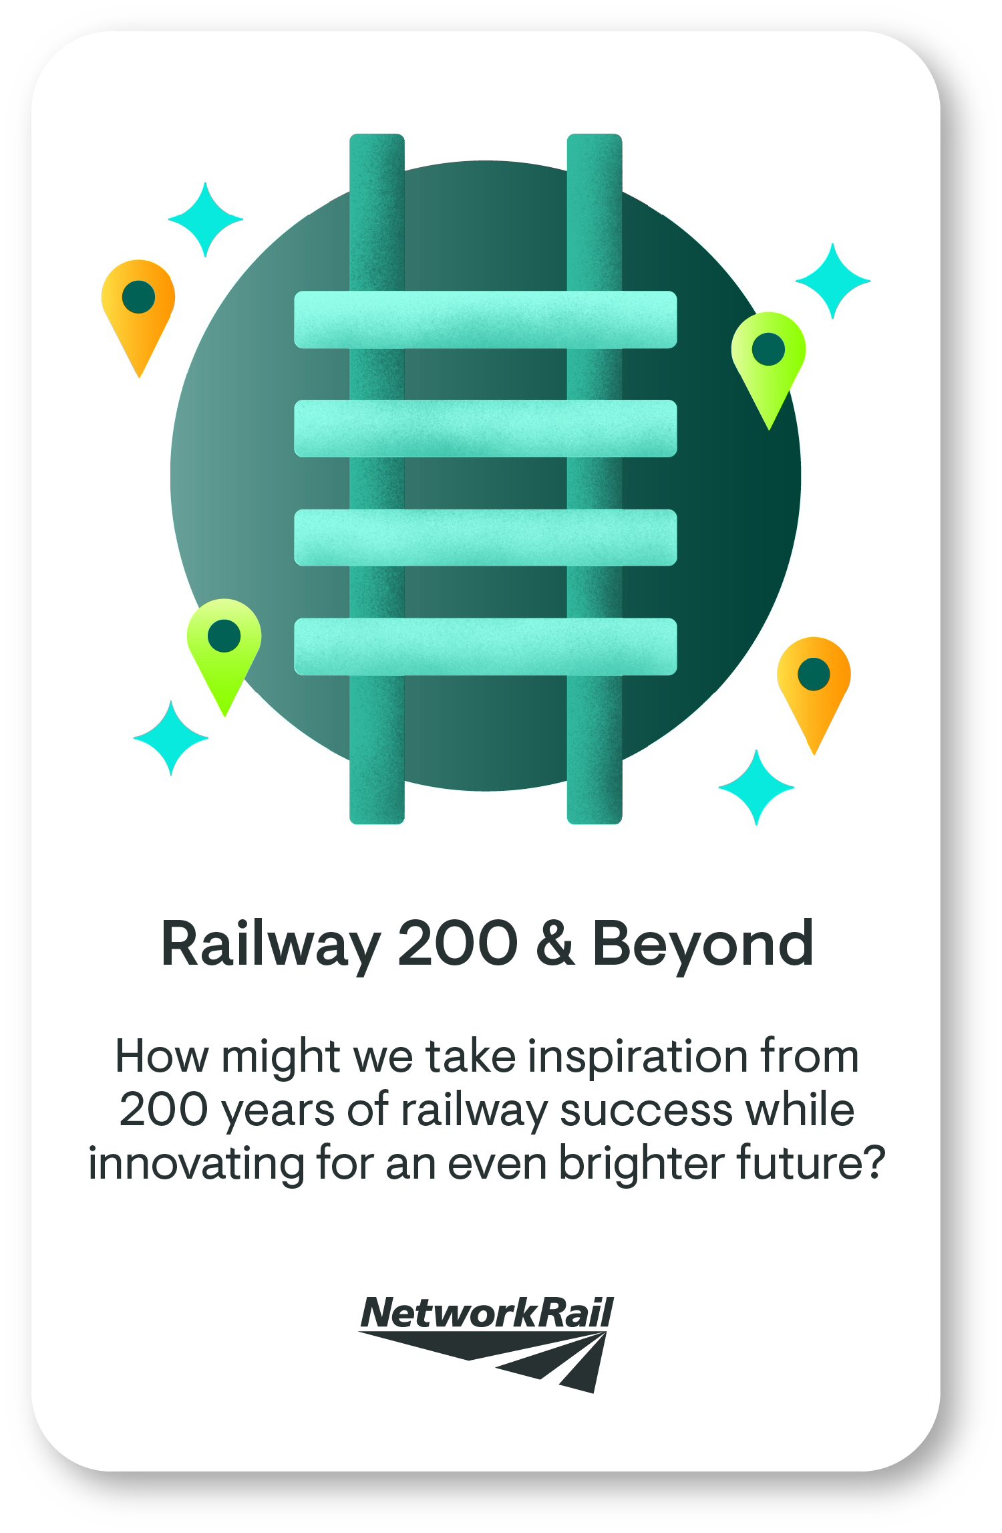
What real-world briefs can students respond to?
Notes:
This year, Spark has four real-world briefs that do more good for people, places and the planet. We partner with purpose-led organisations to co-create briefs that make a difference and to connect them with students with the brightest ideas and greatest potential. By this stage, you should have selected a brief, identified important human and non-human stakeholders affected by the brief and considered their perspectives, and selected a point of possibility that aligns to your brief.
In the past, top quality entries have successfully shown how the brief, point of possibility and idea aligns to what you or your team care about and the needs of your stakeholders. The first, second and third workshops provided you with support on how to do that.
This workshop looks at how you test and adapt your ideas to feedback so you’re ready to submit a refined and developed idea to RSA Spark for further feedback and support. Sharing your idea means it will be seen by inspiring industry partners who want to find solutions to their mission, and our global community of learners and entrepreneurs who can offer you support and feedback to make your idea even better.
For this workshop, we ask that you work on your chosen brief. If you haven’t had a chance to choose a brief, or be assigned one yet by your educator, we recommend watching workshop 1 on playback, selecting a brief, and then listening to the rest of the workshop series and doing all the activities as you go to develop your ideas.
.

Slide 6
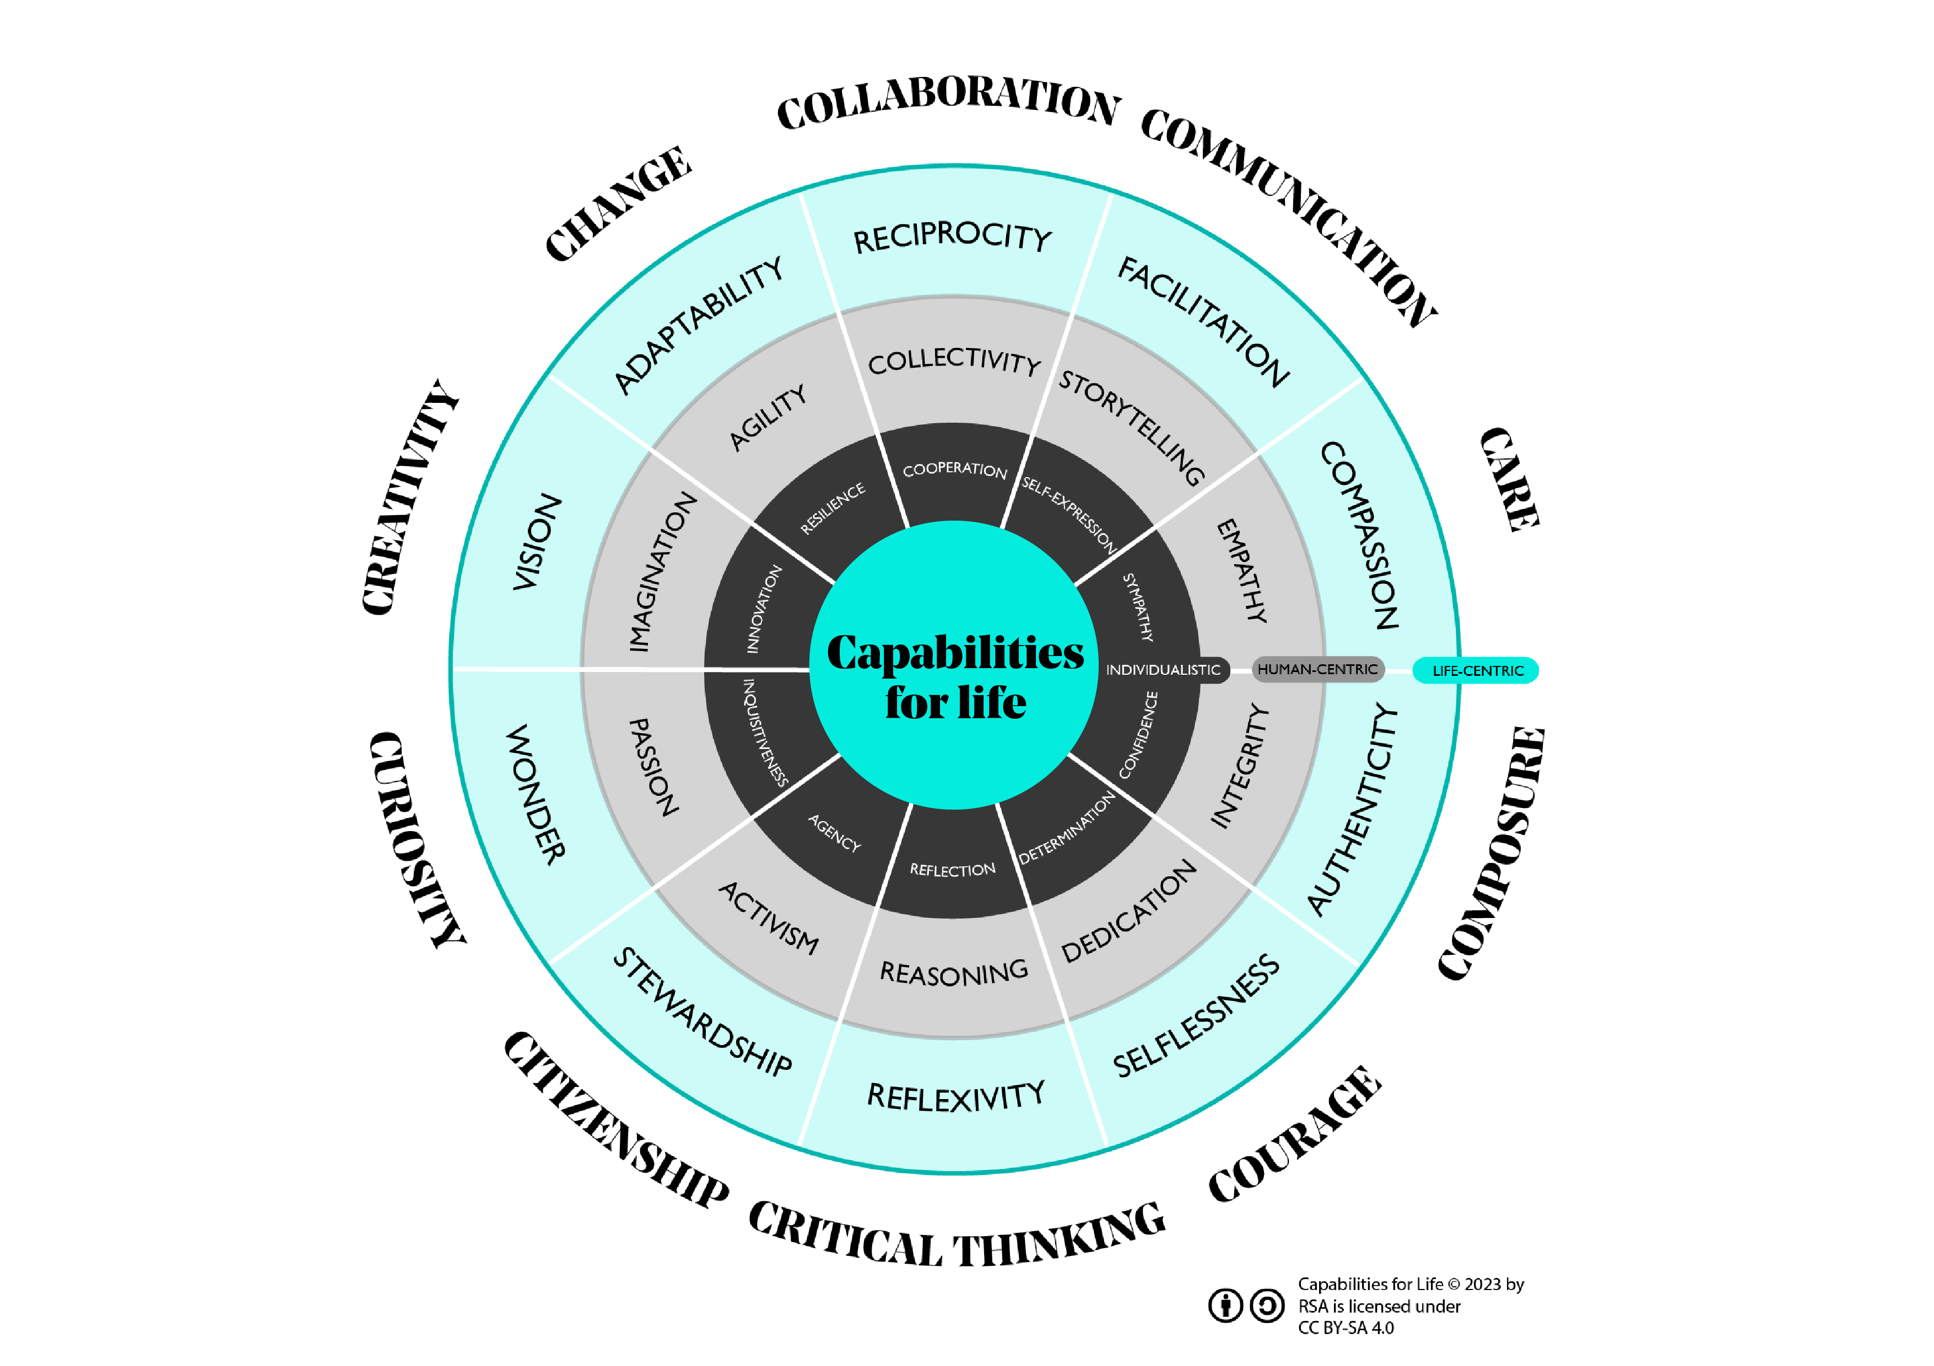
Notes:
In responding to an RSA Spark Brief, you have an opportunity to grow Capabilities for Life, 10 future-proof skills that are important when innovating in ways that positively impact people, places and planet. These capabilities were identified following extensive market review and speaking with over 50 industry experts, educators and regenerative practitioners as the core future-proof capabilities needed to do more good for people, places and planet.

Slide 7
What are the learning workshops on offer?
Discover your purpose
March 2025
Explore diverse perspectives
March 2025
Envision futures
April 2025
Test your impact
May 2025
Explore enterprise
May 2025
Connect with your strengths and with your energy for change as you reflect on the world as it is, the world as it needs to be, and the brief that you care most about.
Capabilities:​ Care, Citizenship, Composure
Shape your vision for change and a diversity of ideas that respond to your chosen brief, while carefully considering which ones are the most opportunistic.
Capabilities:​​ Creativity, Courage, Collaboration
Consider what and how you might test your most promising ideas and how they can have the greatest impact.
Capabilities:​​ Creativity, Change, Communication
Explore the business and economic viability of your idea while delivering positive social and environmental impact.
Capabilities:​​ Courage, Change, Composure
Explore with different points of possibility, thinking about who you should work with and what you can do to better understand the context of your chosen brief.
Capabilities:​​ Care, Curiosity, Critical Thinking
Notes:
RSA Spark proposes a five-stage creative process to guide you through responding to your chosen brief and focus on these capabilities. To support you, we’ve provided a series of online learning workshops that correspond with these stages. You are invited to join the workshop to strengthen your skills and your idea submission. The workshops will also be available for playback.
These workshops take you through the process of exploring the brief to the viability of an actual project – you can dip in as you need/based on your interest.
In the first workshop, Discover Your Purpose, we looked at how you can grow your capabilities in care, citizenship and composure, using activities to help you understand what you care about and connect (or support your student to connect) that to a chosen RSA Spark brief.
In the second workshop, Explore Diverse Perspectives, we looked at how you can grow your capabilities in care, curiosity and critical thinking, using activities that encourage you to explore your chosen brief and craft different points of possibility, thinking think about who you should work with and what you can do to better understand your local context and the brief.
In the third workshop, Envision Futures, we looked at how you can grow your capabilities in creativity, collaboration and courage as you imagine a better tomorrow for you and your community. You drew on your values and motivations (explored in workshop one) and the context of your community (explored in workshop two), to create ideas and prioritised them based on certain criteria.
In this workshop, Test Your Impact, you’ll grow your capabilities in creativity, change and communication, as you consider what and how you might test your most promising ideas and how to make sure they can have the greatest impact.

Slide 8
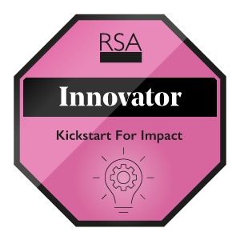
What are the digital badges on offer?
One or more workshops
(live attendance or watch back)
Submitting an idea
Submitting an idea as a team
Completing the entrepreneur's journey
Notes:
By participating in RSA Spark, you'll be celebrated with a digital badge which showcases your growing capabilities and innovation skills. igital badges are awarded to everyone who joins a learning workshop (Explorer Badge) and submits their idea (Practitioner and Collaborator Badges). A handful of learners will be selected for an entrepreneurship learning journey later in the year to further develop their ideas and these participants can earn an additional Innovator badge.
Digital badges enable you to demonstrate interest in a subject and commitment to your learning, and are used to support CVs and ePortfolios. You can show your digital badges to others by sharing them on social media or in your CV should you wish to make them public.

Slide 9
Explorer badges for each workshop
Workshop 1
Workshop 2
Workshop 3
Workshop 4
Workshop 5
Claim your badge!
Claim your badge!
Claim your badge!
Claim your badge!
Claim your badge!
From 26 May
Notes:
Students can get an Explorer digital badge for participating in any of the workshops. This can be through live participation (as you are doing now), or by watching the workshop on playback via Vimeo. To earn a badge, you need to complete both the pre and post workshop surveys, regardless of whether you participate in a live workshop or watch one online. Each workshop has a badge you can earn that recognises the capabilities you’ve developed.
The badges are intended for learners, but we ask all workshop attendees to submit the surveys as they provide important information for the Spark team – so we can learn how to make these resources as useful as possible for educators and students!

Slide 10
What are the learning outcomes?
Capability | Learning outcome
Care | Say why I care about myself, other people and the living world. Understand other people think and feel differently to me and still connect with them.
Citizenship | Say how I can make a difference in my life and the world around me.
Composure | Feel confident in what I am good at and what I can do.
Curiousity | Know where to look for answers and see people, animals and even plants as teachers.
Critical thinking | Look at lots of different information and ideas before deciding what to think or do.
Creativity | Dream big about what is possible. Turn ideas into actions that make things better.
Courage | Try new things, even when it's hard.
Collaboration | Work with others, to make things better.
Change | Deal with things that are unknown or lots of new things happening quickly.
Communication | Speak in a way that makes others listen, understand and act.
Notes:
The learning outcomes from participating in RSA Spark revolve around the 10 Capabilities for Life that was mentioned earlier. The workshops touch on all 10 of these capabilities.

Slide 11
Test Your Impact
Learning Workshop 4
Notes:
This is the fourth in RSA Spark’s series of five free interactive online learning workshops for higher education students and educators. These workshops aim to help you build future-proof skills to make things better for people, places and planet and to strengthen your idea submission for RSA Spark.
In this workshop, you’ll consider how you can bring your ideas to life and start testing them in the real world. You’ll also learn:
How you can adapt and change your idea based on the feedback you receive. This process (called iteration) helps you make your ideas stronger and more effective in the real world.
The potential impact of your ideas on people, places, and the planet. Assessing impact helps you understand the real-world effects of your prototypes and how they contribute to positive change.
Share/remind what students should be working towards at this stage of the design process.
testing their most promising idea (based on feedback from their audience and stakeholders), and
considering its impact and how the positive impacts can be maximised to have the most benefit for people, place and planet.

Slide 12
Laying foundations (survey 1)
To chart a course forward, you must first know where you stand
Capability | Statement
Creativity | Turn ideas into actions that make things better.
Change | Deal with things that are unknown or lots of new things happening quickly.
Communication | Speak in a way that makes others listen, understand and act.
Participants who attend the workshop and complete the workshop surveys will obtain an ‘Explorer’ digital badge
Notes:
While completing the survey, we also encourage you to capture your responses for your own learning and development, so you can identify what you want to grow and how this changes over the next few months.
You can record your responses by taking a photo or screenshot of the completed survey or capturing your responses in a document.
The workshop will grow participant’s capabilities in creativity, change and communication. At the end of the event, participants should be better able to:
Turn ideas into actions that make things better.
Deal with things that are unknown or lots of new things happening quickly.
Speak in a way that makes others listen, understand and act.

Slide 13
Starting point
At this stage, you have:
conducted some research on your brief
considered different human and non-human perspectives
created ‘points of possibility’ (PoP) questions
narrowed your focus to one PoP
generated ideas in line with your brief
prioritised ideas based on their feasibility, viability and desirability, working with your audience and stakeholders
…what next?
Notes:
As you continue on your journey, it's important to reflect on what you've learned so far, and to explore how this connects to your chosen mission brief:
In Workshop 1, you reflected on your personal values and skills and discovered your purpose - your North Star. You may have also crafted a public narrative (a story of me, we and now) to highlight what matters most to you (or your team), and your community.
Ιn Workshop 2, you learned to think positively, learn from multiple perspectives, and identify points of possibility (PoP) that can address your selected mission brief.
In Workshop 3, you dreamed about tomorrow and generated ideas for a better future.
Now, in Workshop 4, you (or your team) will take those dreams and turn them into real, actionable ideas.
In terms of the work you’ve done on your Spark brief: at this stage you should have:
conducted some research on your brief
considered different human and non-human perspectives
created ‘points of possibility’ (PoP) questions
narrowed your focus to one PoP
generated ideas in line with your brief and prioritised them based on their feasibility, viability and desirability, working with your audience and stakeholders

Slide 14
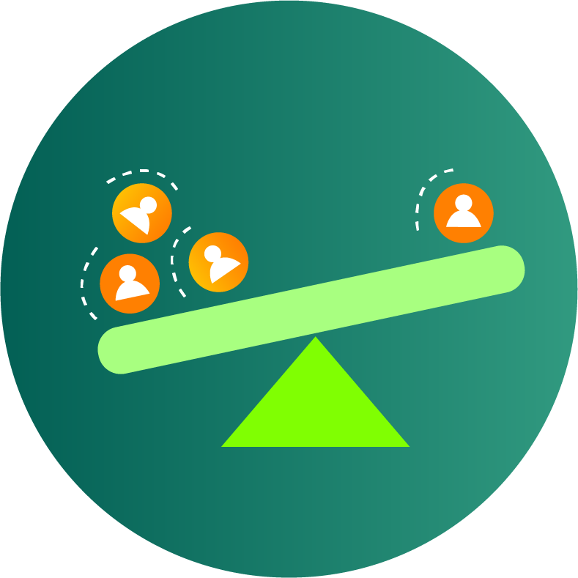
As a reminder…
Points of possibility (PoP) questions describe strategic points in your system where a small change can lead to significant impacts. These are not solutions, but opportunities where your efforts could have meaningful impact.
These PoP questions should reflect ways to address the opportunities or challenges you identified. They can start with “How might we…?” or “What if…?”.
Remember to keep this PoP question specific and realistic for your local community or the place you can have a direct impact on.
Notes:
Points of possibility (or leverage points in a system) are opportunities or small actions that can create a ripple effect, benefiting you, your community, the environment and beyond.
They could involve influencing a specific person or organisation, addressing a particular aspect of your mission in your local area, or changing people's habits or mindsets related to your mission theme. Remember, points of possibility are not solutions themselves. They are like bright spots within your system where your efforts can have the most meaningful impact.
These PoP questions should reflect ways to address the opportunities or challenges you identified. They can start with “How might we…?” or “What if…?”.
Remember to keep this PoP question specific and realistic for your local community or the place you can have a direct impact on.

Slide 15
Next steps
Mapping your best ideas in terms of its regenerative impact
Understand what prototyping is and why its useful
Planning a planet-centric prototype to test your idea
Notes:
First you will map your ideas, then create a learning plan, then prototype and test your idea, and finally turn your idea into action.

Slide 16
Mapping your impact
Activity 1 (15 min)

Slide 17
Identifying potential for regenerative impact
RSA Spark encourages you to create regenerative ideas – ideas that do more good for people, places and planet.
Now that you’ve shortlisted ideas that are feasible, viable and desirable, it’s time to consider their potential net impact; in other words, consider the interconnected systems and their relationships.
Notes:
Regenerative impact is one that actively restores and renews ecosystems and communities, going beyond simply minimizing harm to create a net positive effect on the environment, society, and the economy. It involves shifting from an extractive approach to one that fosters thriving, resilient systems.

Slide 18
Nested system framework
Environment
Environmental impact includes how your idea impacts air quality, water quality, waste, energy, biodiversity, land and physical assets, etc.
Societal impact includes impact on people health and wellbeing, their social connections, their sense of safety, housing, education, etc.
Economic impact includes impact on people's wages and living expenses, on the availability of jobs, which industries grow etc.
Society
Economy
Notes:
To support you in thinking about these things, its useful to look at a simple nested systems framework showing considerations related to the environment. Society and economy.
What we mean by impact on the economy is the impact on people's wages and expenses, on jobs, etc.
What we mean by impact on society is the impact on people health and wellbeing, their social connections, their sense of safety, housing, education, etc.
What we mean by impact on the environment is air quality, water quality, waste, energy, biodiversity etc.
It’s useful to consider how your idea affects all of these ‘layers’, and for each layer, is you idea doing more harm, less harm, undoing harm, or doing more good? If it's not already doing more good, how might you evolve it to do more good?

Slide 19
Reflective prompts
What is the overall impact of your idea on each layer?
Doing more harm
Doing less harm
Undoing harm
Doing more good
Environment
+/-
++
Society
+
+/-
Economy
Notes:
Consider the second and third prompt questions - do these relationships or flows add or take from these layers? And what is the overall impact?
In other words, is the overall impact extractive, where it takes more than it adds? Or additive, where it provides more than it takes and supports regeneration? You’ll notice most ideas will have elements of both. The question we want to interrogate is how are we minimising h.rm and actively trying to restore and regenerate our systems?

Slide 20
Reflective prompts
How might you reimagine your idea to make sure the relationships and flows to do more good to the layers?
Environment
+++
+++
Society
+++
+++
Economy
Notes:
This brings us to the final question – how can you change your idea so it does more good for each layer?
For example, if your idea supports growing a particular industry, is it one that uses renewable or eco-friendly resources? And does it provide job opportunities to the local community with fair wages? And if it may result in increasing costs to locals, how could that be changed or avoided?
Keep reimagining and evolving your idea until you feel it supports regenerative impact!

Slide 21
Example

Slide 22
Notes:
Let’s revisit the example we discussed in the last few workshops.. Remember the example was a team looking at the urban cool brief and asking how might they support communities to create cooler, greener and fairer cities in response to climate change.
We createed a potential map showing how different elements of the brief could be interconnected and discussed how research could further develop their understanding of this system. We also discussed how insights from this research could be used to identify points of possibility, where a small change can lead to significant positive impacts.

Slide 23
How might we support communities to create cooler, greener and fairer cities in response to climate change?
Research found that students with access to green spaces reported a 30% lower incidence of mental health issues compared to those in areas without access to green spaces.
“We know that extreme heat lowers a child’s ability to learn. But our school can’t afford aircon.”
“My closest park is 30 minutes away and it isn’t safe for my son and his friends.”
Public health risks are exacerbated by climate change (e.g. obesity due to reduced physical activity)
The city is investing in expanding its cycle infrastructure from the city centre into growing suburbs
…
How might we ensure that every child in Bristol has access to safe, cool and green spaces that improve their mental well-being and social interaction?
How might we provide safe and green opportunities for commuting and physical recreational activities (like walking, jogging or cycling)?
…
Notes:
We showed some examples of the types of insights that could have been gathered showed how these could be written as PoP statements.
We then chose to focus on the PoP statement related to children’s access to safe, cool and green spaces that improve their mental well-being and social interaction.

Slide 24
Viability
Make access to nature a human right
Access to safe, cool and green spaces part of school assessment criteria
Alternative outdoor venues for school activities (e.g. classrooms, theatre productions)
Biodiversity corridors as school pedestrian routes
Increase access to nature-based extracurricular activities
Desirability
Feasibility
Notes:
In the last workshop we spoke about how we could generate ideas and prioritise them with our stakeholders based on viability, desirability and feasibility.

Slide 25
Viability
Biodiversity corridors as school pedestrian routes
Desirability
Feasibility
Notes:
Let’s say we decide that biodiversity corridors as school pedestrian routes is a strong idea based on viability, feasibility and desirability. Let’s interrogate this idea using the simple system framework.

Slide 26
What is the overall impact of your idea on that layer?
 | Doing more harm | Doing less harm | Undoing harm | Doing more good
Environment | Increased foot traffic through previously sheltered habitats Potential increase in e.g. pollution from litter | Development and maintenance more environmentally friendly | Biodiversity gains Soil quality and water retention improvements | Increased human-nature interactions Decreased GHG emissions than alternative forms of commuting (car/bus) Decreased flooding risks
Society | Not necessarily safer than alternative commuting routes (potential isolation) May increase commute times, with knock on implications for working parents and school operations | Greener and cooler commute than current alternative for pedestrians (walking along concrete-based routes) | Improving access to green space for all children | Increased human-nature interactions Improved health and learning outcomes Potentially safer than alternative commuting routes (decreased proximity to traffic)
Economy | Investment costs (for EIA, community engagement, etc) Diverts potential customers away from businesses (e.g. corner shops) | Cheaper maintenance costs |  | Recognises the long-term economic benefits of improved health and learning outcomes (e.g. improved social mobility)
Notes:
This allows us to know think through the overall impact and how we can improve the idea. For example, let’s look at the impacts on society. The idea may do much good in terms of increased human-nature interactions, improved health and learning outcomes and providing a potentially safer alternative commuting routes (due to decreased proximity to traffic). And it could undo the harm where the design and evolution of urban environments has reduced access to nature for many children, particularly in areas of multiple deprivation, and do less harm by providing a greener and cooler commute than what is currently offered. However, there are a few instances where the idea can create more harm to society and economy… for example, it may not necessarily be safer so the safety element will need to be carefully considered. It may also take longer to commute to school. This may be a worthwhile trade off if the journey is pleasant enough (which needs to be tested), but may have implications in terms of learners being late for school or parents being late for work.
From this analysis, we can see that considering the safety and commute time is an important consideration to make sure the idea doesn’t do more harm, and that focusing on supporting human-nature interconnections and health and learning outcomes is the way this idea could support regeneration.

Slide 27
Improve and select your idea for prototyping
The nested systems framework can help identify assumptions and gaps in your knowledge (e.g. ecological impacts of foot traffic) and can help you reimagine your idea to make sure the relationships and flows to do more good for people, place and planet.
For example, you can use the framework to improve your idea so that it mitigates or reduces the impact of something that does harm, and increases the impact of things that undo harm or do more good.
Once you’ve considered ways to improve the impact of your prioritized ideas, select the idea that has the most potential to have a positive regenerative impact.
Notes:
Ultimately, as the example shows, the systems framework can help identify assumptions and gaps in your knowledge (e.g. ecological impacts of foot traffic) and can help you reimagine your idea to make sure the relationships and flows to do more good for people, place and planet.
For example, you can use the framework to improve your idea so that it mitigates or reduces the impact of something that does harm, and increases the impact of things that undo harm or do more good..
How might we:
Increase human-nature interactions in a way that:
Provides safe experiences for children
Reduces the impact of foot traffic through previously sheltered habitats
Prevents pollution from e.g. litter
Ensure that the commuting time is comparable to current averages
Make the design, development and maintenance as environmentally friendly as possible
Create jobs or opportunities for businesses who may be impacted by lower throughfare
Measure impact (to check we’re not causing harm and undoing harm and/or doing more good)

Slide 28
Repeat with other high-potential ideas…
Viability
Alternative outdoor venues for school activities (e.g. classrooms, theatre productions)
Biodiversity corridors as school pedestrian routes
Increase access to nature-based extracurricular activities
Desirability
Feasibility
Notes:
You could do this with a few more ideas that you think are strong.
Once you’ve considered ways to improve the impact of your prioritized ideas, select the idea that has the most potential to have a positive regenerative impact.

Slide 29
Me, We, World prompts (optional)
If you need further support in selecting an idea to prototype, consider the following:
Me (self/team) | I have the resources (e.g. time, money, capabilities, partnerships, technology and confidence) to bring this idea to life. I am confident this idea will play a part in bringing our dream for a positive future to life.
We (the community) | I have evidence that this idea comes from what people need and what is already happening around us. I know this idea’s message and positive impact can spread beyond my immediate environment and target audience.
World | I know this idea can continue growing and supporting life, even beyond my lifetime, e.g. it can be reused and adapted based on varied contexts and changing times. I know this idea will promote the happiness and health of all life (humans and non-humans).
Notes:
Me (self)
I have the resources (e.g. time, money, capabilities, partnerships, technology and confidence) to bring this idea to life.
I am confident this idea will play a part in bringing our dream for a positive future to life.
We (others)
I have evidence that this idea comes from what people need and what is already happening around us.
I know this idea’s message and positive impact can spread beyond my immediate environment and target audience.
World (planet)
I know this idea can continue growing and supporting life, even beyond my lifetime, e.g. it can be reused and adapted based on varied contexts and changing times.
I know this idea will promote the happiness and health of all life (humans and non-humans).

Slide 30
Activity 1: Mapping your impact (15 min)
In this activity, you are encouraged to use the system framework to map the potential impact of your best ideas (no more than 3).
This is just to help you start mapping – you can return to complete the map after the workshop!

Slide 31
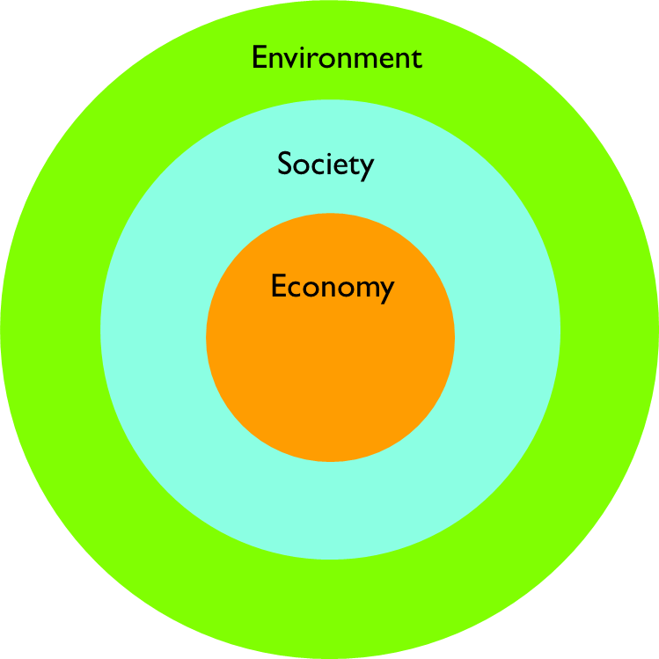
Reflective prompts
What is the overall impact of your idea on that layer?
Doing more harm
Doing less harm
Undoing harm
Doing more good
How might you reimagine your idea to make sure the relationships and flows to do more good to the layers?
Environmental impact includes how your idea impacts air quality, water quality, waste, energy, biodiversity etc.
Societal impact includes impact on people health and wellbeing, their social connections, their sense of safety, housing, education, etc.
Economic impact includes impact on people's wages and living expenses, on the availability of jobs, which industries grow etc.

Slide 32
Reflect and share
Notes:
Comment on the aggregated responses.

Slide 33
Introduction to prototyping

Slide 34
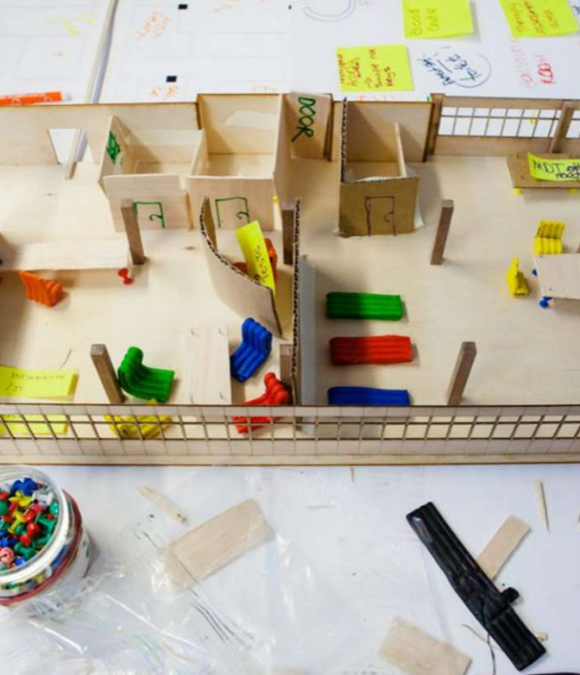
Prototyping
A prototype is a preliminary version of an idea or product. It helps inventors and designers bring ideas to life and is used to test and refine concepts before creating a final version.
Importantly, prototyping allows you to:
explore your ideas beyond abstract concepts,
test your ideas quickly and with limited resources,
learn from real-world feedback, and
make improvements.
Notes:
Even though you have been in conversation with the people most affected by brief throughout the process, a prototype gives you the opportunity to test your idea under real-world conditions.
A prototype is a preliminary version of an idea or product. It helps inventors and designers bring ideas to life and is used to test and refine concepts before creating a final version. Importantly, prototyping allows you to test your ideas quickly and with limited resources, learn from real-world feedback, and make improvements.
It is:
… a HYPOTHESIS that you need to test; a way to do applied research and ask questions
… a low cost & quick way to learn more about your idea
… something concrete to share with possible users to welcome them into the creative process
… NEITHER a pilot of the ultimate solution NOR a questionnaire or survey
Don’t just talk about your ideas – make them tangible & something others can interact with
Assess:
Feasibility – can it be done?
Desirability – is it wanted?
Value – what impact does it have?
If a version of your prototype doesn’t work or receives critical feedback, it’s a great opportunity to tweak your design and ensure it is eventually a version of itself that will have the most positive impact on those you are innovating with and for.

Slide 35
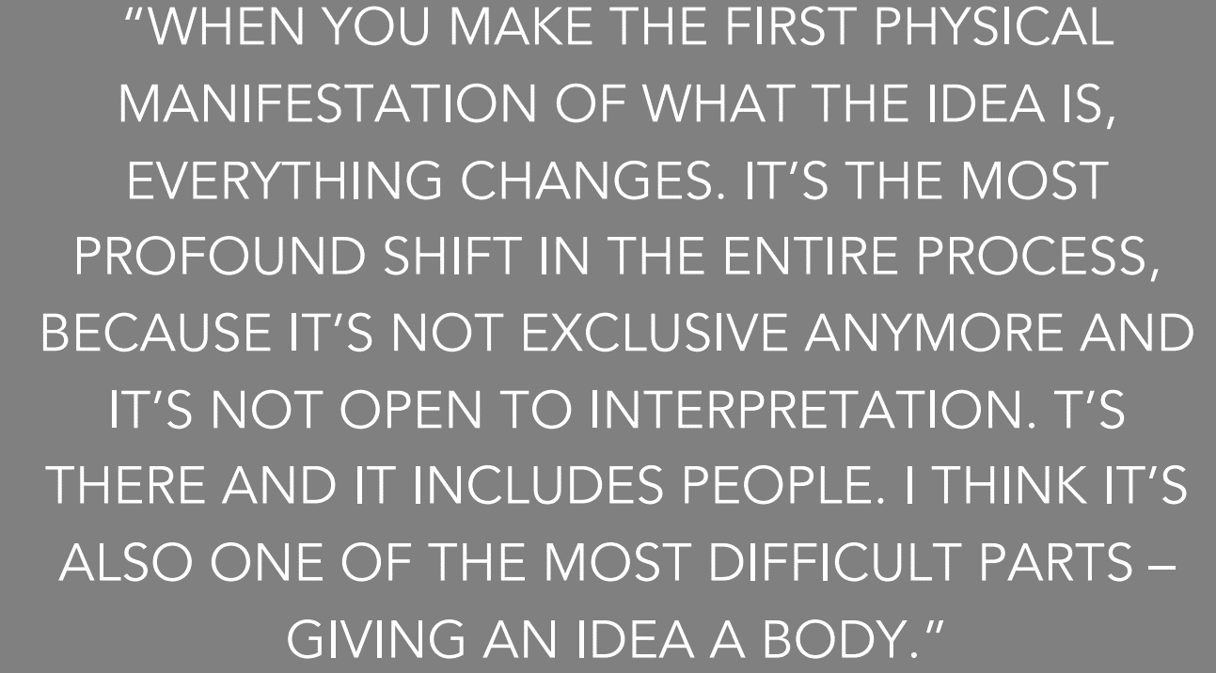
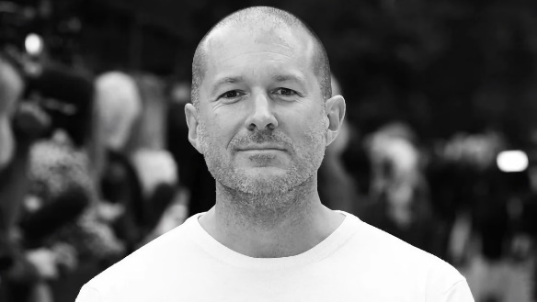
Jony Ive, two time RSA Student Design Award winner and Chief Design Officer at Apple

Slide 36
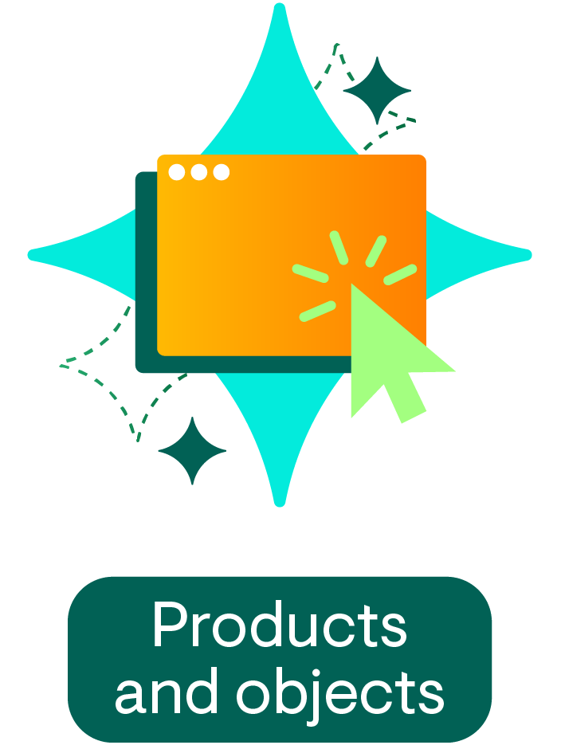
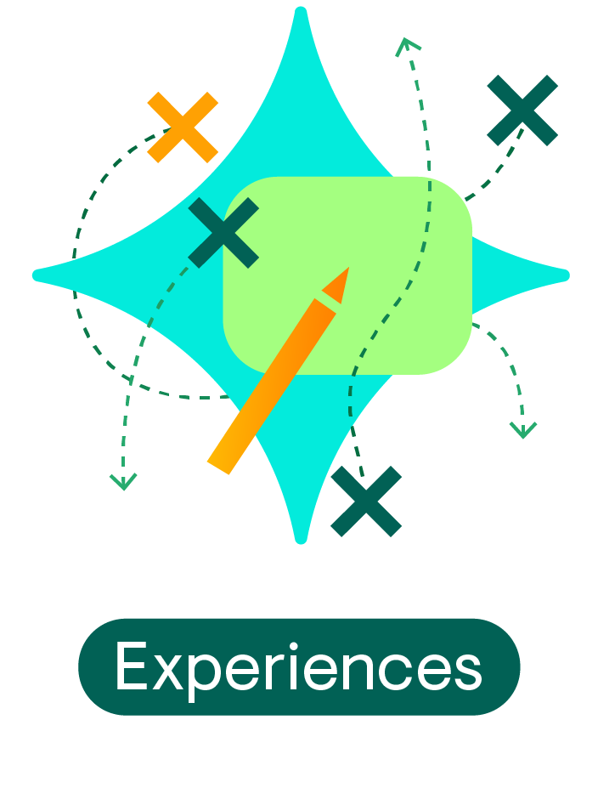
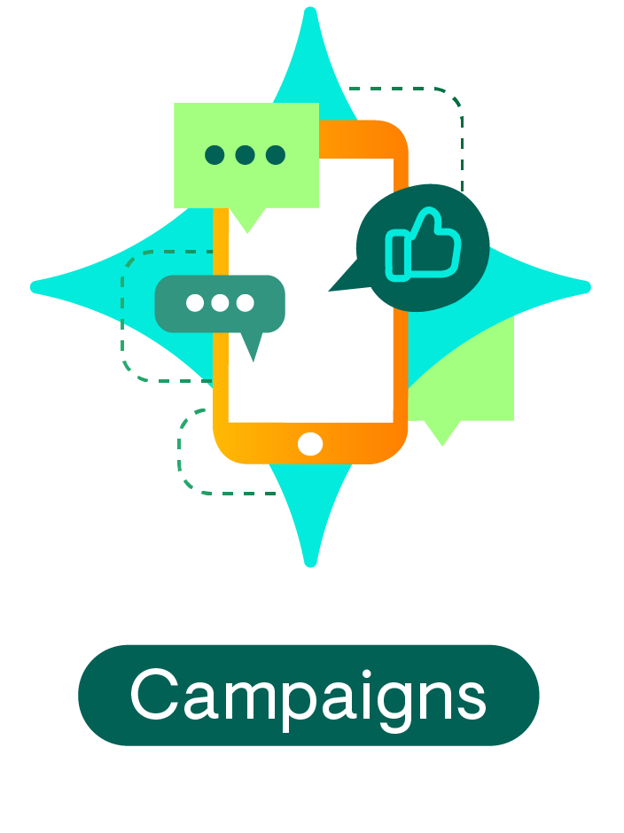
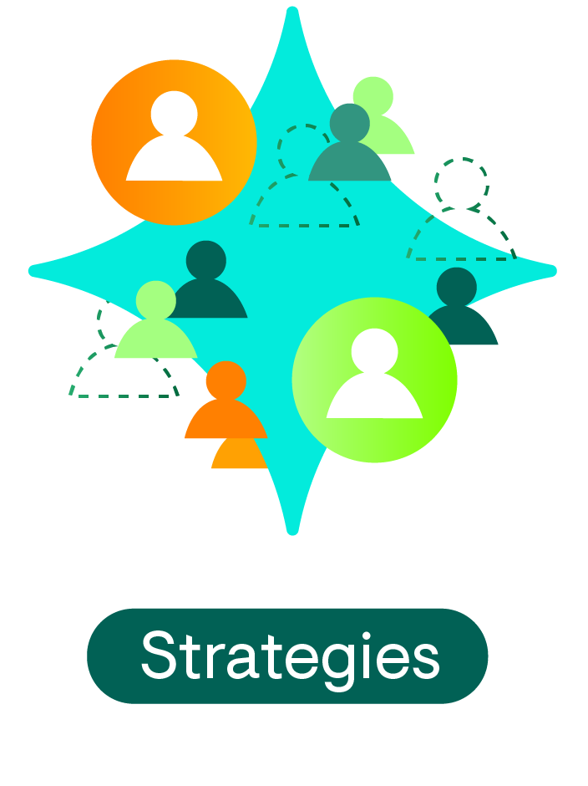
Examples of prototypes
Notes:
Examples:
Products and objects (specifically physical and digital models)
Events and experiences (storyboards, mapping and role play)
Campaigns (poster boards and flyers, mock ups of social media posts, etc)
Strategies (creating and testing scenarios using e.g. role play)
Products and objects
Physical models: Use sustainable, everyday materials to create simple models of your products. Consider materials that have minimal environmental impact and are easy to recycle or biodegrade. For example, using cardboard model of a new space or building, or shaping objects using natural clay.
Digital mock ups: If creating an app or website, use easy to use prototyping and wireframing websites like Figma, Sketch, or Canva to create samples of what these could look like. If you want to learn more about wireframes, we encourage you to read this overview by the Interaction Design Foundation. Don’t worry about how the wireframe looks at this point. This is just used to test the purpose, functionality, and ease of use.
Experiences
Storyboard and mapping: Draw a series of sketches to plan out an experience. This can be the use of a product or service, or an event. For instance, sketching different sections of a multicultural fair in your local park, or how a local mentorship experience would work, or creating a series of different frames for an app or website (building a wireframe).
Role play: Act out the experience with peers or users of your innovation to identify potential issues and improvements. For example, practicing how people will use or walk around a new public garden, playground, app or website.
Campaigns
Poster boards and flyers: Create hand-drawn or printed posters and flyers to test the look and message of a campaign. Display them in different places to get feedback from peers and your target audience.
Social media mock posts: Draft social media posts on paper, or use free online tools templates (like Canva) to visualise how a campaign might look online. Share with a small group for feedback.
Strategies
Creating and testing scenarios: Break down large ideas into parts and test how the different parts can work and interlink. For example, a recycling strategy for your neighbourhood could include different ideas like a door-to-door or digital education campaign, neighbourhood recycling competitions, or influencing your local government to improve access to recycling tools and information. You can prototype these ideas and their combinations using the ideas above.
Scenario role play: Form small groups to role-play different parts of your strategy. For example, if planning a new public garden, you can create different roles like garden designer, children who will play here, adults who will use this garden, gardeners and nature experts and more, and role-play how this garden will impact each person in this idea. Or if you’re building an app, it can include different users.

Slide 37
Which are prototypes?
A cardboard model
An idea without execution
A finished product
Only written plans
A role-playing game with different scenarios
A mock-up of a poster or social media post
A simple drawing
A sequence of sketches, e.g. different frames of an app or website (also known as a wireframe)
A garden map showing where the new tree can be planted

Slide 38
Which are prototypes?
A cardboard model
An idea without execution
A finished product
Only written plans
A role-playing game with different scenarios
A mock-up of a poster or social media post
A simple drawing
A sequence of sketches, e.g. different frames of an app or website (also known as a wireframe)
A garden map showing where the new tree can be planted
Notes:
Correct answers:
The following are examples of prototypes, as they represent a draft version of an idea, expressed in a physical way that allows a person to test it.
A cardboard model
A sequence of sketches, e.g. different frames of an app or website (also known as a wireframe)
A garden map showing where the new tree can be planted
A role-playing game with different scenarios
A mockup of a poster or social media post
The following are not prototyped, as they are either unable to be tested in a meaningful way, or are the completed version of an idea.
A finished product: The final version of an idea that is ready to implement in community or use, is not a prototype. Prototypes are the first versions used for testing and improving ideas.
An idea without execution: Simply having an idea or concept in your mind is not a prototype. A prototype involves creating a tangible or digital model to test the idea.
A simple drawing: While drawings can visually represent your ideas, people are not always able to interact with them. Prototypes are usually interactive and test how the final product will actually be in the real world.
Only written plans: Detailed plans or written notes on their own are not prototypes. Prototypes involve some form of a tangible or usable model.

Slide 39
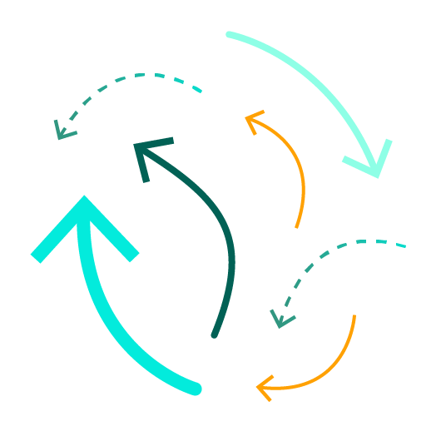
Tips
Keep it simple
Gather feedback
Make failure your friend
Iterate and improve
Be playful
Notes:
Keep it simple: Focus on your core idea. Use basic materials to represent the main features or concepts.
Be playful: Use your imagination and think outside the box. Think of unconventional uses of everyday items to build your prototypes.
Gather feedback: Present your prototypes to peers or your target audience to get feedback and suggestions.
Iterate and improve: Keep changing and improving your ideas based on feedback. Prototype as many times as you need.
Make failure your friend: Remember, failure and things not working are important to the prototyping process. Every idea you have is not going to work, and an idea that seems good on paper (and got good feedback from your target audience) may get some challenging feedback when your audience tests it as a prototype.

Slide 40
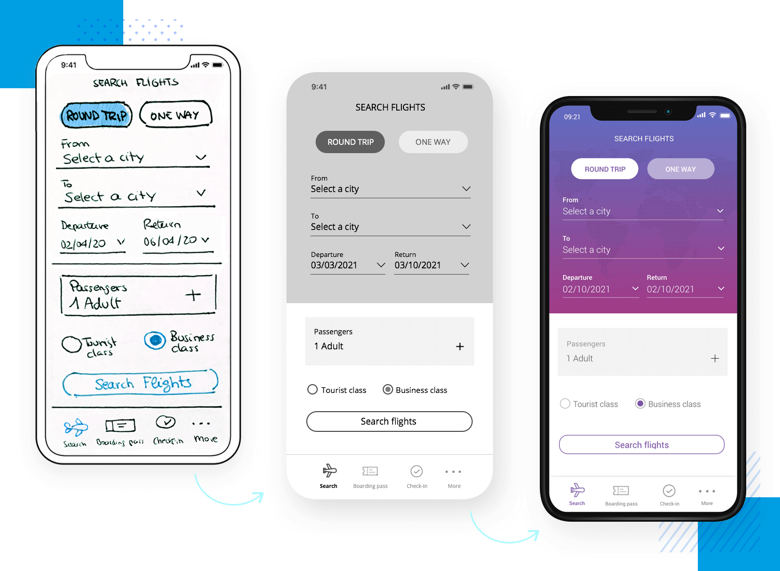
Different types of prototypes
Low fidelity – very far from the final idea, usually just testing one small aspect of the solution
High fidelity – quite true to the final idea, often bringing together multiple elements
Notes:
Keep it simple: Focus on your core idea. Use basic materials to represent the main features or concepts.
Be playful: Use your imagination and think outside the box. Think of unconventional uses of everyday items to build your prototypes.
Gather feedback: Present your prototypes to peers or your target audience to get feedback and suggestions.
Iterate and improve: Keep changing and improving your ideas based on feedback. Prototype as many times as you need.
Make failure your friend: Remember, failure and things not working are important to the prototyping process. Every idea you have is not going to work, and an idea that seems good on paper (and got good feedback from your target audience) may get some challenging feedback when your audience tests it as a prototype.

Slide 41
Useful resources
Explore the Rapid Prototyping video (approx. 2.5 minutes) to learn more about the importance of prototyping.
Other inspirational resources:
IDEO Shopping Cart video (approx. 8 minutes)
Google Glass video (approx. 8 minutes)
Notes:
There are some wonderful resources to support you to develop planet-centric prototyping.

Slide 42
Planet-centric prototyping

Slide 43
Building a planet-centric prototype
Planet-centric prototyping involves creating and testing ideas that actively promote the health and wellbeing of all life on this planet, including all the people and biodiversity living on it.
It ensures that your innovations not only address immediate opportunities, but ensure a long-term growth towards the positive future you and your community envision.
Quite simply, this is an approach that considering the planet when prototyping.
Notes:
Given that we want to create a better place for people, places and planet, it’s important to consider the impact of your prototype and its testing.
Planet-centric prototyping involves creating and testing ideas that actively promote the health and wellbeing of all life on this planet, including all the people and biodiversity living on it. It ensures that your innovations not only address immediate opportunities, but ensure a long-term growth towards the positive future you and your community envision.
Quite simply, this is an approach that considering the planet when prototyping. In this workshop you’ll practice planet-centric prototyping.
On planet centric prototyping, there are a couple of useful resources that we can point to, again referenced in my session. One of these is the Life Cycle Design canvas, another is the Ethical Assessment (both in the Planet Centric Design Toolkit linked). There's also a great talk we can reference: https://ixda.org/video/prototyping-for-the-planet/. I think as this was the 'promise' for the session it's good to reference this.

Slide 44
Useful resources
We highly recommend watching the Prototyping for the Planet video (approx. 20 minutes) to learn more about planet-centric prototyping.
To support you in building planet-centric prototypes, download the Planet Centric Design Toolkit. This contains:
The Life Cycle Design Canvas
The Ethical Assessment
Notes:
There are some wonderful resources to support you to develop planet-centric prototyping.
The toolkit, and specifically the Life Cycle Design Canvas, supports you to answer these questions:
How will you consider the planet while prototyping?​
How might your prototype (and the solution you are working towards) be extractive or harm the social and ecological ecosystems it will live in? ​
What opportunities are there for your prototype to actively do good for the planet?

Slide 45
Creating and testing a prototype
Activity 2 (15 min)

Slide 46
Learning from feedback
Once you have determined which idea you want to prototype, it is essential to plan what you want to learn through this process, so that your prototyping and testing journey can be most effective.
Think of small, scrappy, and inexpensive ways of testing your idea. The aim is to get feedback from the people you’re designing for in a quick and rapid way, quickly move through a variety of iterations, and build on what you learn.
To get meaningful feedback, plan the information you want to test and collect before going out in the real-world to test your prototype.
Notes:
What is learning from feedback?
Learning from feedback means taking ideas and suggestions from others.
Doing this helps you to improve your ideas and solutions by learning from what others tell you.
It also helps you think critically about how your actions impact people and the health of our planet, including all the people and other living things.
What is iteration?
Iterating means making changes and improvements based on that feedback.
This is a continuous process of improving your ideas and prototypes to make sure they are effective and impactful.

Slide 47
Step 1: Craft your hypothesis
If your idea was successfully implemented in the real-world, what would be true?
Craft a clear, testable statement that predicts the result of your idea being implemented successfully. Use your research and point of possibility (PoP) from to craft this hypothesis.
For example:
“I/We believe that transforming school pedestrian routes into biodiversity corridors that connect and grow safe, cool and green spaces will help every child in Bristol to improve their mental well-being and social interaction.”
Notes:
Guidance
If you are working as a team, please create this plan together.
Step 1: Craft your hypothesis
If your idea was successfully implemented in the real-world, what would be true?
Craft a clear, testable statement that predicts the result of your idea being implemented successfully. Use your research and point of possibility (PoP) from to craft this hypothesis.
For example
“I/We believe that using AI to map existing intergenerational spaces in my community will help build better relationships.”
Step 2: Determine metrics of success
Define 3-4 data points that can help you measure if your hypothesis is true or now. Be as specific and time bound as possible.
For example
“80% of the spaces my software finds in the community are actually spaces my users want to visit and gather in.”
“Within 3-months of my testing and iteration, 90% users will find my software easy or very easy to use for themselves in my survey.”
In this step, remember to consider how long you can realistically run this testing period for. Your idea will always be adapting and changing, even after it is launched, so it is important for you to select an end point.
Step 3: Plan your prototype
What does your prototype look and feel like to test your hypothesis?
Given the example metrics of success in the previous point, the prototype will need to find the community spaces AND be something your everyday users can use on their own.
In this step determine the resources you would need and how reliable your data would be.
For instance, if your final idea will be used by an intergenerational community in a town in India, but you only test your prototype(s) with a few adults in the age group of 40-50 years, then your data will only be moderately reliable as you haven’t tested with young people and users of other ages.

Slide 48
Step 2: Determine metrics of success
Define 3-4 data points that can help you measure if your hypothesis is true or not.
Be as specific and time bound as possible.
Remember to consider how long you can realistically run this testing period for - your idea will always be adapting and changing, even after it is launched, so it is important for you to select an end point.
For example:
There are potential alternative and safe pedestrian routes through connected green spaces in over 70% of schools in areas of multiple deprivation.
The time taken to walk through the potential route is no more than 20% more than current routes.
Within 2 weeks of my testing and iteration, 90% of potential users will indicate an interest in trying the alternative route.
Notes:
Step 2: Determine metrics of success
Define 3-4 data points that can help you measure if your hypothesis is true or now. Be as specific and time bound as possible.
For example
“80% of the spaces my software finds in the community are actually spaces my users want to visit and gather in.”
“Within 3-months of my testing and iteration, 90% users will find my software easy or very easy to use for themselves in my survey.”
In this step, remember to consider how long you can realistically run this testing period for. Your idea will always be adapting and changing, even after it is launched, so it is important for you to select an end point.
Step 3: Plan your prototype
What does your prototype look and feel like to test your hypothesis?
Given the example metrics of success in the previous point, the prototype will need to find the community spaces AND be something your everyday users can use on their own.
In this step determine the resources you would need and how reliable your data would be.
For instance, if your final idea will be used by an intergenerational community in a town in India, but you only test your prototype(s) with a few adults in the age group of 40-50 years, then your data will only be moderately reliable as you haven’t tested with young people and users of other ages.

Slide 49
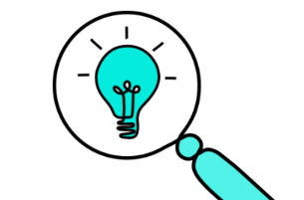
Step 3: Plan your prototype
What idea do you need to prototype?
What does the prototype need to look and feel like to test your hypothesis?
Your prototype doesn’t need to be in the same format as the final product, service, programme or policy
What does success from the prototyping look like? What do I need to learn? Which questions will this prototype answer? e.g. Do we need to test the whole experience or just an aspect that we are most interested in?
Who do you want to test this prototype with? How will we get feedback? How can we gather non-human perspectives?
What resources you would need?
How reliable is your data likely to be?
Notes:
Plan, considering the following questions:
What idea do you need to prototype?
What does the prototype need to look and feel like to test your hypothesis?
What does success from the prototyping look like? What do I need to learn? Which questions will this prototype answer? e.g. Do we need to test the whole experience or just an aspect that we are most interested in?
Who do you want to test this prototype with? How will we get feedback? How can we gather non-human perspectives?
What resources you would need?
How reliable is your data likely to be?

Slide 50
Example

Slide 51
PoP: How might we ensure that every child in Bristol has access to safe, cool and green spaces that improve their mental well-being and social interaction?
Idea: Biodiversity corridors as school pedestrian routes
Hypothesis: Transforming school pedestrian routes into biodiversity corridors that connect and grow safe, cool and green spaces will help every child in Bristol to improve their mental well-being and social interaction.
Metrics of success
There are potential alternative and safe pedestrian routes through connected green spaces in over 70% of schools in areas of multiple deprivation.
The time taken to walk through the potential route is no more than 20% more than current routes.
Within 2 weeks of my testing and iteration, 90% of potential users will indicate an interest in trying the alternative route.
Notes:
Let’s revisit the example we discussed earlier. Remember the example was a team looking at the urban cool brief and asking how might they support communities to create cooler, greener and fairer cities in response to climate change.
We are focusing on the urban cool brief and the PoP statement related to children’s access to safe, cool and green spaces that improve their mental well-being and social interaction. We’ve crafted a hypothesis and metrics of success. Now to develop the prototype…

Slide 52
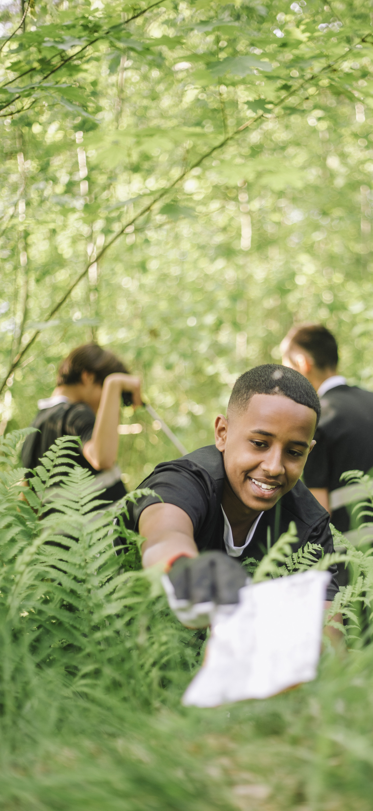
Prototype ideas
Option | Metric 1 | Metric 2 | Metric 3
School route mapping workshop with children, parents and nature specialists to map existing walks to school and spot opportunities for greening. | X | X | X
School route biodiversity audit with children and nature specialist to identify opportunities | X
School route greening meetup where teachers, students and parents gather to plant bulbs, spread pollinator seeds, etc in public green spaces on school routes |  |  | X
Metric 1: There are potential alternative and safe pedestrian routes through connected green spaces in over 70% of schools in areas of multiple deprivation.
Metric 2: The time taken to walk through the potential route is no more than 20% more than current routes.
Metric 3: Within 2 weeks of my testing and iteration, 90% of potential users will indicate an interest in trying the alternative route.
Notes:
We have a 2-week timeframe for creating and testing the prototype(s) and a need for low-cost, fast, and tangible methods. Our team also has experience in running community workshops and in creating physical prototypes, but limited experience in creating digital prototypes. As a result, the team are going to look at prototype options to emphasize physical, community-led, and interactive role-play or map-based approaches.
Options we discussed:
School route mapping workshop with children, parents and nature specialists to map existing walks to school and spot opportunities for greening. This can include:
Large-scale printed local maps and sticker annotations
A role-playing game where children move through different “route scenarios”
School route biodiversity audit with children and nature specialist to identify opportunities
School route greening meetup where teachers, students and parents gather to plant bulbs, spread pollinator seeds, etc in public green spaces on school routes
In order of selection: we’d opt for either option 1 or 2 (preferably 2) and option 3 – this tests all of our metrics. If we had to further prioritise, we would just do option 2 – this covers two metrics and is a better reveal of community knowledge and priorities than option 1.

Slide 53
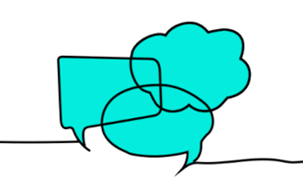
Tips for gathering useful feedback
Think about incentives for participating
Script the beginning and end of your feedback process
Ask users to ‘think out loud’ as they engage with your prototype
Don’t rush to explain – observe, record without judgement
Invite users to perform a specific task, where relevant
Run multiple tests with small groups, iterating your prototype in-between each test
Invite multiple kinds of stakeholder as testers
Thank users for their time
Notes:
Script the beginning + end of your feedback process
Ask users to ‘think out loud’ as they engage with your prototype
Don’t rush to explain – observe, record without judgement
Invite users to perform a specific task, where relevant
Run multiple tests with small groups, iterating your prototype in-between each test
Invite multiple kinds of stakeholder as testers
Your prototype doesn’t need to be in the same format as the final product / service / programme / policy / place
Thank users for their time (and think about incentives for participating)

Slide 54
Activity 2: Planning your prototype (15 min)
In this activity, you are encouraged to plan the creation and testing of a physical or digital planet-centric prototype.
Remember to use simple materials and to focus on the core features of your idea.
Remember to include your:
Hypothesis
Metrics of success

Slide 55
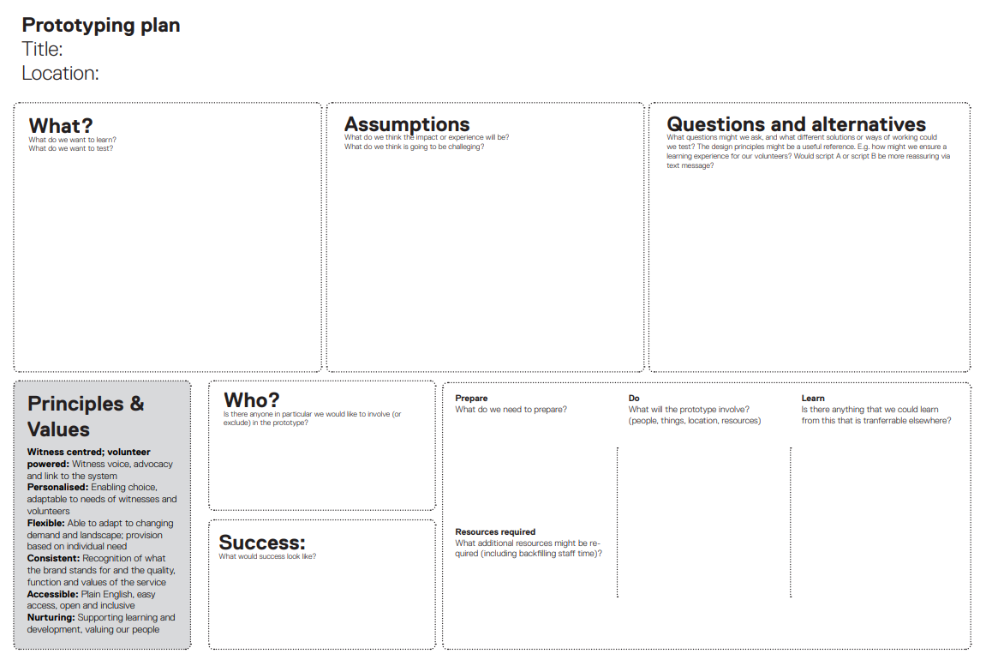
Notes:
You can also use this prototyping plan to support you.

Slide 56
Reflect and share
Notes:
Comment on the aggregated responses.

Slide 57
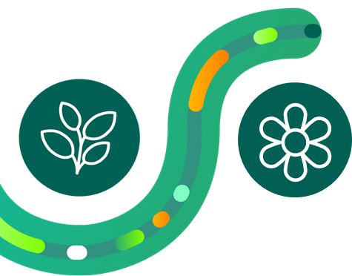
Next steps
To prepare for the next workshop:
Reflect on the potential impact of your ideas and continue to refine your approach to test one of these ideas
Create a prototype and test it with your audience, iterating based on feedback
Measure your impact where possible
Sign up for the workshop: 28th May
Explore Enterprise
May 2025
Reminder: Idea submissions open on the 20th May
Notes:
Highlight key topics covered.
Outline prep for next workshop.
Guidance
Make sure you get feedback from a variety of people to have a well-rounded view:
Different age groups: Include young and old participants if your idea is not for a specific age group.
Various backgrounds: Seek feedback from people with different cultural and educational backgrounds.
Different roles: Engage people who will use, support, or be affected by your idea in different ways.
Non-human perspectives: Think about others. For example, if non-human beings interact with your prototype, what feedback would they give?
To support you to do this, think of one species of bird, one species of animal, and one natural space (garden or river) that will directly be impacted by your idea.

Slide 58
Assessing growth (survey 2)
Capability | Statement
Creativity | Turn ideas into actions that make things better.
Change | Deal with things that are unknown or lots of new things happening quickly.
Communication | Speak in a way that makes others listen, understand and act.
Participants who attend the workshop and complete the workshop surveys will obtain an ‘Explorer’ digital badge
Notes:
Encourage completion of survey.
Explain that survey needs to be completed in order to receive a digital badge.
Congratulations on completing this workshop.
The last activity it to complete the survey, reflecting on whether you feel more confident in the three capabilities and what you still want to do better. Participants who have completed the baseline survey and end-of-workshop survey will get an Explorer digital badge. These badges will be emailed to you by the end of March.
While completing the survey, we also encourage you to capture your responses for your own learning and development, so you can identify what you want to grow and how this changes over the next few months.
You can record your responses by taking a photo or screenshot of the completed survey or capturing your responses in a document.

Slide 59
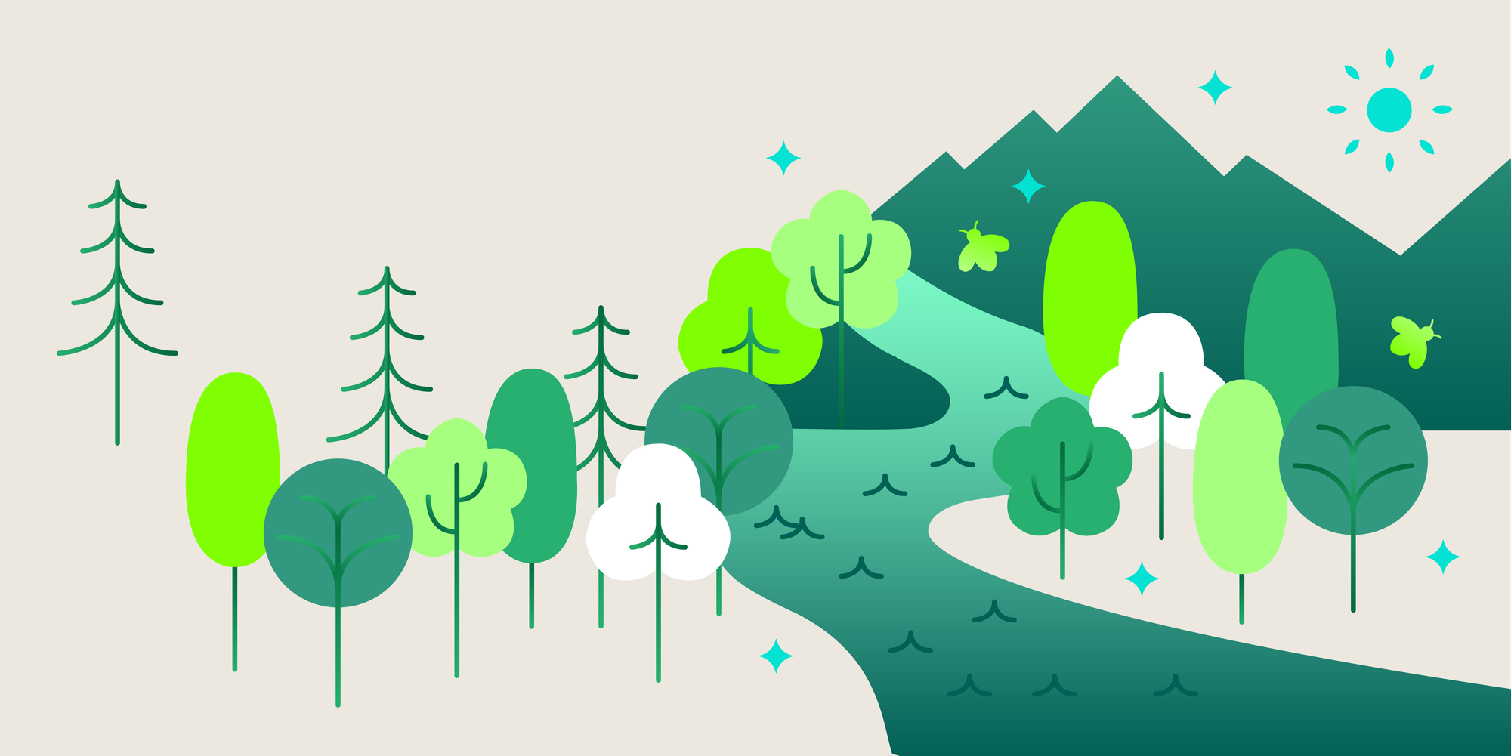
3-2-1
Three things you learned
Two things you’re curious about
One thing you don’t understand (yet)
Notes:
To close out this session, let’s do a 3-2-1:
Three things you learned
Two things you’re curious about, and
One thing you don’t understand (yet)

Slide 60
Q&A
Your chance to ask us anything

