Slide 1
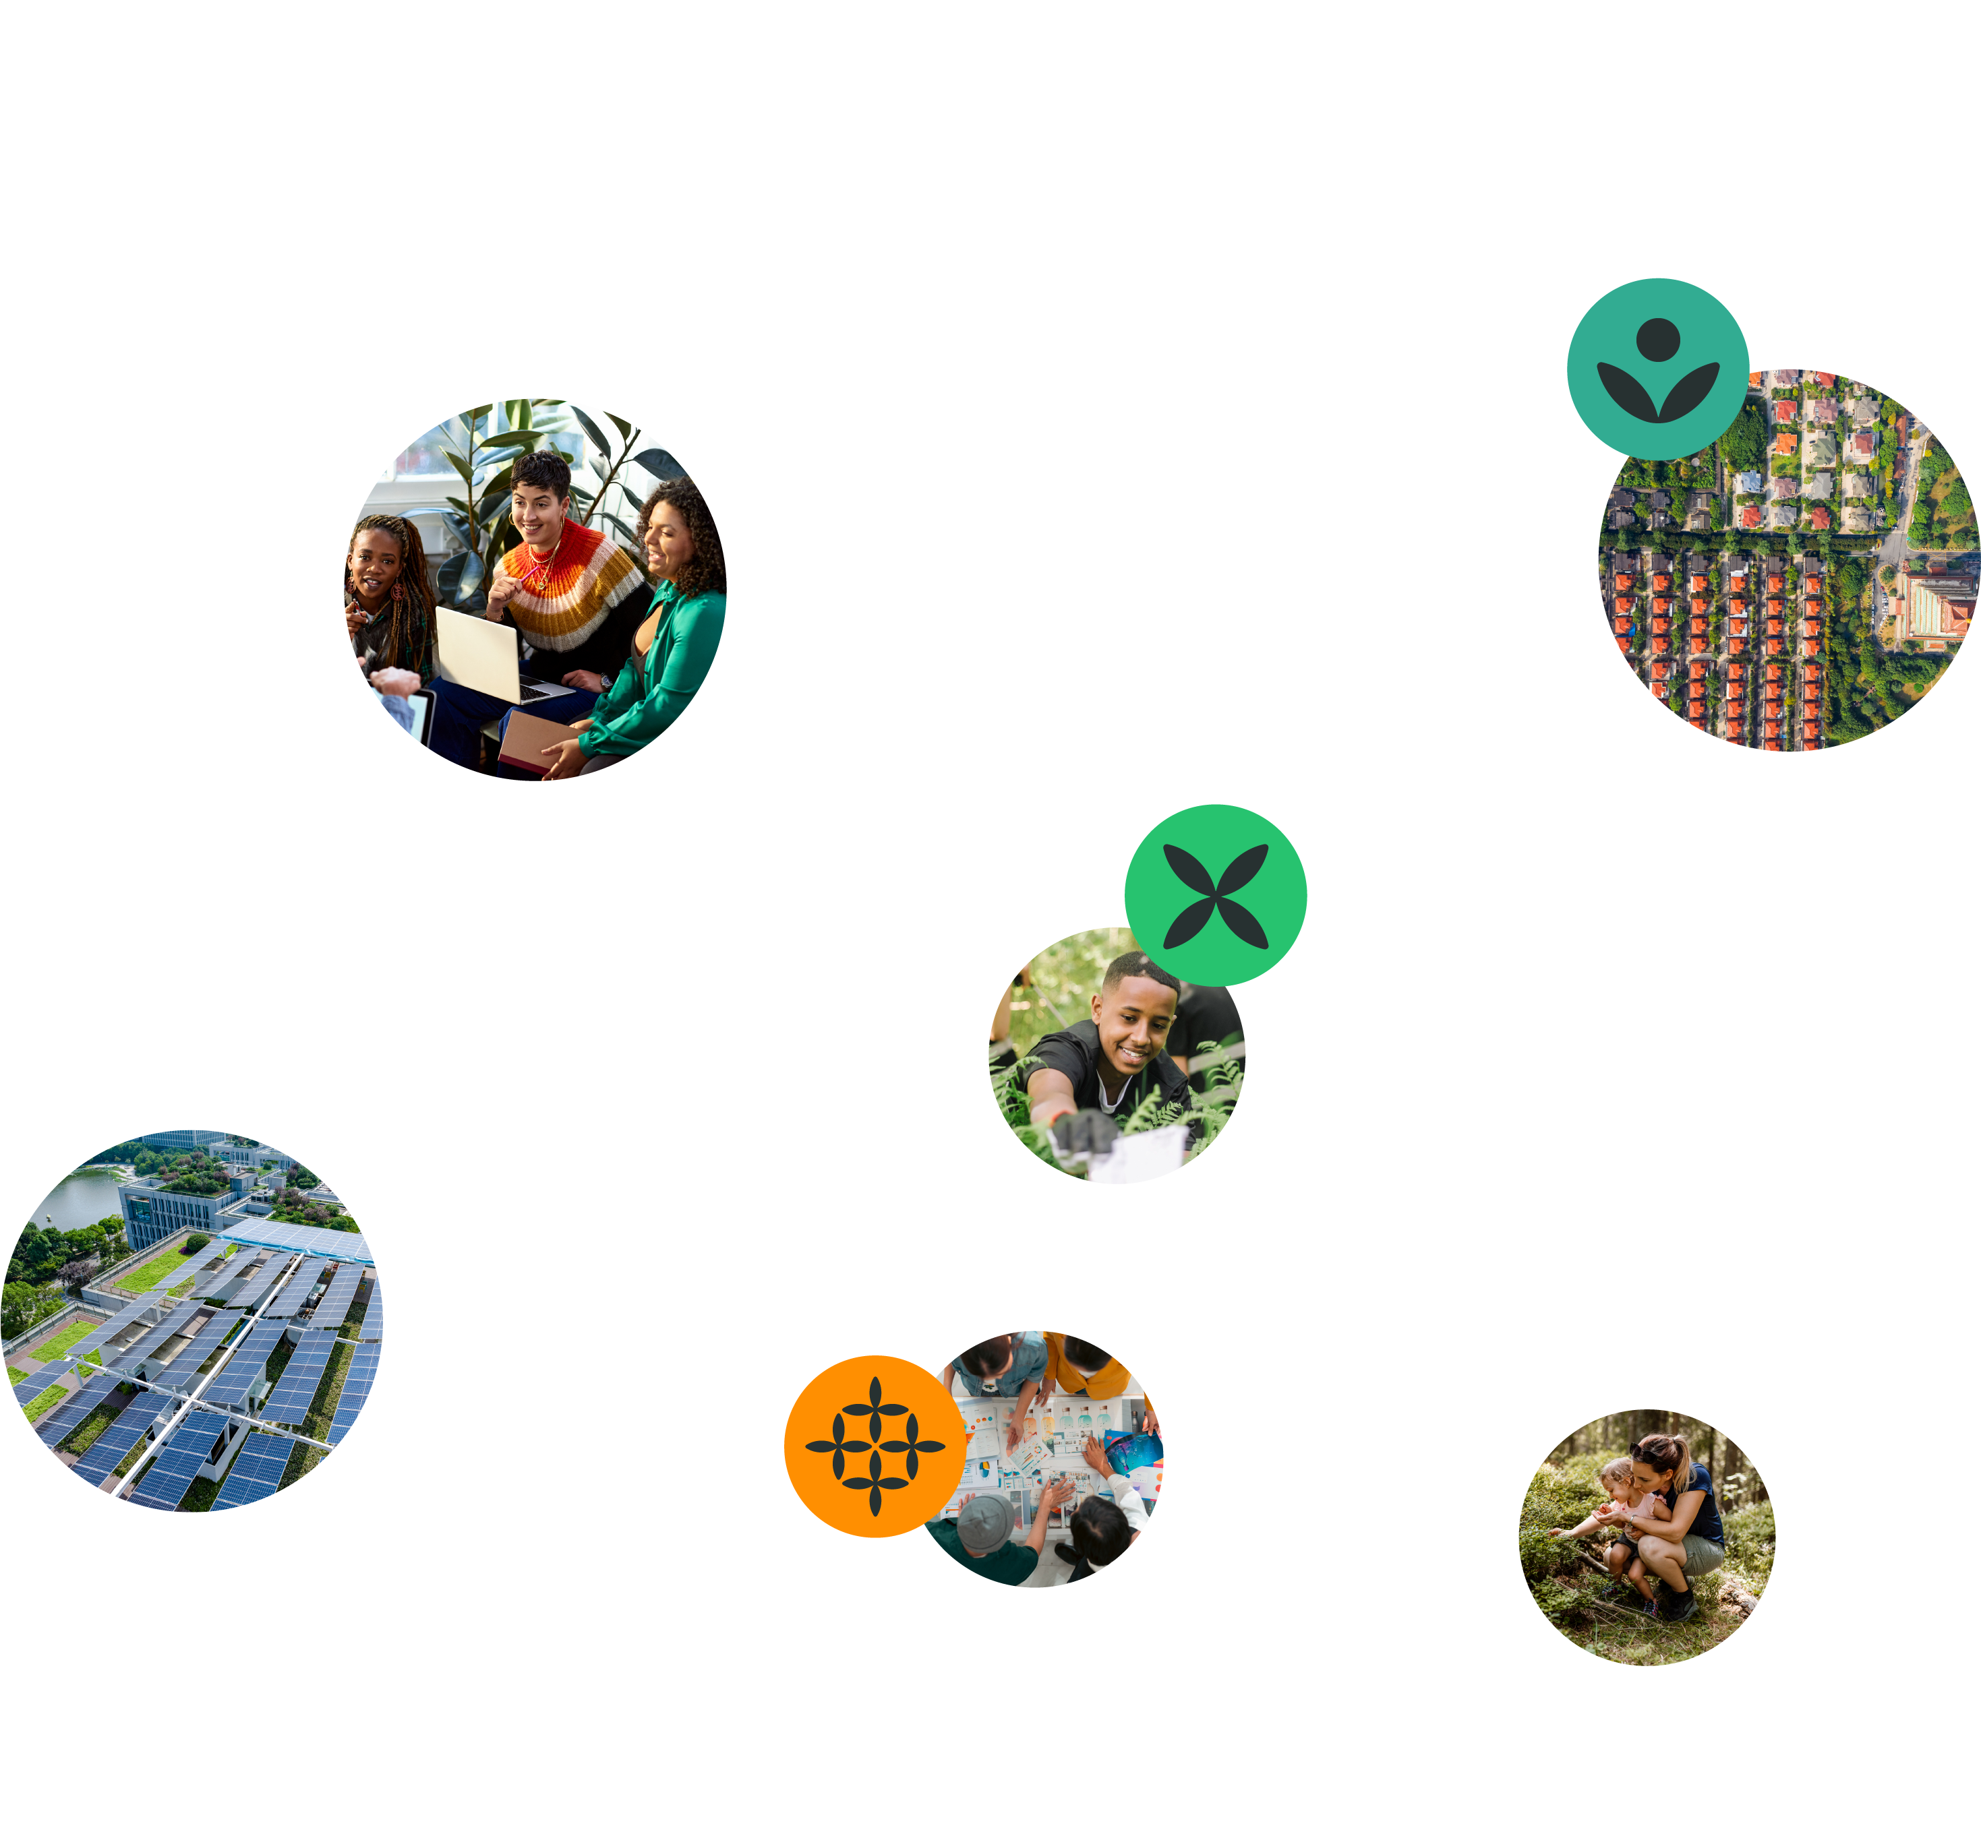
Envision Futures
Learning Workshop 3
30 April 2025

Slide 2
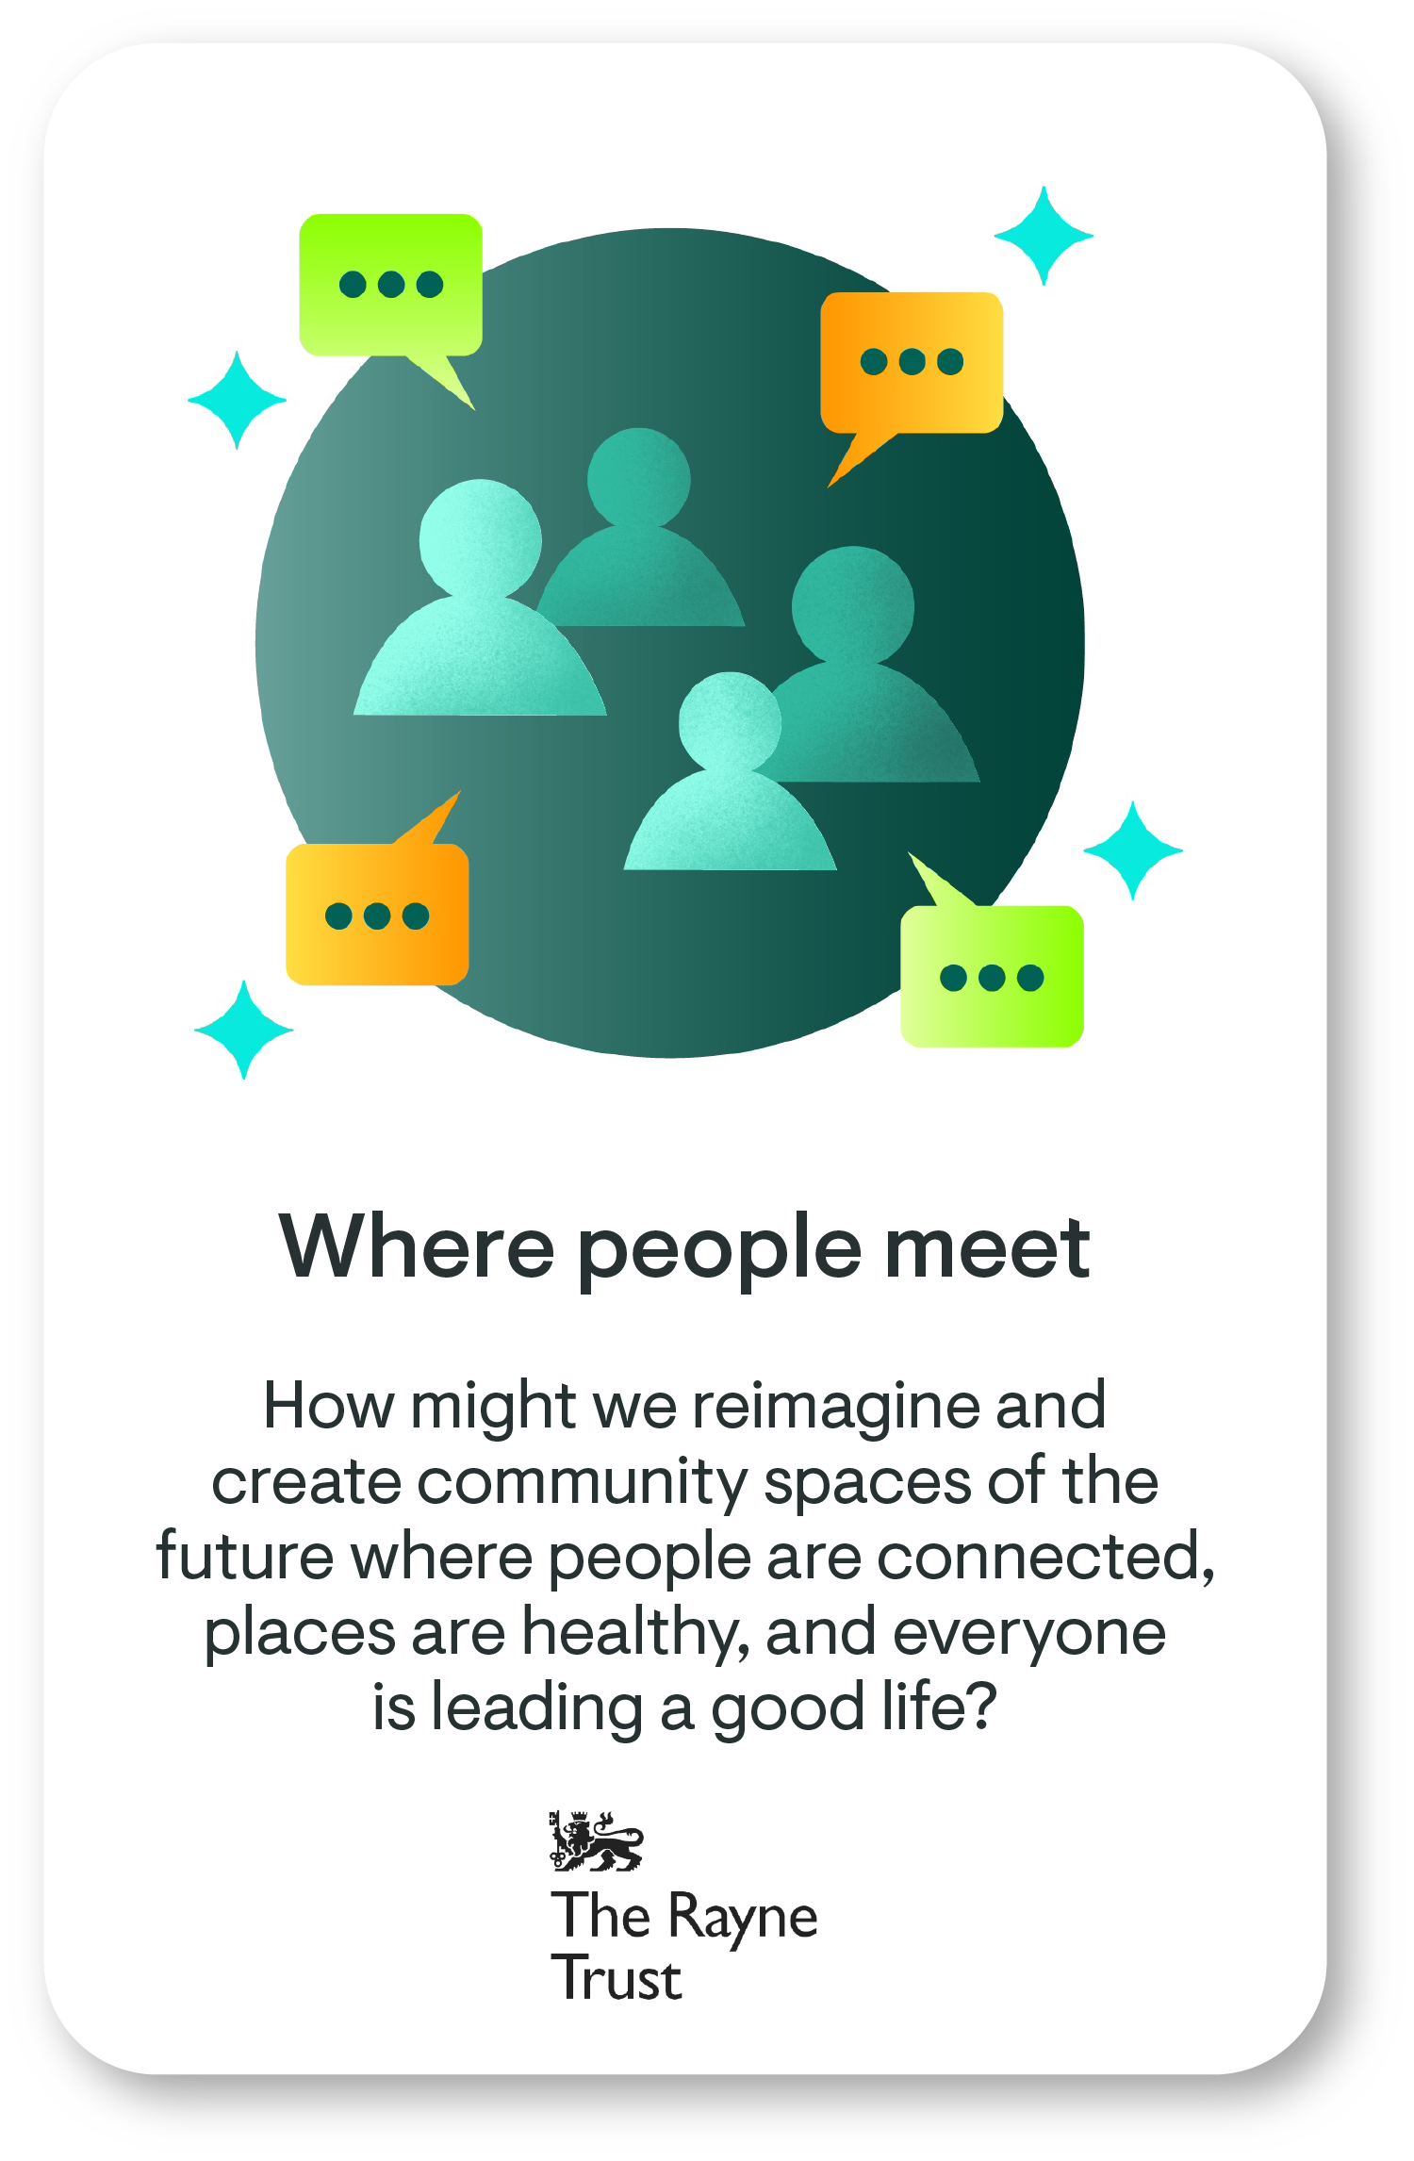
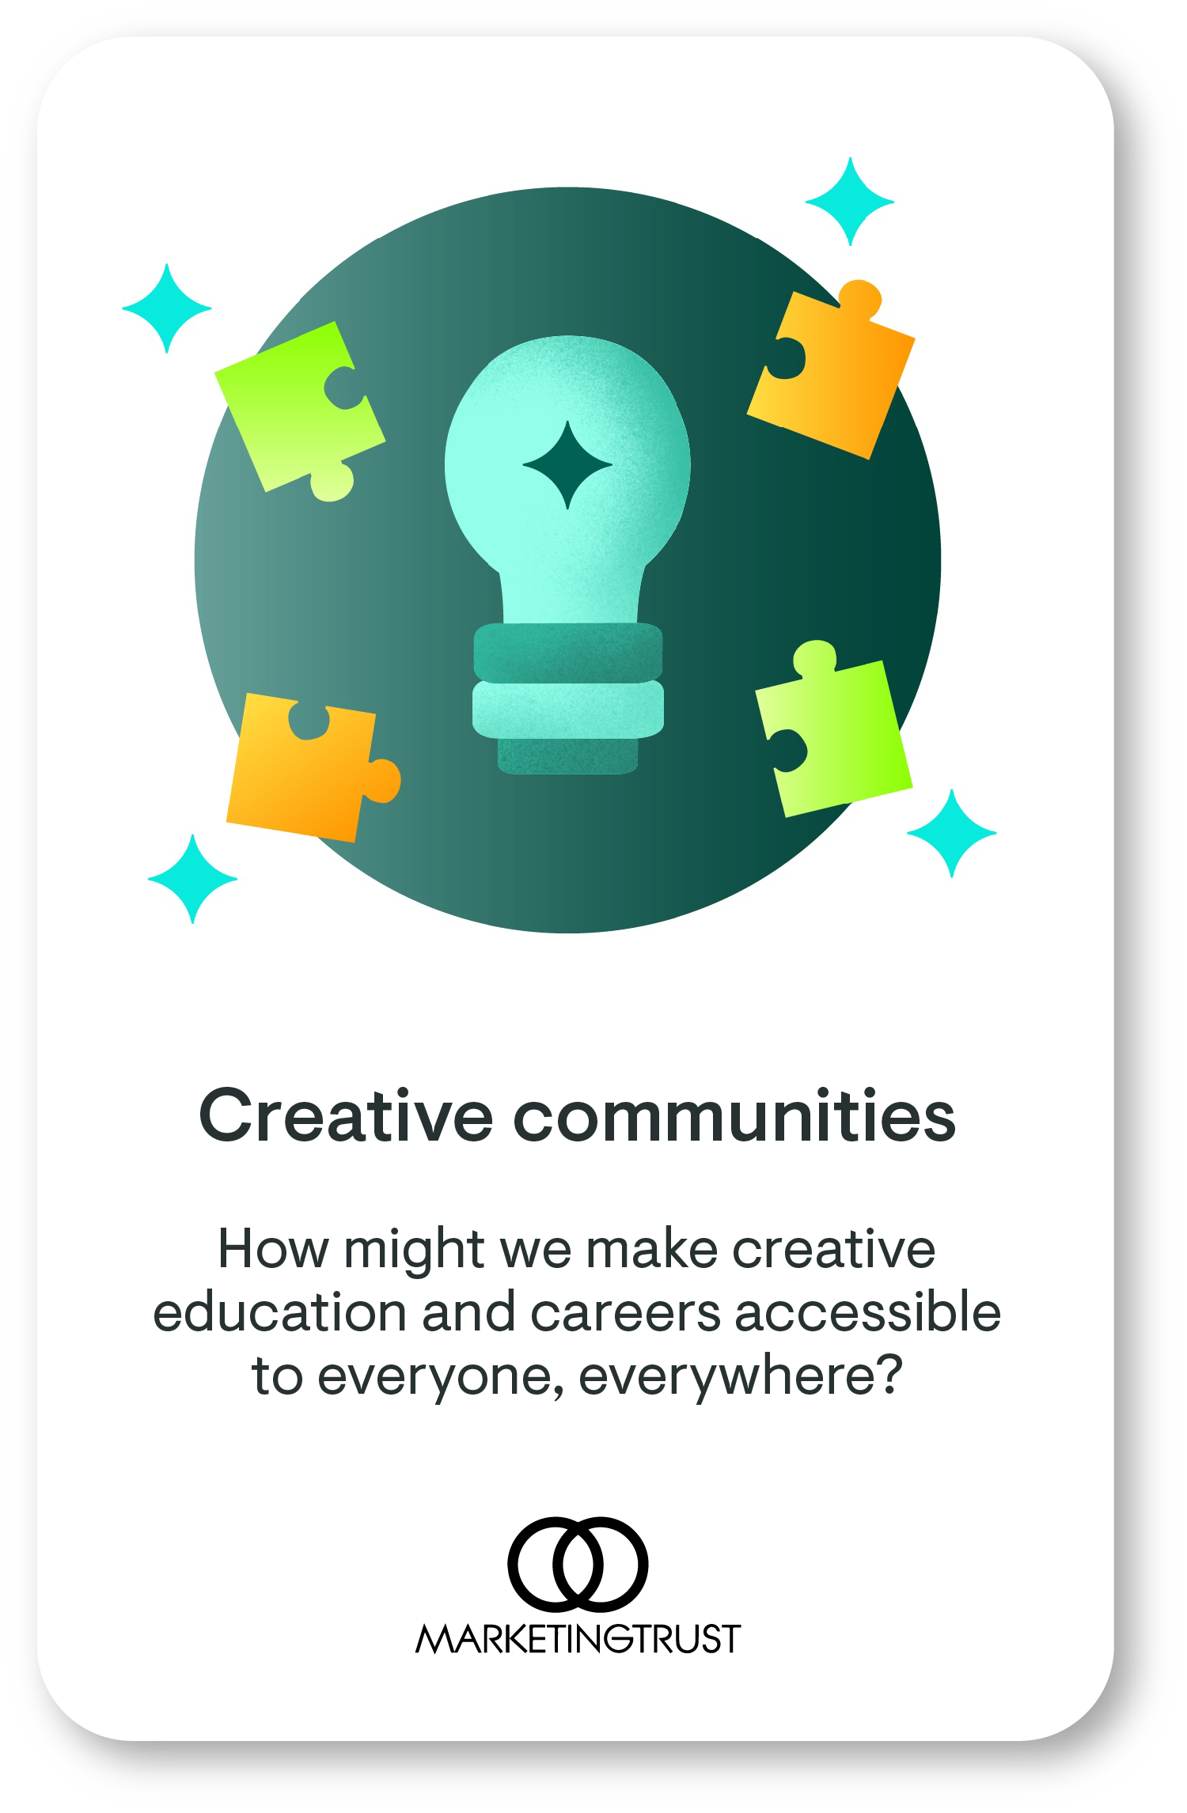
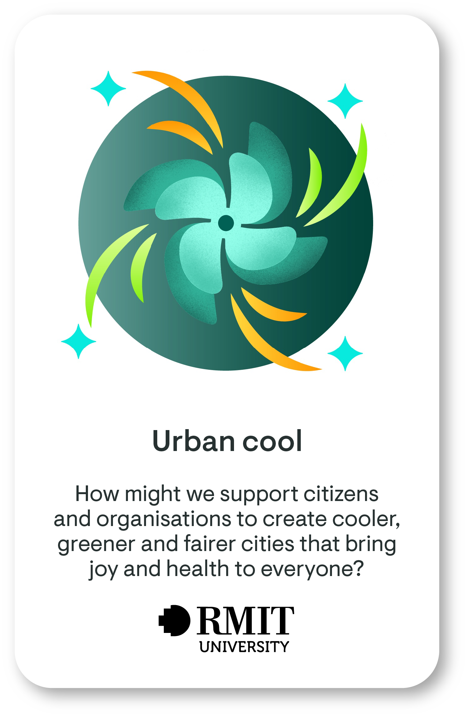
What real-world briefs can students respond to?

Slide 3
What are the learning workshops on offer?
Discover your purpose
March 2025
Explore diverse perspectives
March 2025
Envision futures
April 2025
Test your impact
May 2025
Explore enterprise
May 2025
Connect with your strengths and with your energy for change as you reflect on the world as it is, the world as it needs to be, and the brief that you care most about.
Capabilities:​ Care, Citizenship, Composure
Shape your vision for change and a diversity of ideas that respond to your chosen brief, while carefully considering which ones are the most opportunistic.
Capabilities:​​ Creativity, Courage, Collaboration
Consider what and how you might test your most promising ideas and how they can have the greatest impact.
Capabilities:​​ Creativity, Change, Communication
Explore the business and economic viability of your idea while delivering positive social and environmental impact.
Capabilities:​​ Courage, Change, Composure
Explore with different points of possibility, thinking about who you should work with and what you can do to better understand the context of your chosen brief.
Capabilities:​​ Care, Curiosity, Critical Thinking

Slide 4
Laying foundations (survey 1)
To chart a course forward, you must first know where you stand
Capability | Statement
Creativity | Dream big about what is possible.
Courage | Try new things, even when it's hard.
Collaboration | Work with others, even when it's hard.
Participants who attend the workshop and complete the workshop surveys will obtain an ‘Explorer’ digital badge

Slide 5
Connecting to the futurear

Slide 6
Quiz
The future is…
a time beyond the present moment
a time encompassing all the possibilities, events, and experiences yet to come
a time that cannot be shaped by current actions
all of the above

Slide 7
Quiz
The future is…
a time beyond the present moment
a time encompassing all the possibilities, events, and experiences yet to come
that cannot be shaped by our current actions
all of the above

Slide 8
Remember
We all have a unique view of the future based on our thoughts, feelings, and life experiences.
Your future, and the actions and events that shape it today, are interconnected with that of other people and all living beings
You, and every other person, can change the future and shape a better tomorrow.

Slide 9
Starting point
At this stage, you have:
conducted some research on your brief
considered different human and non-human perspectives
created ‘points of possibility’ (PoP) questions
narrowed your focus to one PoP

Slide 10
As a reminder…
Points of possibility (PoP) questions describe strategic points in your system where a small change can lead to significant impacts. These are not solutions, but opportunities where your efforts could have meaningful impact.
These PoP questions should reflect ways to address the opportunities or challenges you identified. They can start with “How might we…?” or “What if…?”.
Remember to keep this PoP question specific and realistic for your local community or the place you can have a direct impact on.

Slide 11
Activities

Slide 12
Connecting with others
Activity 1

Slide 13
Connecting with others
Activity to do with community & stakeholders
Think about your chosen brief and the point of possibility you’ve selected.
Now think about the future… In this world, your point of possibility is now a reality, and the people and the environment affected by your mission theme are living a happy and healthy life. What does that world feel like?
Ask for feedback using appropriate and inclusive methods
E.g. select a Dixit card image that illustrates your view, share your image and explain why you selected it.
A more detailed version of this activity is detailed in the slide notes. We recommend doing the detailed activity if possible.
Notes:
Dreaming of the future together
In this activity, you will build on the points of possibility you identified and create collective dream for the future. This requires you to bring together diverse voices that have shaped, and continue to shape, the community or place you are focused on, and who are affected by, and influential in, your chosen mission area.
Guidance
This is a co-design approach that moves beyond the idea of user research or participation. It aims to bring together different people for a single purpose. For example, if you wanted to make a neighborhood better, you’d want to bring together the people, organisations and businesses that are located there or care about the neighbourhood, as well as the local government and any individuals or organisations that can support and advocate on the behalf of other living things affected by the neighbourhood (for example, wildlife or environmental organisations).
You will need at least two hours to complete this activity. Before you begin, you will need to have access to five or six people who are affected by, and can affect, the mission you're working on, either individually or in a group (see Step 4 below). These can be the same people you interviewed during your research phase (after workshop 2) if they are still linked to your selected your point of possibility, or new people.
Explore further (optional)
If you are interested in learning more about how regenerative approaches can help people and places collectively re-design their communities, cities and economies so that all living things can thrive, listen to the RSA’s Regeneration Rising podcast. We specifically recommend the 40-minute ‘Future Dreaming’ episode with Dr. Anne Poelina, Co-Chair of Indigenous Studies at the University of Notre Dame and a Nyikina Warrwa Indigenous woman from the Kimberley Region of Western Australia.
Instructions
Step 1: Envision
First, take 10–15 minutes in a quiet space, close your eyes, and reflect on the following prompt:
Imagine you enter a time machine and travel 100 years into the future.
In this world, your point of possibility (from Module 2) is now a reality, and the people and the environment affected by your mission theme are living a happy and healthy life.
What does that world feel like?
Tap into your senses and imagine what you would see, hear, smell, taste, and feel in this future 100 years from now.
Here are some more prompts to spark your imagination:
How do people and the natural environment interact harmoniously?
What current events or actions have contributed to this positive future?
What are two to three key challenges of today that have been resolved in this future?
Step 2: Record
Record what came to your mind when you imagined this future through notes in your journal, a drawing, a voice note, or any way you prefer.
Teamwork
If you are working in a team, now is the time to share your personal vision of the future with your team, and to notice similarities and differences in your visions. Try and combine your visions of the future into a shared vision.
Step 3: Map
The next step is to make a map showing all the different kinds of people and other living things that are affected by your mission, and that could influence your PoP. These are the people you need to involve in creating and shaping your ideas. This may be similar to the stakeholder map you made during your research, but it should be more detailed and more relevant to your chosen point of possibility.
Step 4: Prepare
Next, think about how you will speak to different people. Do you want to speak to them individually or gather them in a group? How are you going to communicate with them and gather their answers to the questions in Step 5?
Guidance
You can choose any way to communicate, for example by speaking to them in person, or via a phone call, or by sending a message. Remember to be careful about what personal information you give to other people. Refer to this Ethnography Field Guide by the Hasso Plattner Institute of Design at Stanford University for tips of how to interview people.
Step 5: Interview
Ask the people involved about their vision of the future. For some support, here is a draft prompt you could adapt:
I am (or we are) asking this research question:
_________ (insert your PoP question from Module 2) so that I (or we) can _________ (adjust your ‘How Might We Question’ from your chosen mission brief).
Imagine the world 100 years in the future. In this future, we have all worked together as a community to make sure all life can thrive, and our mission is achieved!
What does this world look like to you? What do you hear, taste, smell, feel in this world?
Remember, this prompt question is just a guide, and can be adjusted to suit your purposes, as shown in the example below.
Example
If your PoP was the use of AI to map spaces for intergenerational play, and if your mission brief is to ‘reimagine the community buildings of the future to create connected healthy places where everyone leads a good life,’ the prompt could be:
“We are exploring how can we use AI to map spaces and buildings in our community for intergenerational play so that we can reimagine and create community spaces of the future.
To help us in creating ideas, please imagine the world 100 years in the future. In this future, we have all worked together as a community to make sure all life can thrive, and our mission is achieved!
What do the community buildings in this world look like to you? What do you hear, taste, smell, feel in this world?”
You can also include other questions about the future. For example, what community buildings they would want within walking distance from their homes, and the kinds of community connections they’d love to have.
Step 6: Create (optional)
Now, bring your personal vision of the future, and the responses you got from your interviews, together into a collective dream for the future.
Notice what is similar in all the visions and make sure these common themes are represented in your vision.
Notice reflections that are unique or different in all the visions. Think about why there are differences, and how they can come together to be part of your vision too.
Step 7: Represent (optional)
Use your creative making skills to bring your ‘collective dream of the future’ to life. This could be in the form of a story you write, a drawing, a poem, a collage, or any other way you express your imagination. If you’re in a team, work together to make your creation.
Step 8: Share (optional)
Share your creative expression of the future with others.
Step 9: Reflect (optional)
Finally, reflect on your mission in light of this collective vision for the future. Specifically read the ‘Story From the Future’ section of your mission brief and think about how combining your collective dream with your mission partner’s dreams for the future could inspire transformative changes.

Slide 14
Connecting with others (continued)
You are encouraged to reflect on whether the same themes are described by different stakeholders.
If not, we encourage you to take a step back and spend more time defining your point of possibility, so it reflects the collective vision.
The workshop pack will provide some suggested activities to help you further shape this collective vision for the future.

Slide 15
Ideation
Activity 2

Slide 16
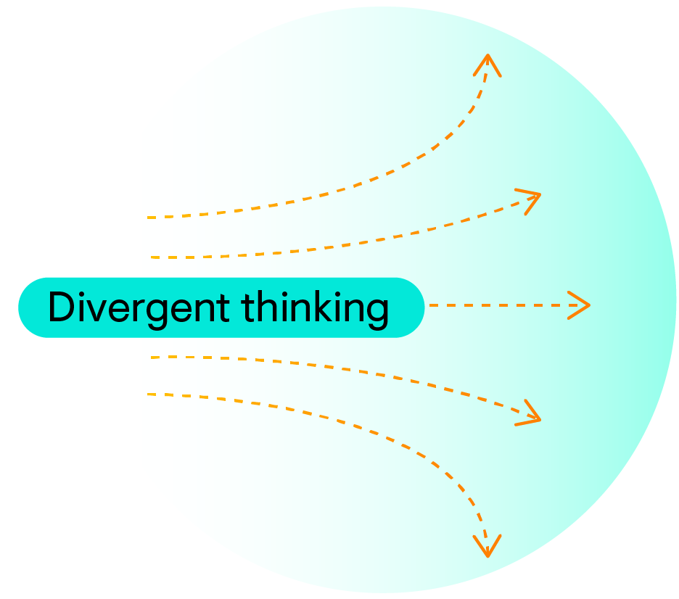
Creating ideas
Divergent thinking believes that there many ways of approaching a problem.
Brainstorming is a specific technique used to assist divergent thinking.
They work together to support creativity and problem-solving.

Slide 17
Overview
This activity is split into several steps:
Preparation: Seeking inspiration and preparing your brainstorming prompts
Creating ideas: Using the brainstorming canvas and prompts to generate ideas for your selected point of possibility
Prioritising ideas: Using criteria to select three ideas for testing and development
Testing ideas: Planning three audience/stakeholder groups to test your ideas with in preparation for the next workshop
You can also choose to reviewing the creativity of your ideas at the end of step 2, before moving to prioritisation (an optional step)
Notes:
Mapping your mission’s system
Think about your chosen mission. What are some of the various parts or factors involved in it? How might they be connected?
<component: information>
Title: Guidance
In this activity, you will map your mission’s system and start to build an idea of its main parts and how they are connected. We recommend setting aside a maximum of 1 hour for this activity.
If you need some support to do this, consider signing up for an RSA Guide so you can connect with a mission expert. And if you’re participating in RSA Spark as a team, please do this activity together and co-create a single map.
</component>
<h4>Instructions
The first step is to identify the key parts of your mission’s (e.g., people who are affected, people who are working on this mission across the world, non-human beings impacted by this mission brief, the places and environments, the resources that form an important part of this mission brief, the policies that affect the communities and places, etc.) through desk research (via books and the internet).
<component: exclamation>
Title: Note
You will have an opportunity to conduct more research later in the module, so we recommend limiting this research to 30 minutes.
We recommend focusing on the breadth of your research rather than its depth (in other words, focus on understanding the wider system rather than diving deep into a single element).
</component>
Static Visual Asset Instructions Template
Asset number
LJ1_015A
Source image
N/A
Reference images
N/A
Origin of the image/s
N/A
Instructions
Take a photo of a systems map in progress or create a designed graphic illustrating this. This system map will be broken down into 3 parts to illustrate system mapping. This is the first part – doing research and identifying key parts.
Copy
N/A
Asset type
Photo or RSA-designed graphic (dependent on GD capacity)
Link to asset
https://royalsocietyarts.sharepoint.com/:f:/s/DesignforLife/Ejf17u3tEpBItUhy62K46rEBCdbvVSM6eMiMrkyddrma5g?e=myj1Kx
ALT text
TBC
<caption>
[LD/ED to insert caption title if citation required e.g. 3D globe with heatmap]
[LD/ED to include source if citation required, e.g. Source: Joshua Stevens, NASA, 2022.]
</caption>
Next, draw connections between these parts to show how they interact and depend on each other.
Static Visual Asset Instructions Template
Asset number
LJ1_015B
Source image
N/A
Reference images
N/A
Origin of the image/s
N/A
Instructions
Take a photo of a systems map in progress or create a designed graphic illustrating this. This system map will be broken down into 3 parts to illustrate system mapping. This is the second part – drawing connections.
Copy
N/A
Asset type
Photo or RSA-designed graphic (dependent on GD capacity)
Link to asset
https://royalsocietyarts.sharepoint.com/:f:/s/DesignforLife/Ejf17u3tEpBItUhy62K46rEBCdbvVSM6eMiMrkyddrma5g?e=myj1Kx
ALT text
TBC
<caption>
[LD/ED to insert caption title if citation required e.g. 3D globe with heatmap]
[LD/ED to include source if citation required, e.g. Source: Joshua Stevens, NASA, 2022.]
</caption>
Finally, think about how changes in one part might affect the others.
Static Visual Asset Instructions Template
Asset number
LJ1_015C
Source image
N/A
Reference images
N/A
Origin of the image/s
N/A
Instructions
Take a photo of a systems map in progress or create a designed graphic illustrating this. This system map will be broken down into 3 parts to illustrate system mapping. This is the third and final part – showing changes.
Copy
N/A
Asset type
Photo or RSA-designed graphic (dependent on GD capacity)
Link to asset
https://royalsocietyarts.sharepoint.com/:f:/s/DesignforLife/Ejf17u3tEpBItUhy62K46rEBCdbvVSM6eMiMrkyddrma5g?e=myj1Kx
ALT text
TBC
<caption>
[LD/ED to insert caption title if citation required e.g. 3D globe with heatmap]
[LD/ED to include source if citation required, e.g. Source: Joshua Stevens, NASA, 2022.]
</caption>
Once you’ve completed the activity, share your system map in the discussion forum and look at others’ maps to see how they’ve visualised their missions.
Next, we'll reflect on how using this approach can help you conduct better research and come up with more effective ideas for your mission.
[Embed forum]
Forum Instructions Template
Setting
Instruction
Group
Yes
Threaded replies
Yes
Users must post before seeing replies
No
Podcast feed
No
Graded
Yes (participation – complete/incomplete)
Allow ‘liking’
Yes
Add to student to-do
No
</page>

Slide 18
Preparation
Activity 2: Step 1

Slide 19
Instructions
In this activity, you are asked to come up with at least 10 ideas related to your chosen point of possibility.
To help you, we’ve provided a brainstorm canvas template and some playful prompts. You can either use the brainstorm canvas and playful prompt cards provided in these slides (adding text and moving the cards within the slides), or draw your own canvas and prompt cards… either physically using paper and pen (for teams working in the same physical location), or digitally using a whiteboard tool for collaboration (e.g. Miro) (for teams working remotely).
You will need at least an hour to complete this activity, so this is just a brief session to get you started!
Please don’t do the following:
Think too much or do any further research. Use all the information you currently have to guide you through the activity.
Jump to a solution or provide just one idea for your PoP. This part of your journey is about coming up with many different ideas!
Worry about how possible the ideas are. Just have fun and get your creative juices flowing.

Slide 20
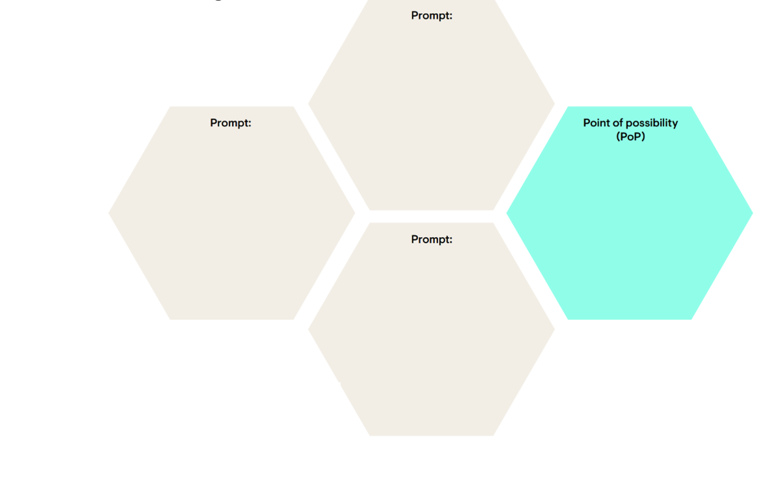
Add your PoP in the hexagon
How might we…
How might we…

Slide 21
Select and/or create 5-10 playful prompts (examples provided on the following slides)...
What if…
What if…
What if…
What if…
What if…
What if…
What if…
What if…
What if…
What if…

Slide 22
Example

Slide 23
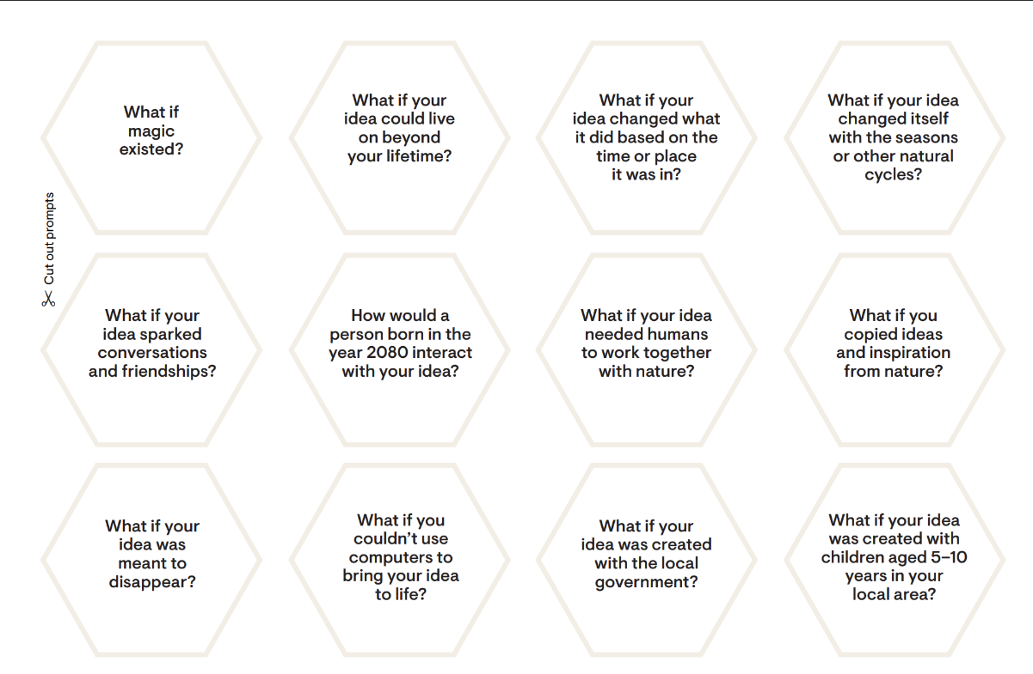
Examples
What if… your idea was made by Lego? Ikea? Nike?
Or a brand you admire?
What if… you had £1 million to make your idea happen?
What if…people subscribed to your idea for a monthly fee?

Slide 24
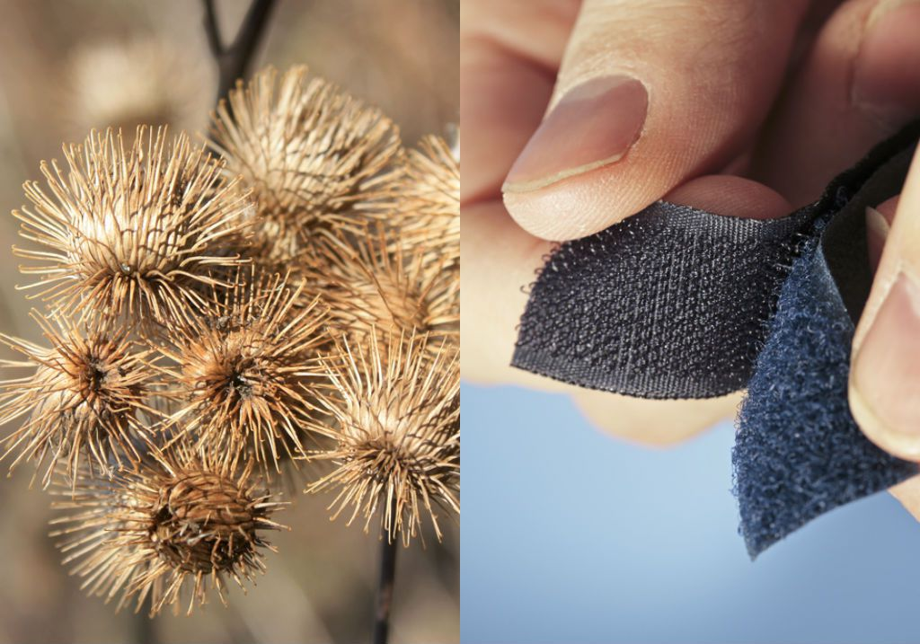
Drawing inspiration from nature
We can learn from and mimic nature’s strategies to solve design challenges in a regenerative way.
This approach is called biomimicry.
The goal is to develop solutions that are not only effective but also environmentally sustainable, reflecting the well-adapted, time-tested innovations found in nature.

Slide 25
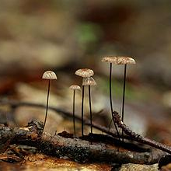
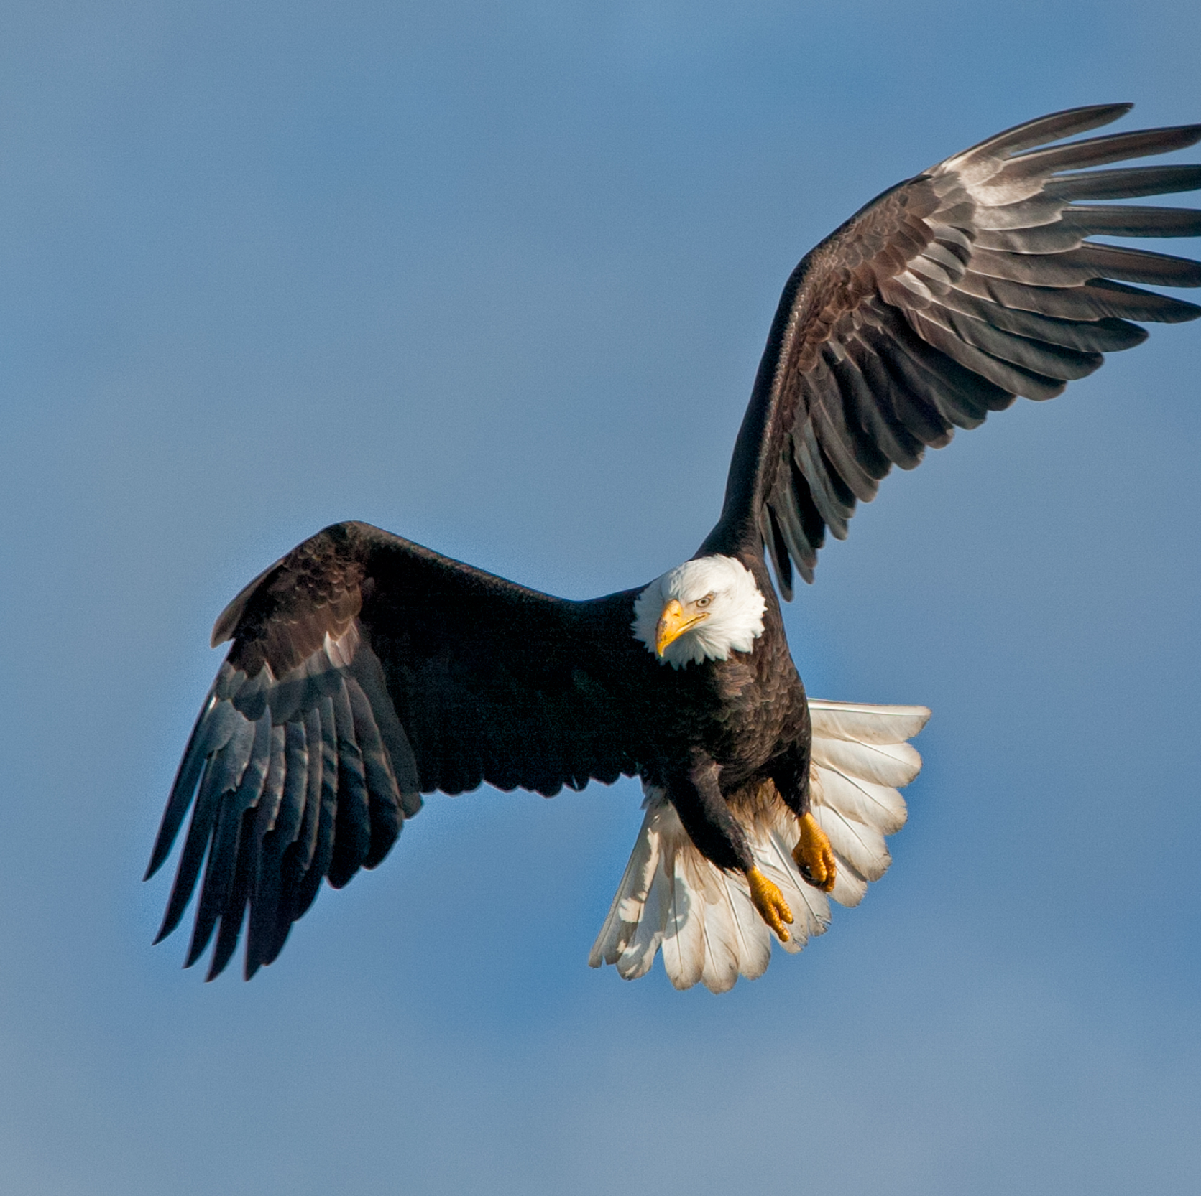
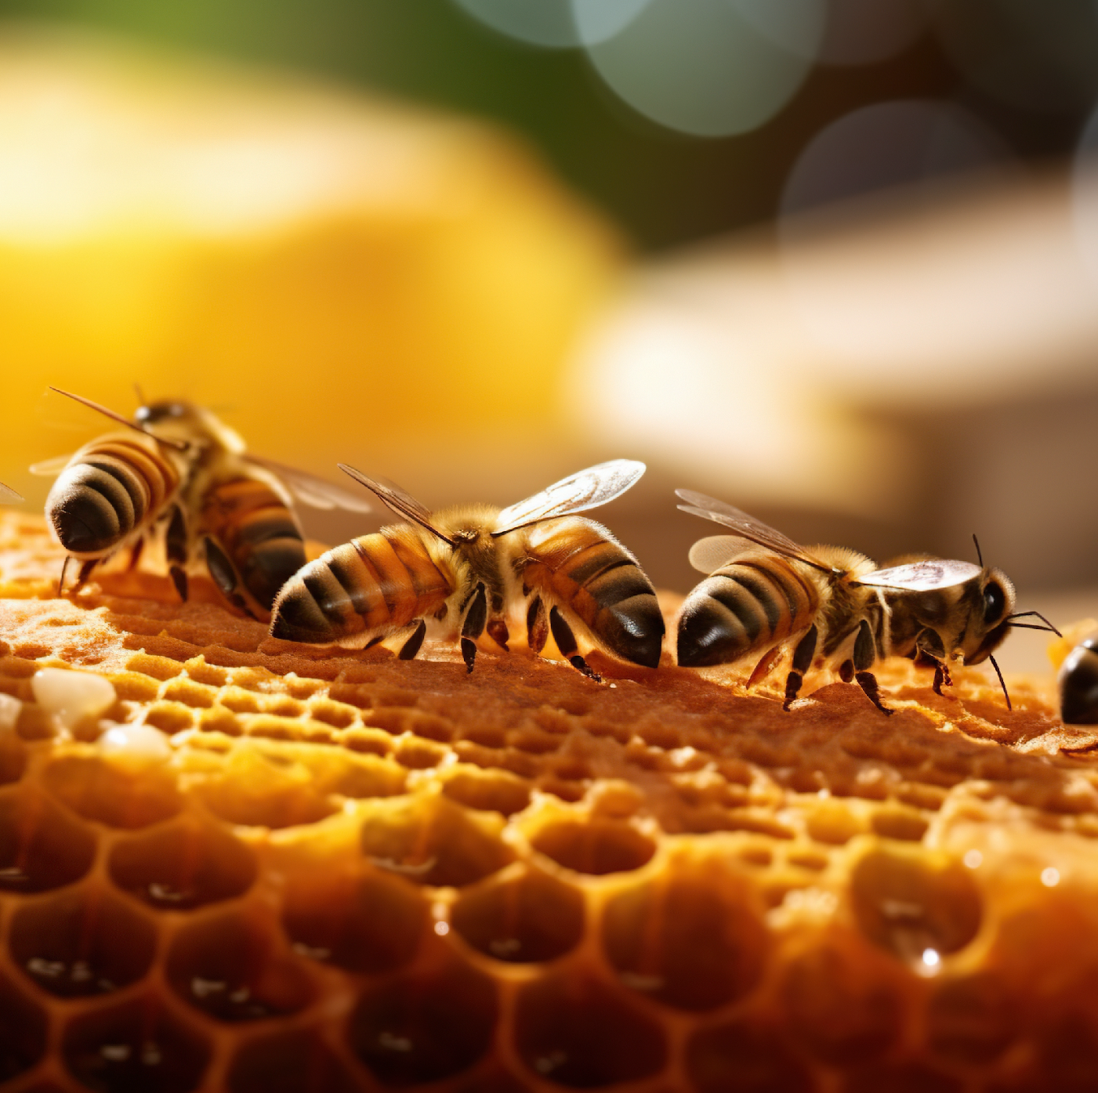
Examples of nature-inspired ideas
Bee-inspired optimisation of delivery routes
Innovative building materials
Nature-inspired wings
Mycocycle
NASA
Routific
For more information on the examples shared, and for additional examples, explore Asknature.
Other useful resources with examples include:
The article ‘50 of the World's Best Biomimicry Examples (so far)’ by Learn Biomimicry
The article ‘10 examples of ‘peer-led’ behaviours in nature’ by Zahra Davidson

Slide 26
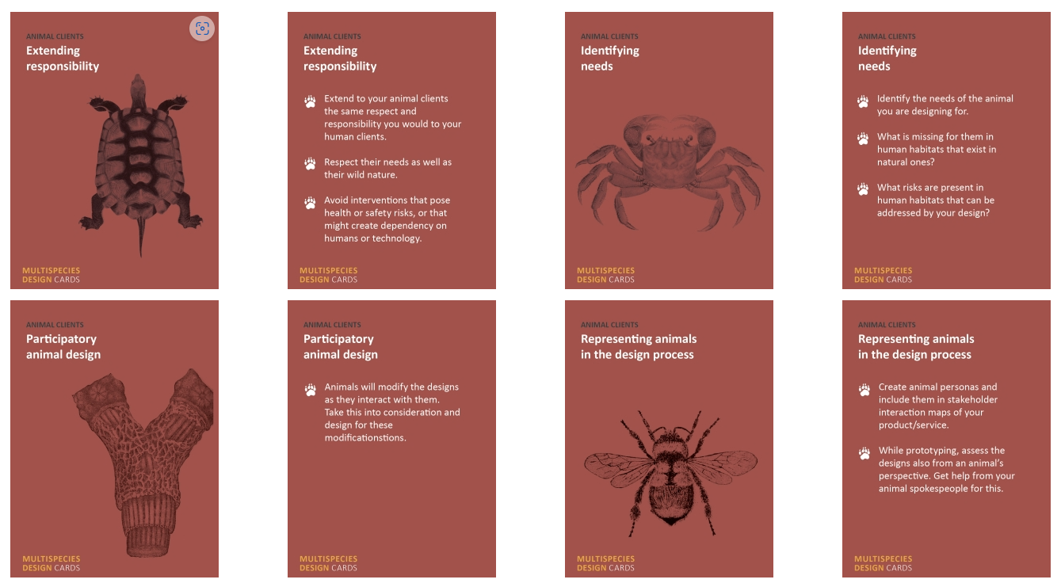
Inspiration: Daniel Metcalfe’s Multi Species Design Cards
What if your client was an endangered animal?
What if animal interactions improve the design?
Animals as Clients of Design
Source: https://danimetcalfe.com/index.php/md/animals-as-clients-of-design/
Notes:
You can also look for inspiration from other places: for example, Daniel Metcalfe’s Multi Species Design Cards or the crazy eights game where you add prompts on how ideas (or their parts) can be subtracted, reversed, added, exaggerated, simplified, made impossible, or multiplied.

Slide 27
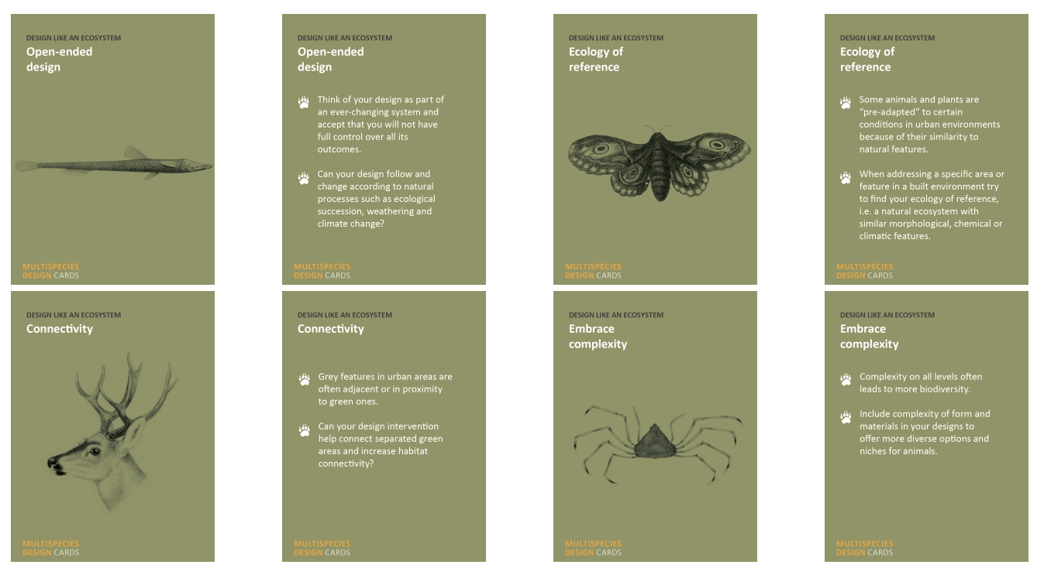
Inspiration: Daniel Metcalfe’s Multi Species Design Cards
What if you could connect green areas to grow habitats?
Designing like an Ecosystem
Source: https://danimetcalfe.com/index.php/md/animals-as-clients-of-design/

Slide 28
Creating ideas
Activity 2: Step 2

Slide 29
General guidance
For all students
When brainstorming with others, consider how you can be inclusive as possible and encourage balanced participation. Effective strategies you can adopt include:
Anonymous contributions using the brainwriting approach.
Reverse brainstorming generating conditions where a problem or issue would be made worse. This can then be followed by conventional brainstorming, providing opportunity for new ideas where the poor conditions are improved. (Useful for groups who tend toward negative thinking.)
Alternating sessions of brainstorming alone or together in a way that best suits the group and goal, e.g. alone-together-alone, 6-3-5 (where 6 participants each record 3 ideas every 5 minutes before passing them on to the next participant for a number of rounds).

Slide 30
General guidance
Students participating in Spark as a group
We encourage you to work together, building and developing one another’s ideas and drawing on the knowledge and experiences of all members of the team.

Slide 31
Select one or more prompts…
What if…
How might we…
How might we…
What if…

Slide 32
Unleash your creativity!
Use the prompt as inspiration and come up with as many ideas as you can. When you feel stuck, change the prompt or combine prompts for further inspiration.
Idea!
Idea!
What if…
Idea!
Idea!
How might we…
How might we…
What if…
Idea!
Idea!

Slide 33
Example

Slide 34
Example
Notes:
Let’s revisit the example we discussed in the last workshop to show how you could use this canvas and the prompts to generate ideas.. Remember the example was a team looking at the urban cool brief and asking how might they support communities to create cooler, greener and fairer cities in response to climate change.

Slide 35
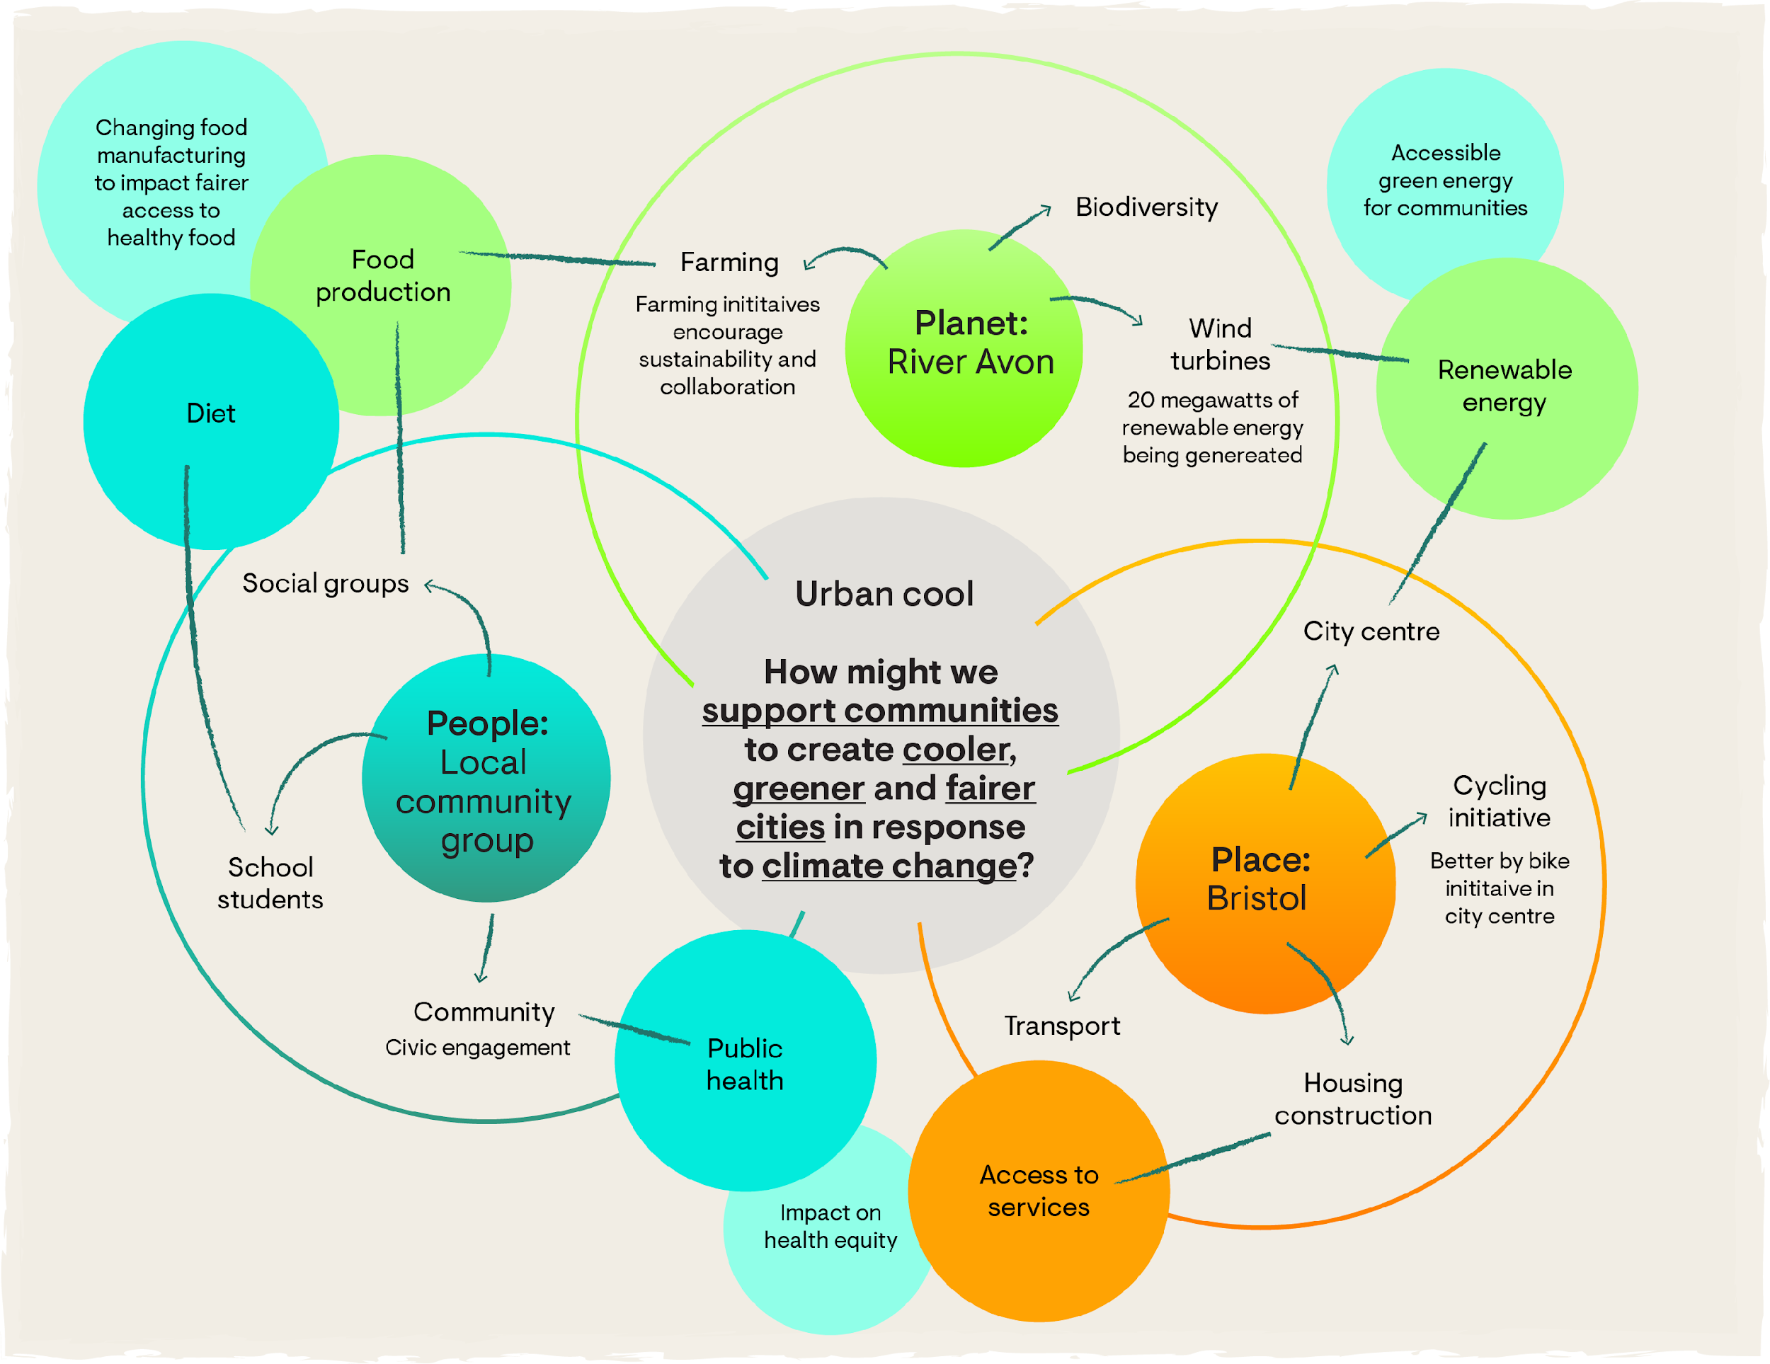
Example
Notes:
We discussed a potential map showing how different elements of the brief could be interconnected and discussed how research could further develop their understanding of this system. We also discussed how insights from this research could be used to identify points of possibility, where a small change can lead to significant positive impacts.

Slide 36
Example
How might we support communities to create cooler, greener and fairer cities in response to climate change?
Research found that students with access to green spaces reported a 30% lower incidence of mental health issues compared to those in areas without access to green spaces.
“We know that extreme heat lowers a child’s ability to learn. But our school can’t afford aircon.”
“My closest park is 30 minutes away and it isn’t safe for my son and his friends.”
Public health risks are exacerbated by climate change (e.g. obesity due to reduced physical activity)
The city is investing in expanding its cycle infrastructure from the city centre into growing suburbs
…
How might we ensure that every child in Bristol has access to safe, cool and green spaces that improve their mental well-being and social interaction?
…
Notes:
We showed some examples of the types of insights that could have been gathered showed how these could be written as PoP statements.
For this activity, let’s assume that the team has chosen to focus on the PoP statement related to children’s access to safe, cool and green spaces that improve their mental well-being and social interaction.

Slide 37
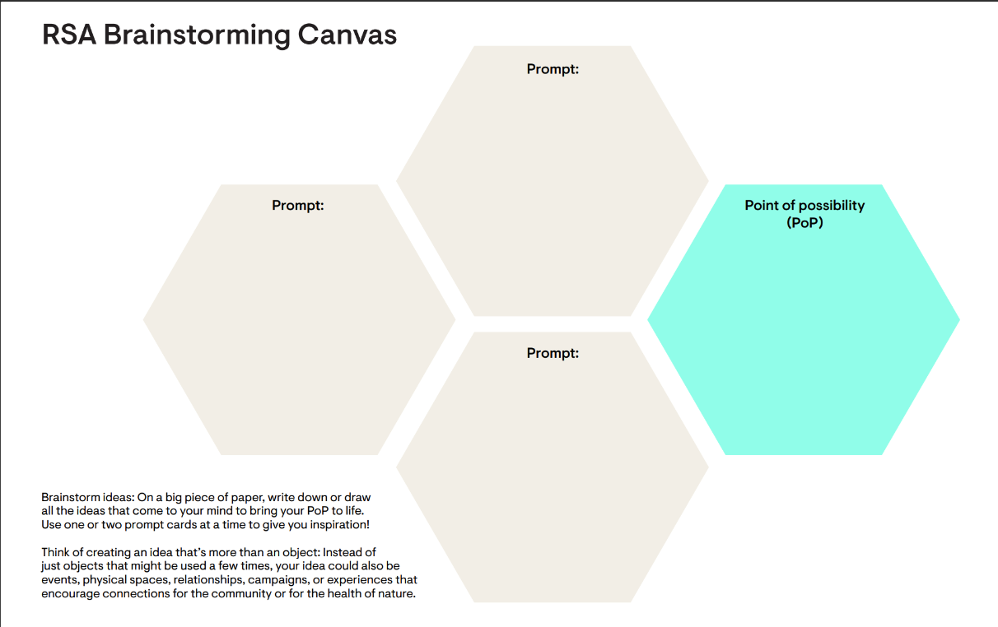
Example
Outdoor classrooms?
How might we ensure that every child in Bristol has access to safe, cool and green spaces that improve their mental well-being and social interaction?
What if you could connect green areas to grow habitats?
Biodiversity corridors as school pedestrian routes!
Notes:
Using the brainstorm canvas and this statement, they can then start to look at prompts to help generate ideas.
Again, please don’t worry about how possible the ideas are at this stage – just have fun with your ideas.

Slide 38
Example
Outdoor classrooms?
How might we ensure that every child in Bristol has access to safe, cool and green spaces that improve their mental well-being and social interaction?
What if you could connect green areas to grow habitats?
What if humans could help the non-humans thrive through their day-to-day activities?
Biodiversity corridors as school pedestrian routes!
Children distributing seeds on their commute
Notes:
You can change or add prompts for more ideas

Slide 39
Review ideas
Activity 2 (optional step)

Slide 40
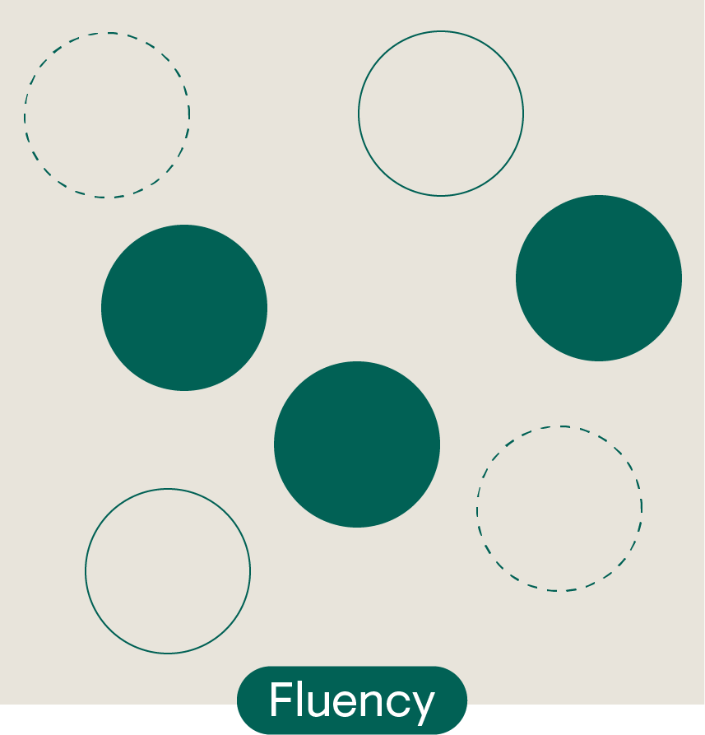
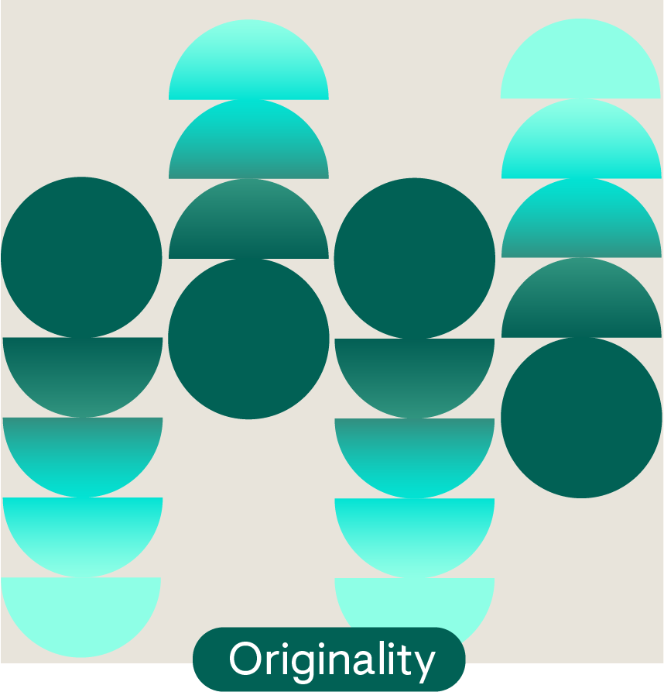
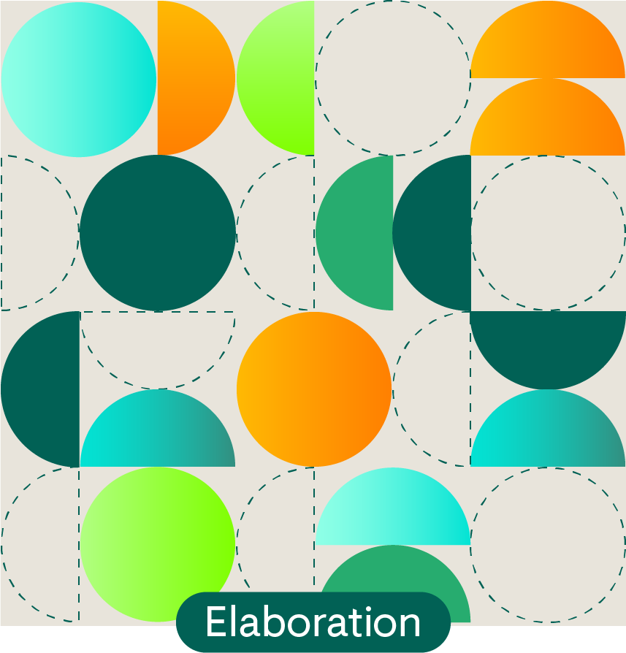
Review your ideas (optional step)
Reflect on how different and original your ideas are at this stage.
You can do this using four creativity dimensions (see details in slide notes).
Notes:
Review your ideas
When we use brainstorming, we want to produce many different and original ideas whose potential value can be easily assessed.
In this way, we can get an indication of how creative we’ve been by looking at four measures:
Fluency
The amount of ideas produced.
Flexibility
The variety and/or diversity of those ideas (i.e. can the ideas be divided into many different categories).
Originality
The degree to which the ideas are unusual or unique.
Elaboration
The extent to which the ideas are detailed and clear (they are not abstract ideas with no view to application).
Note that there is no ‘right level’ of creativity to you need to reach. These measures are just provided as guidelines to help you (or your team) decide on whether you want to move onto the next step (where you will prioritise and select a few ideas for further development), or whether you want to try additional strategies to improve creativity.

Slide 41
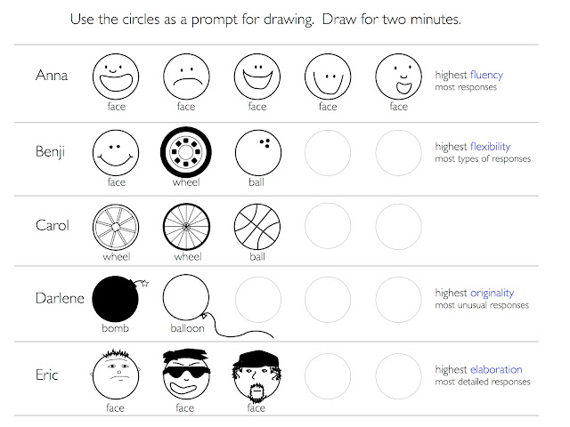
Simple illustrative example
Source: http://www.senseandsensation.com/2012/03/assessing-creativity.html
Notes:
Review your ideas
When we use brainstorming, we want to produce many different and original ideas whose potential value can be easily assessed.
In this way, we can get an indication of how creative we’ve been by looking at four measures:
Fluency
The amount of ideas produced.
Flexibility
The variety and/or diversity of those ideas (i.e. can the ideas be divided into many different categories).
Originality
The degree to which the ideas are unusual or unique.
Elaboration
The extent to which the ideas are detailed and clear (they are not abstract ideas with no view to application).
Note that there is no ‘right level’ of creativity to you need to reach. These measures are just provided as guidelines to help you (or your team) decide on whether you want to move onto the next step (where you will prioritise and select a few ideas for further development), or whether you want to try additional strategies to improve creativity.

Slide 42
Example

Slide 43
Example
High fluency (number of ideas)
Physical education lessons outdoors where possible
Geography lessons outdoors where possible
Biology lessons outdoors where possible
Art lessons outdoors where possible
PSHE lessons outdoors where possible
High flexibility (diversity of ideas)
Biodiversity corridors as school pedestrian routes
Outdoor classrooms
Increase access to nature-based extracurricular activities
High flexibility & originality (uniqueness of ideas)
Make access to nature a human right
Access to safe, cool and green spaces part of school assessment criteria
Outdoor learning and play a mandatory part of the curriculum
Notes:
The urban cool brief example showing three team members contributions and how their ideas demonstrate three different measures (elaboration has not been included here).

Slide 44
Example
Biology lessons outdoors where possible
Geography lessons outdoors where possible
Outdoor classrooms
Make access to nature a human right
Physical education lessons outdoors where possible
Alternative outdoor venues for school activities
Increase access to nature-based extracurricular activities
Biodiversity corridors as school pedestrian routes
Access to safe, cool and green spaces part of school assessment criteria
Could be improved on flexibility & originality (uniqueness of ideas)?
Notes:
If you’ve been working as a team or with others, there may be duplicated or similar ideas that can be grouped together.
Fluency (number of ideas)
Ask yourself, have you (or your team) come up with a large number of ideas? Preferably a minimum of 20 different ideas.
If not, think about your process. Have you (or your team) created a space that is free from criticism and judgement – a space that encourages all kinds of people to contribute ideas? And can you possibly invite others to join your brainstorming – preferably those with experiences and ways of thinking that differ from your own (or your team)?
Flexibility (diversity of ideas)
Ask yourself, how diverse are the ideas? In other words, can the ideas be divided into many different categories?
If not, have we looked at the point of possibility in different ways? And can we look at some of our existing ideas in different ways?
Originality (uniqueness of ideas)
Ask yourself, are the ideas unusual or unique? Both within your brainstorming group and in the world more widely?
If not, have we looked at the point of possibility in new ways? And can we look at some of our existing ideas in new ways?
Elaboration (clarity of ideas)
Ask yourself if the immediate potential of all the ideas are clear, or whether any of them need more detail or development?
Note, do not spend a large amount of time adding detail and developing each idea – just make sure the idea is not too abstract and its application is clear enough so it’s potential can be immediately considered.

Slide 45
Prioritising ideas
Activity 2: Step 3

Slide 46
Instructions
In this activity, you are asked to prioritise 3 ideas related to your chosen point of possibility. You may need more time to brainstorm and then reprioritise, so this is just a brief session to get you started!
Select the top three ideas, using the following criteria:
Desirability: The idea shows a solution that is wanted and needed. What is the idea that most excites those who will be benefiting from and interacting with the idea?
Viability: The idea can be delivered in the real-world with a business model to sustain it. What is the idea you can start to action immediately?
Feasibility: The idea is practical operationally, paying attention to how delivery impacts communities and the environment?
These criteria link to the criteria that will be used to select ideas for the RSA Spark showcase (see next slide).

Slide 47
How will ideas be selected?
Rigour:
Research has been undertaken to understand audience goal / need
Viability:
The idea can be delivered in the real-world with a business model to sustain it.
CHOSEN
IDEA
Desirability:
The idea has been tested and the feedback shows the proposed solution is wanted and needed
Feasibility:
Idea is practical operationally, paying attention to how delivery impacts communities and the environment
Learning Mindset:
Participant(s) demonstrate commitment to growing capabilities in themselves and others
Impact:
Idea has clear potential for doing more good for the economy, society and the environment

Slide 48
Example

Slide 49
Example
Viability
Make access to nature a human right
Access to safe, cool and green spaces part of school assessment criteria
Alternative outdoor venues for school activities currently indoors (e.g. classrooms, theatre productions)
Biodiversity corridors as school pedestrian routes
Increase access to nature-based extracurricular activities
Desirability
Feasibility

Slide 50
Testing ideas
Activity 2: Step 4

Slide 51
Instructions
In this activity, you are asked to plan who you’re going to target for feedback on your top three ideas.
Consider the following:
Who will be affected by the change this idea is proposing?
Who do you need to make this idea a reality?
Who do you have access to in your community?
Can you bring in non-human perspectives?

Slide 52
Next steps

Slide 53
Next steps
To prepare for the next workshop:
Reflect on the quality of your ideas and their potential for positive impact
If necessary, continue brainstorming to generate new ideas, using new approaches where useful (e.g. SCAMPER)
Share ideas for feedback
Further develop promising ideas using new approaches where useful (e.g. six hats)
Sign up for the workshop: 14th May
Test Your Impact
May 2025
Reminder: Idea submissions open on the 20th May

Slide 54
Assessing growth (survey 2)
Capability | Statement
Creativity | Dream big about what is possible.
Courage | Try new things, even when it's hard.
Collaboration | Work with others, even when it's hard.
Participants who attend the workshop and complete the workshop surveys will obtain an ‘Explorer’ digital badge

Slide 55
Optional activities

Slide 56
Adding and developing ideas
Try a different activities to:
Change the goal of a question or point of view
Add or expand on an initial idea
You can do these activities on your own or, if relevant, with your Spark team using different ideas.
We recommend 15-30 minutes for each activity.
Notes:
Weird, impossible, and impractical ideas often give way to truly inspired ones. You will need 15 minutes for this fun and optional activity. Ensure you’re comfortable and have materials like pens, paper, sticky notes, and anything you can write and draw with. You can do this activity on your own or, if relevant, with your Spark team.
Step 1: Prepare
Select an idea. We recommend developing an idea that someone else has selected as intriguing or promising – ideally a stakeholder or teammate. If you are doing the first activity, rephrase the idea as a question or POV.
For example, if the idea is ‘Biodiversity corridors as school pedestrian routes’ this can simply be changed to ‘HMW create biodiversity corridors as school pedestrian routes? Or you can make it broader - ‘HMW create ecologically thriving school pedestrian routes?’
Next, set a timer for 10 minutes
Step 2: Brainstorm
Use the SCAMPER prompts to come up with additional ideas. When you are ready, start the timer. Try come up with one idea per prompt, but if you get stuck, move on.
Guidance
Embrace the flow: Don’t judge your ideas while brainstorming and don’t overthink it. When a minute ends, move on to the next idea and try to make each idea as different as possible based on the prompts. The goal at this stage is to stretch your imagination. Even wild and seemingly impractical ideas are welcome!
Think visually: Use sketches or diagrams to quickly convey concepts.
Stay focused: Keep your mind on the challenge at hand and avoid distractions.
Have fun: Enjoy the process and let your imagination run wild.
Step 3: Review
Once the timer stops, take a few minutes to review your ideas.
Which one do you find most intriguing or promising to develop further?
Add a star to the grid to indicate your selected idea or ideas.
Step 4: Pause and reflect
Finally, reflect on this process. What did you learn from building on others’ ideas? Did you find it easier or harder than you expected? What are some of the benefits that could come from using an approach?

Slide 57
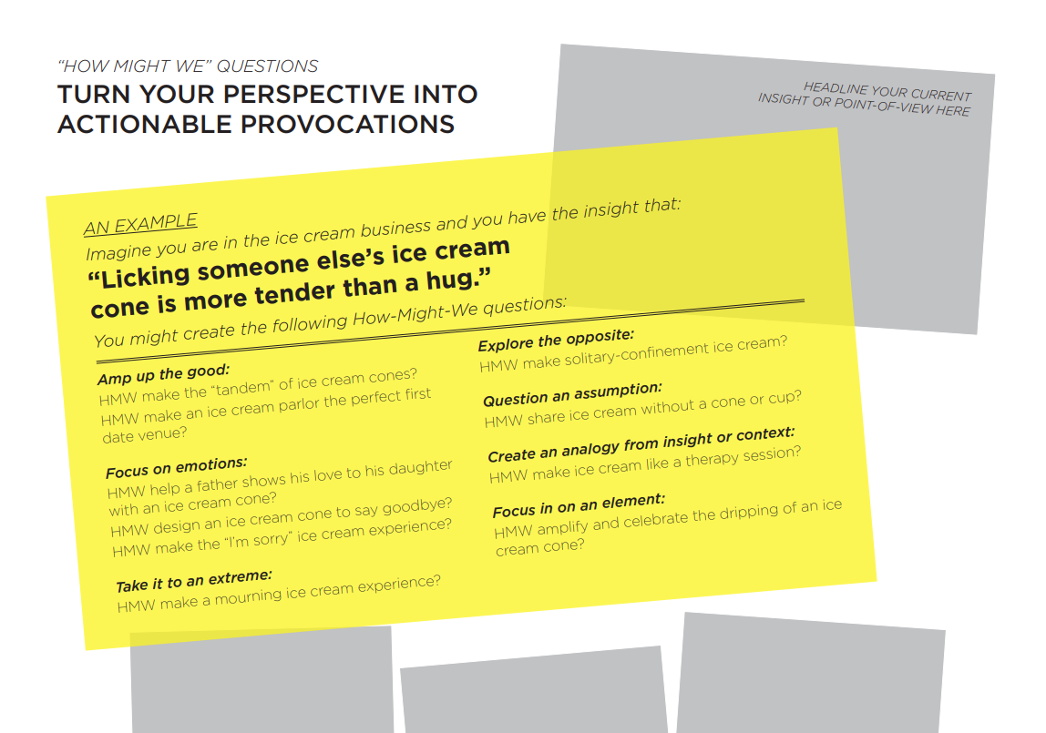
How Might We…
Activity to open up creativity and generating ideas by reframing a statement or point-of-view (POV).
Sources with worksheets and examples:
https://statics.teams.cdn.office.net/evergreen-assets/safelinks/1/atp-safelinks.html
https://dschool.stanford.edu/tools/how-might-we-questions
Additional prompts:
Amp up the good
Remove the bad
Explore the opposite
Question an assumption
Go after adjectives
ID unexpected resources
Create an analogy from need or context
Play against the challenge
Change a status quo
Break POV into pieces
Notes:
"How Might We" questions are a way to frame your ideation. They are often used for launching brainstorm sessions because they help you look at your idea in new ways.

Slide 58
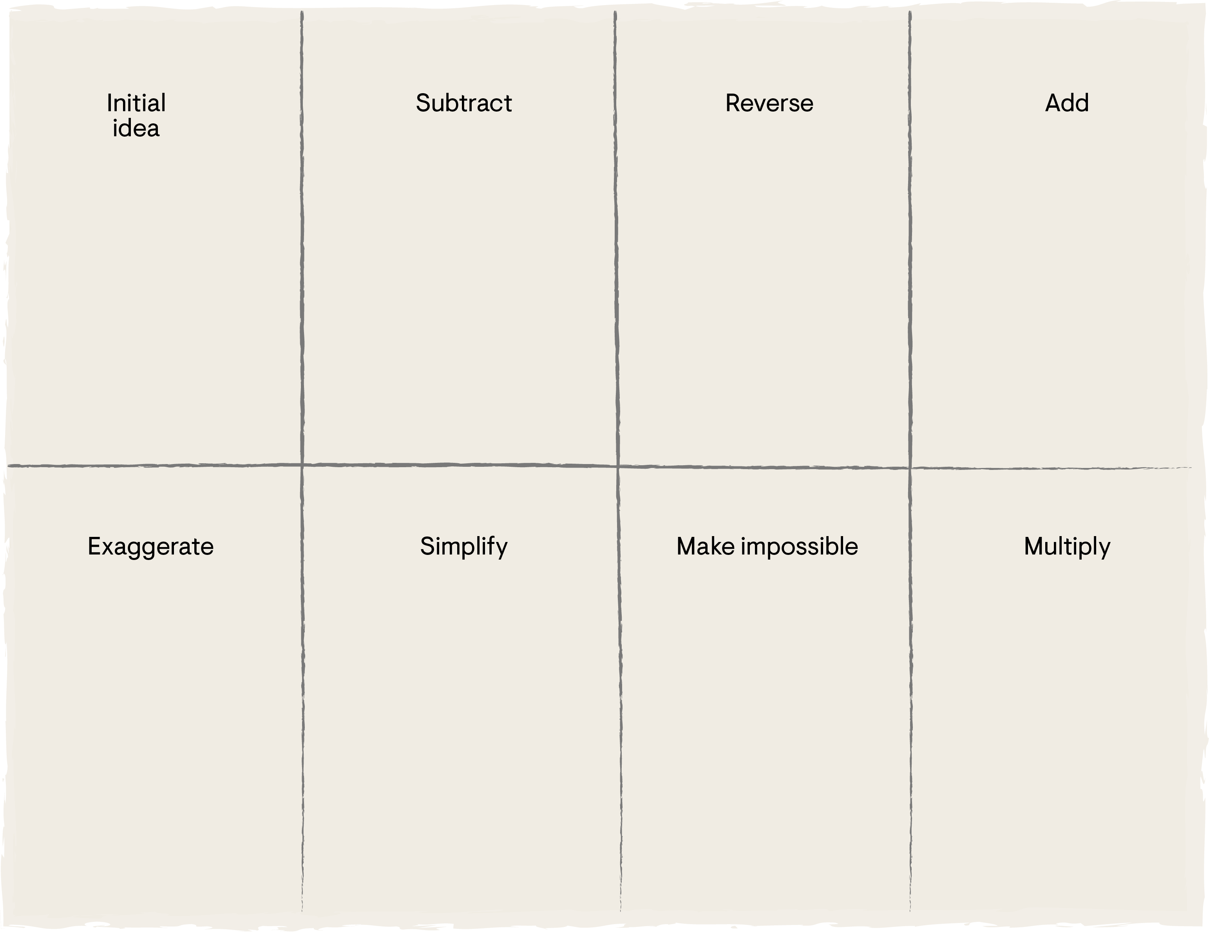
Crazy 8
Activity to generate and develop ideas
Instructions provided in the slide notes…
Notes:
Weird, impossible, and impractical ideas often give way to truly inspired ones. You will need 15 minutes for this fun and optional ‘crazy 8s’ activity. Ensure you’re comfortable and have materials like pens, paper, sticky notes, and anything you can write and draw with. You can do this activity on your own or, if relevant, with your Spark team.
Step 1: Prepare
Take a sheet of paper and fold it to create eight rectangular sections. If you’re using a digital tool, create a template with eight equal sections.
Next, add the following titles to each of the sections, as shown in the image below: initial idea, subtract, reverse, add, exaggerate, simplify, make impossible, and multiply.
Under the first section, we recommend developing an idea that someone else has selected as intriguing or promising – ideally a stakeholder or teammate.
Next, set a timer for 8 minutes
Step 2: Brainstorm
In this activity, you will focus on one section of your paper for 1 minute. First you will sketch or describe an idea related to your chosen challenge. This should be done in the first section of your paper (the section titled initial idea).
After you’ve spent 1 minute coming up with your initial idea, move to the next section, and so on.
Each of the following sections will ask you to do something different with your idea. First you will be asked to subtract or remove something from the idea. Then you are asked to reverse the idea (to create the opposite idea), add something to any of the ideas you’ve generated so far, exaggerate any of the ideas, simplify the idea (make the idea as simple as it can be), and then make the idea impossible. Finally, you are asked to try multiplying the different ideas together.
When you are ready, start the timer.
Guidance
Embrace the flow: Don’t judge your ideas while brainstorming and don’t overthink it. When a minute ends, move on to the next idea and try to make each idea as different as possible based on the prompts. The goal at this stage is to stretch your imagination. Even wild and seemingly impractical ideas are welcome!
Think visually: Use sketches or diagrams to quickly convey concepts.
Stay focused: Keep your mind on the challenge at hand and avoid distractions.
Have fun: Enjoy the process and let your imagination run wild.
Step 3: Review
Once the timer stops, take a few minutes to review your eight ideas.
Which one do you find most intriguing or promising to develop further?
Add a star to the grid to indicate your selected idea or ideas.
Step 4: Pause and reflect
Finally, reflect on this process. What did you learn from building on others’ ideas? Did you find it easier or harder than you expected? What are some of the benefits that could come from using an approach?

Slide 59
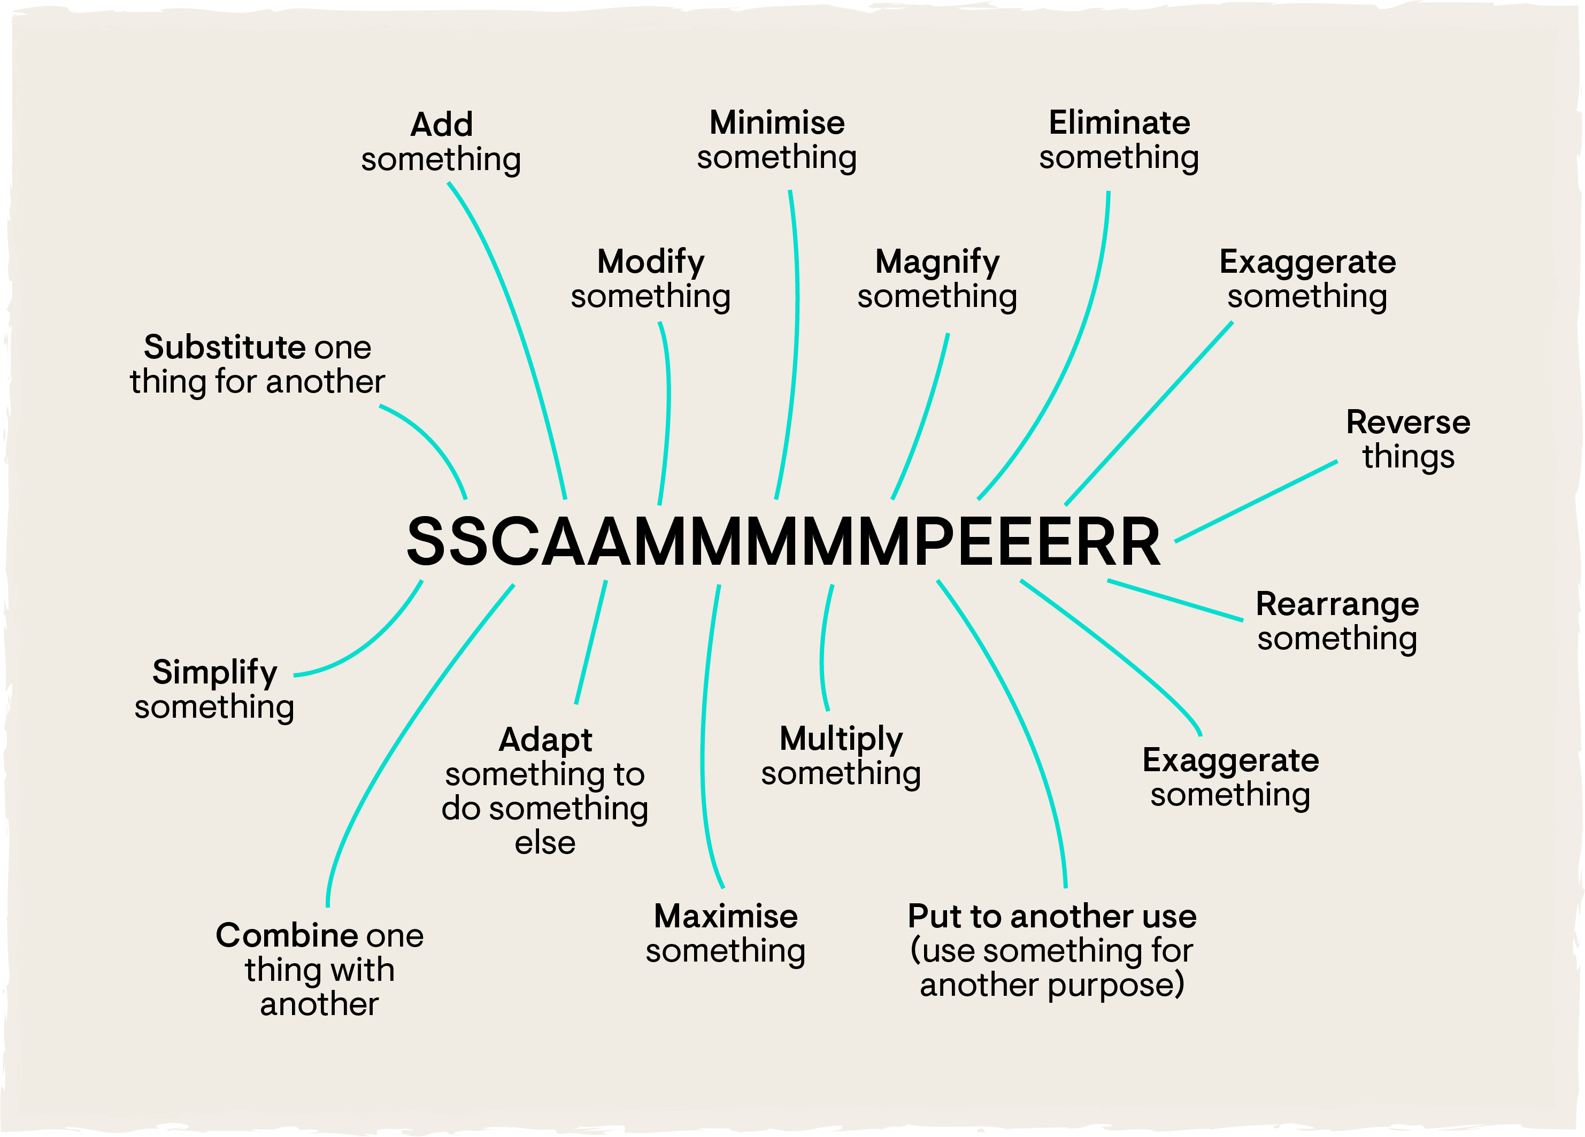
SCAMPER
Activity to generate and develop ideas
Instructions provided in the slide notes…
Notes:
SCAMPER (or SSCAAMMMMPEEERR)
SCAMPER is a checklist that can be used as question prompts to manipulate or develop ideas. The process is similar to the ‘crazy 8s’ activity. The approach starts with a particular idea being considered for elaboration, such as an existing or proposed product, process or intervention. Then each letter of the SCAMPER list is used to sequentially consider different ways to alter the idea. The 16-dimentions in an expanded SSCAAMMMMMPEEERR list are shown in the image.
For more information, read the 10-minute article ‘A Guide to the SCAMPER Technique for Design Thinking’ (Elmansy, 2015).

Slide 60
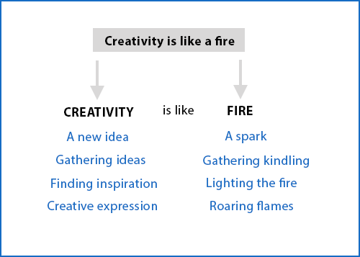
Analogy mapping
Activity to generate and develop ideas
Instructions provided in the slide notes…
Notes:
Analogy mapping
An analogy compares two things to make a point. Analogies can be useful for creativity in that they can help us to identify problems and solutions in one industry or area and apply them to another. This works by recognising the similarities between these industries or areas. For example, retail stores can be mapped to airports by looking at their parts: customers are to stores, as airplanes are to airports. With this in mind, strategies used by airports to control how airplanes move through the airport area can possibly be applied to stores controlling customer flow, and vice versa.
For a step-by-step guide, examine ‘Ideation based on analogies and association’ provided by This is Service Design Doing (Stickdorn et al., 2018). This is one of the 54 methods described in their free online library.

Slide 61
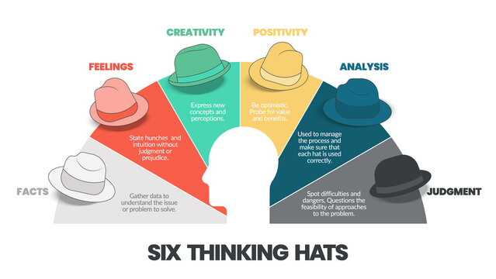
Six Thinking Hats
Activity to generate and develop ideas
Instructions provided in the slide notes…
‘Six Thinking Hats’ developed by Edward De Bono
Notes:
Six thinking hats is an approach that assigns six specific thinking functions and roles to different individuals or groups. Each of these thinking roles is identified with a colored symbolic “thinking hat” that people are asked to wear’ during a conversation, meeting or workshop.
The hats and their roles are as follows:
White hat (the facts hat): This role focuses on just the facts, on those that are available or are required.
Yellow hat (the optimism hat): This role focuses on the positives, on the strengths, the value and the benefits.
Black hat (the pessimism hat): This role focuses on the negatives, on the weaknesses, difficulties, problems and risks. This is essentially an ‘action’ hat. Although it points out the problems, its intent is to be cautious and work toward solutions.
Red hat (the feelings hat): This role focuses on feelings, hunches, first impressions and later views. The person ‘wearing’ this hat can express their emotions and feelings.
Green hat (the creativity hat): This role focuses on new concepts, perspectives, possibilities, alternatives and ideas.
Blue hat (the process hat): This role manages the process. It focuses on which hat is being worn, and which is required next.
Each of the hats act as a critical friend to further develop and improve on ideas.
Find a full explanation and resources at: https://www.debonogroup.com/services/core-programs/six-thinking-hats/

Slide 62
3-2-1 activity
Three things you learned
Two things you’re curious about
One thing you don’t understand (yet)

