Slide 1
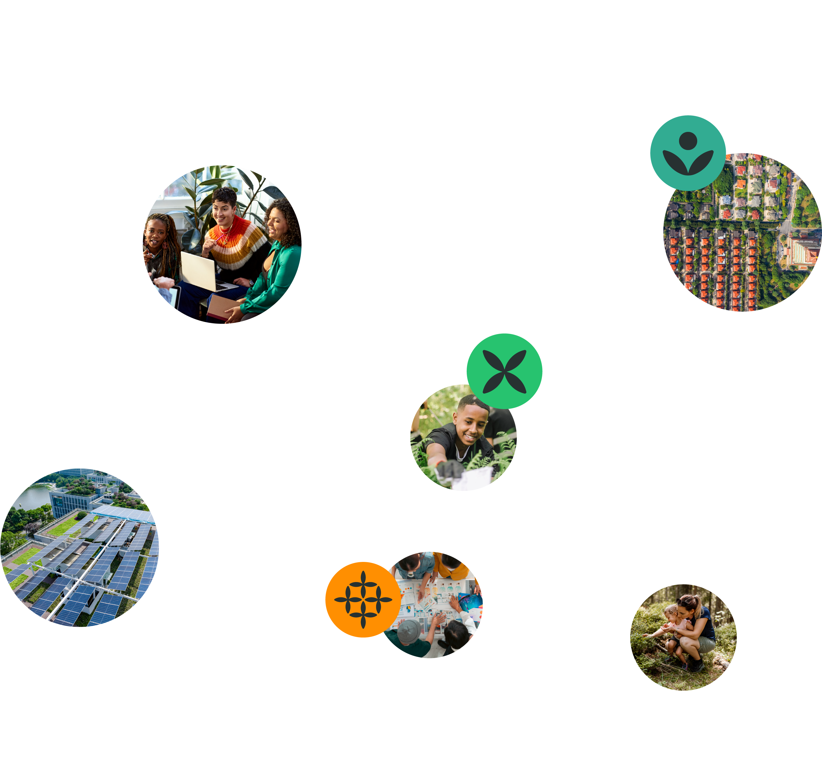
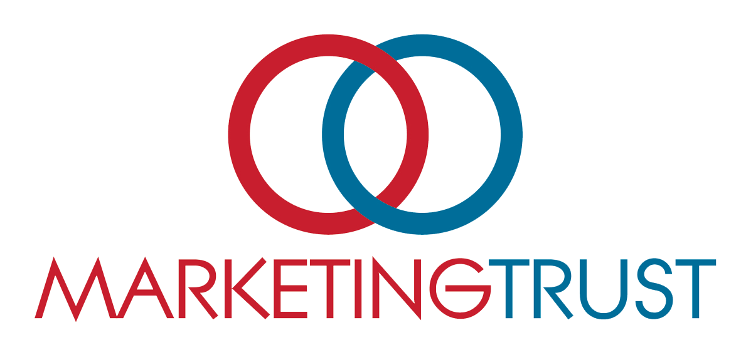
Explore Enterprise
Learning Workshop 5
28 May 2025

Slide 2
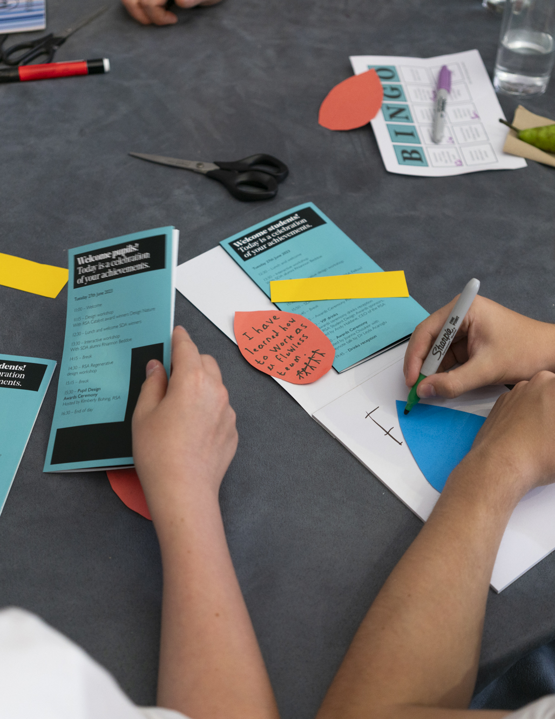
Agenda for session
Agenda for today’s session
Introduction
What is regenerative enterprise?
What does it mean to be a regenerative entrepreneur?
Achieving nested impact
Introduction to the Triple Layered Business Model Canvas
Linking profit to purpose
Planning: idea to implementation
Q&A
Notes:
You'll leave the session having explored: what elements make for a regenerative business, what it takes to be an entrepreneur, the different ways you can turn your idea into impact (enterprise has lots of possible definitions) and how to create a solid plan. All of this helps you answer against 3 of the RSA Spark selection criteria in the Submission Form: ‘Feasibility (could your idea work in the real-world beyond a prototype?), Viability (can your idea be financially, social & environmentally sustainable?) and Learning Mindset (what support would you need in the long term?)’

Slide 3
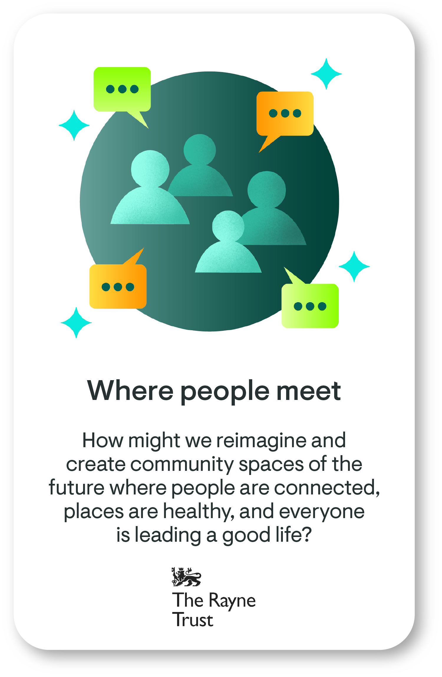
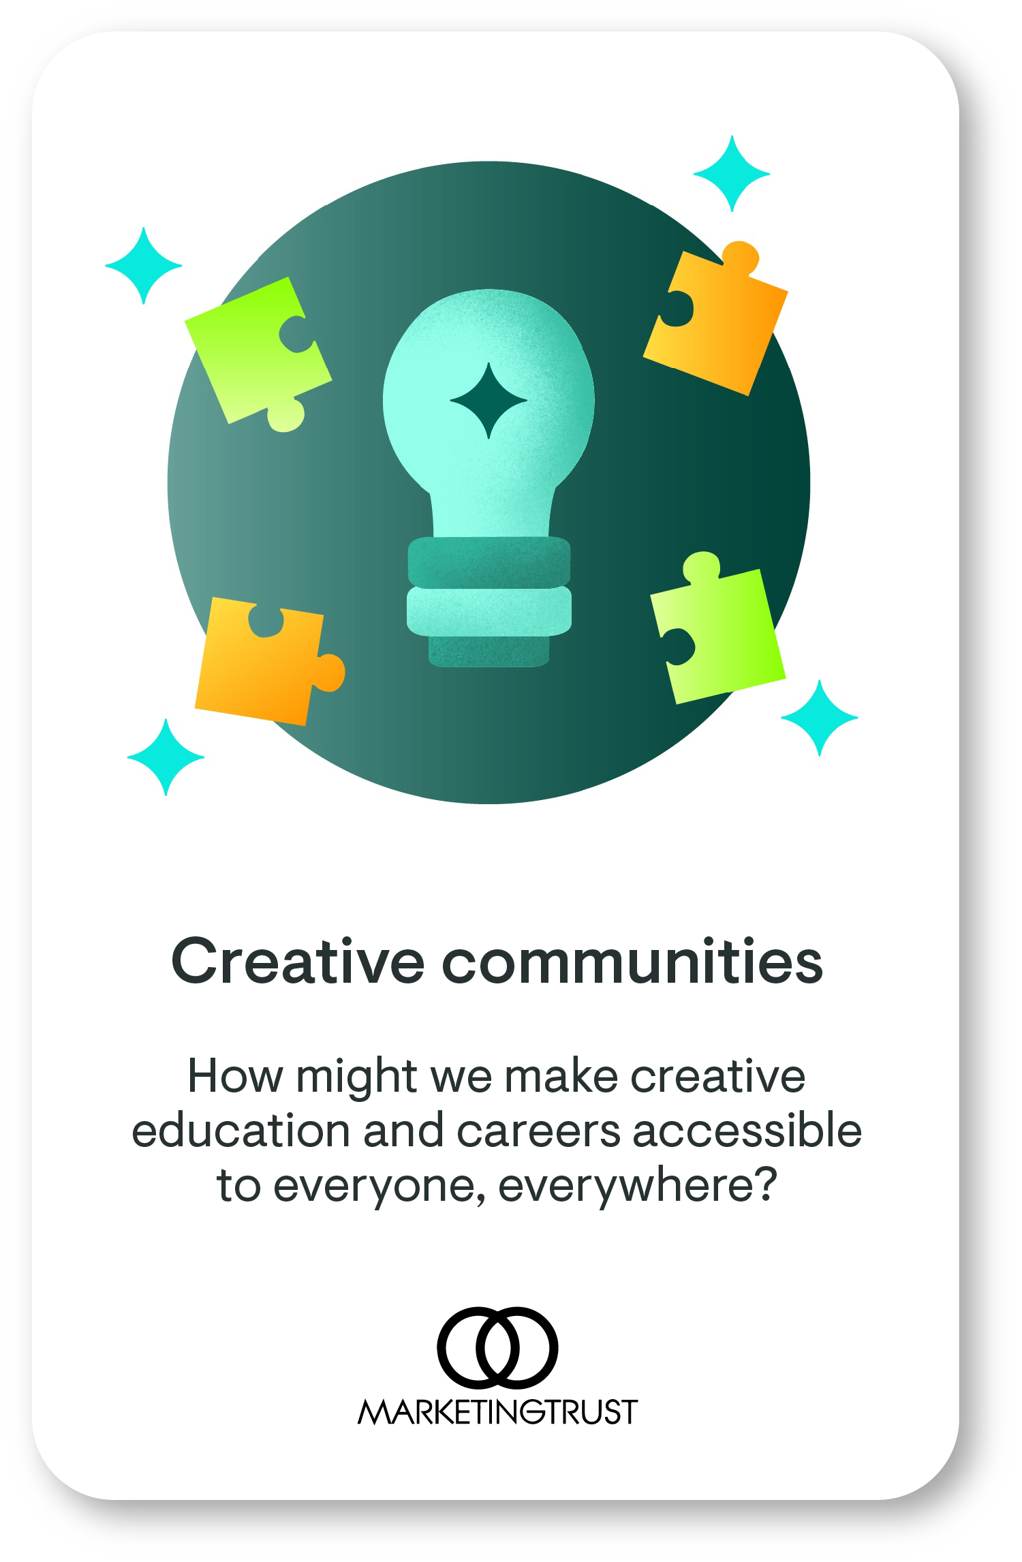
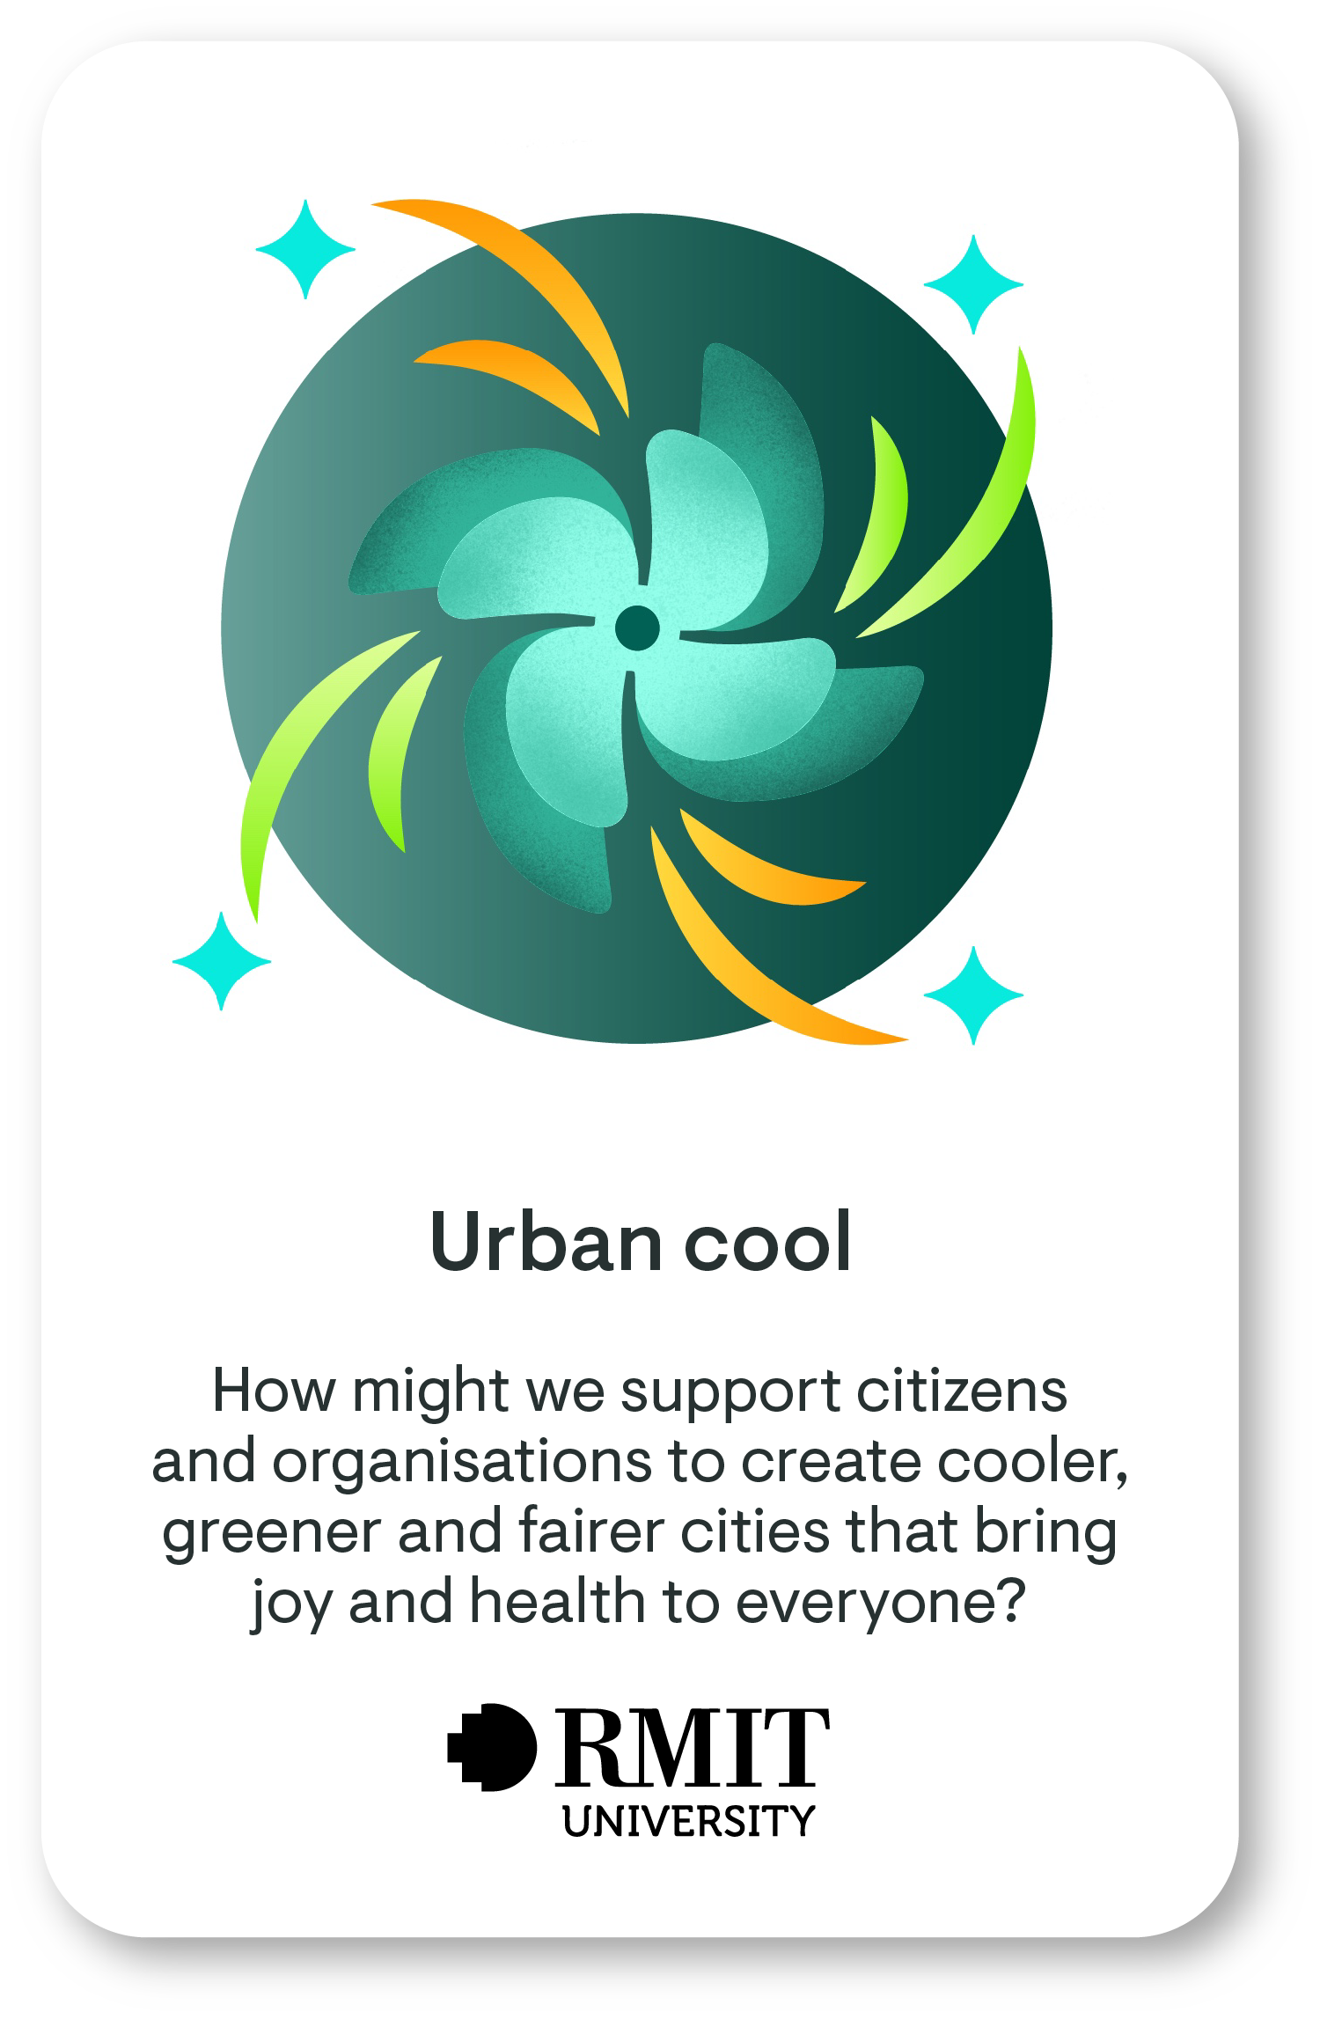
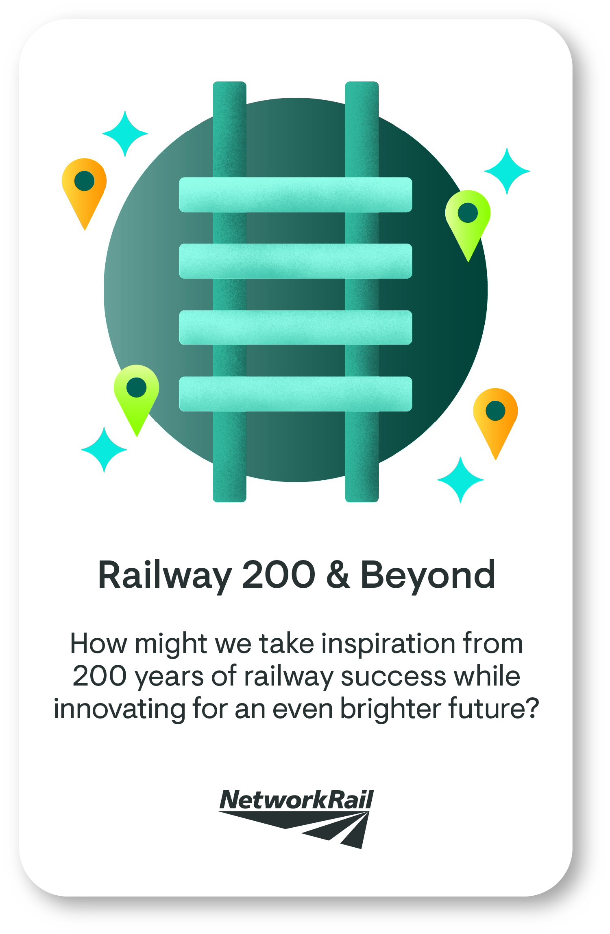
Our real-world briefs: where do we want to see impact and enterprises?
Notes:
Our brief partners are excited by the potential for ideas to turn into real-world impact projects. That is what the session is all about – bridging the gap from concept to delivery. For each brief, we will also be offering 2 places on the RSA Spark Entrepreneur Learning Journey. This is a 4-month online learning programme with your cohort and an experienced business founder mentoring you. You also get £1000 start up grant funding.

Slide 4
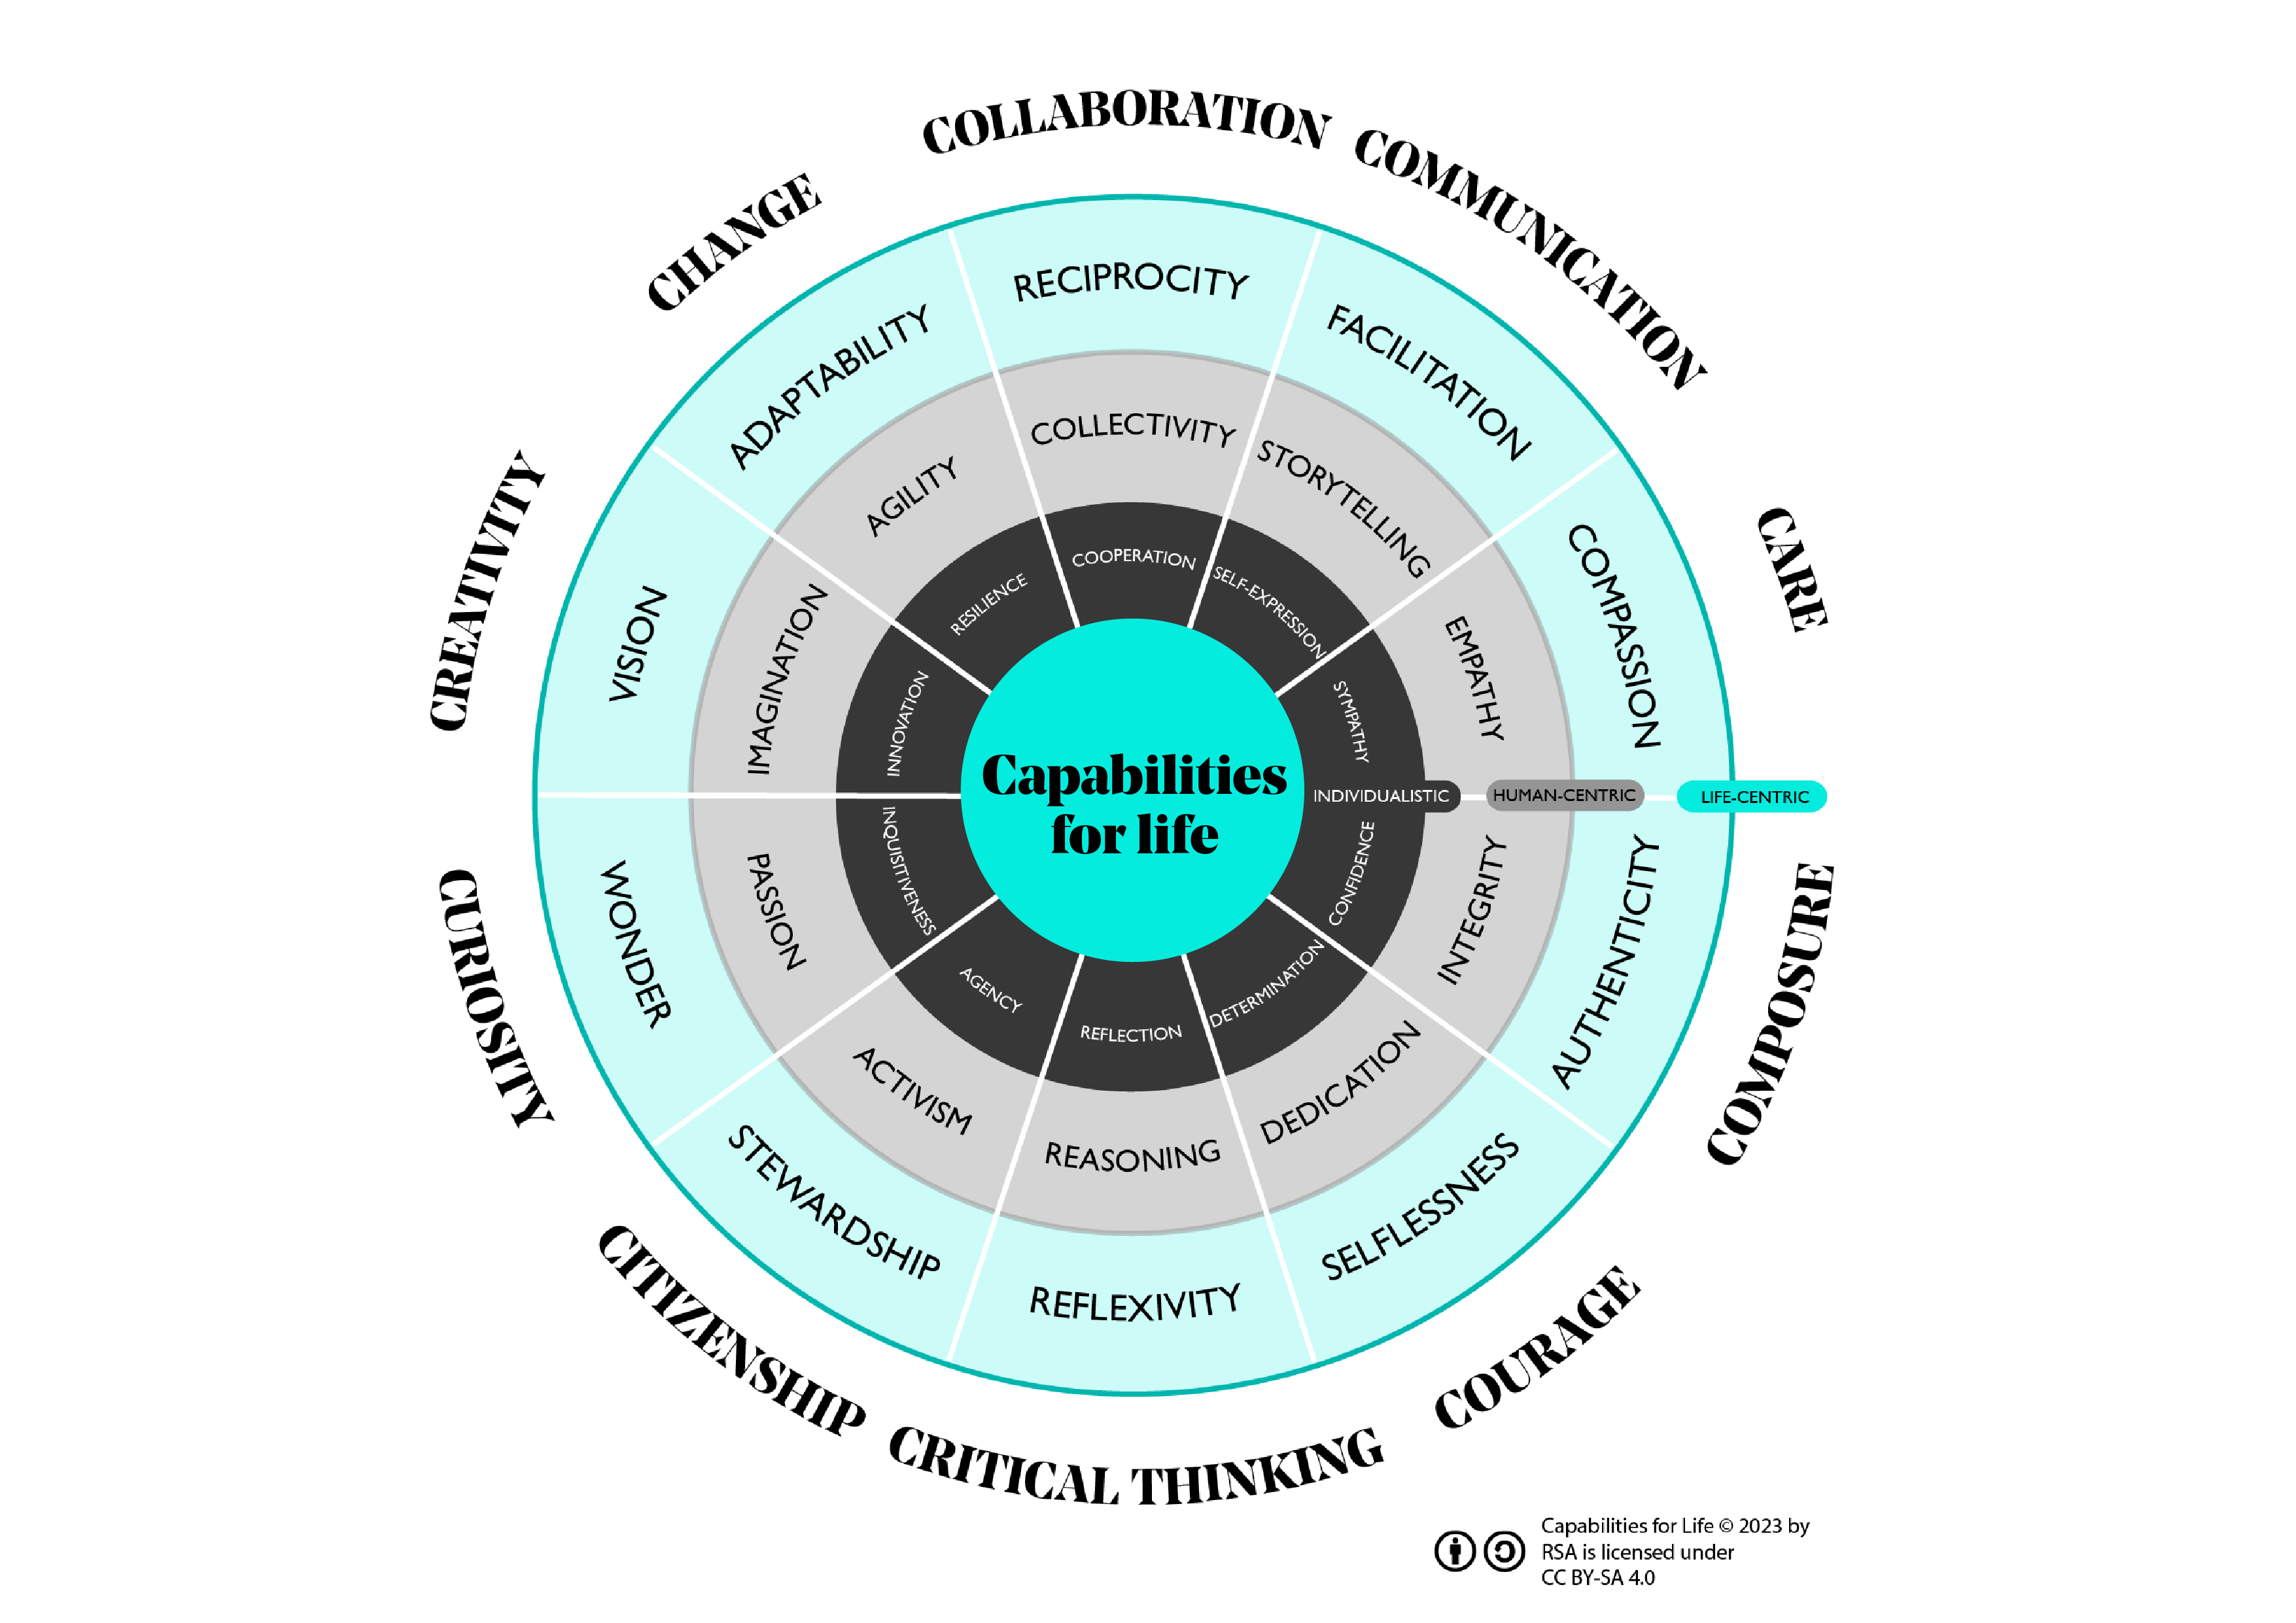
Notes:
In responding to an RSA Spark Brief, you have an opportunity to grow Capabilities for Life, 10 future-proof skills that are important when innovating in ways that positively impact people, places and planet. These capabilities were identified following extensive market review and speaking with over 50 industry experts, educators and regenerative practitioners as the core future-proof capabilities needed to do more good for people, places and planet.

Slide 5
What are the learning workshops on offer?
Discover your purpose
March 2025
Explore diverse perspectives
March 2025
Envision futures
April 2025
Test your impact
May 2025
Explore enterprise
May 2025
Connect with your strengths and with your energy for change as you reflect on the world as it is, the world as it needs to be, and the brief that you care most about.
Capabilities:​ Care, Citizenship, Composure
Shape your vision for change and a diversity of ideas that respond to your chosen brief, while carefully considering which ones are the most opportunistic.
Capabilities:​​ Creativity, Courage, Collaboration
Consider what and how you might test your most promising ideas and how they can have the greatest impact.
Capabilities:​​ Creativity, Change, Communication
Explore the business and economic viability of your idea while delivering positive social and environmental impact.
Capabilities:​​ Courage, Change, Composure
Explore with different points of possibility, thinking about who you should work with and what you can do to better understand the context of your chosen brief.
Capabilities:​​ Care, Curiosity, Critical Thinking
Notes:
In this final workshop of our 5-part series, we are focusing on tools to help you understand and plan for turning your idea into an enterprise. This includes exploring what it means to run a positive impact business and whether you personally feel ready to take on that challenge.

Slide 6
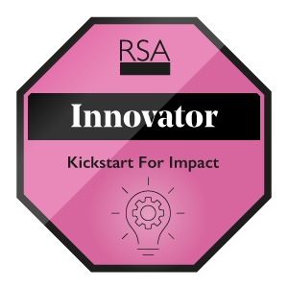
What are the digital badges on offer?
One or more workshops
(live attendance or watch back)
Submitting an idea
Submitting an idea as a team
Completing the entrepreneur's journey
Notes:
By participating in RSA Spark, you'll be celebrated with a digital badge which showcases your growing capabilities and innovation skills. Digital badges are awarded to everyone who joins a learning workshop (Explorer Badge) and submits their idea (Practitioner and Collaborator Badges). A handful of learners will be selected for an entrepreneurship learning journey later in the year to further develop their ideas and these participants can earn an additional Innovator badge.
Digital badges enable you to demonstrate interest in a subject and commitment to your learning, and are used to support CVs and ePortfolios. You can show your digital badges to others by sharing them on social media or in your CV should you wish to make them public.

Slide 7
Explorer badges for each workshop
Workshop 1
Workshop 2
Workshop 3
Workshop 4
Workshop 5
Claim your badge!
Claim your badge!
Claim your badge!
Claim your badge!
Claim your badge!
From 1 June
Notes:
Students can get an Explorer digital badge for participating in any of the workshops. This can be through live participation (as you are doing now), or by watching the workshop on playback via Vimeo. To earn a badge, you need to complete both the pre and post workshop surveys, regardless of whether you participate in a live workshop or watch one online. Each workshop has a badge you can earn that recognises the capabilities you’ve developed.
The badges are intended for learners, but we ask all workshop attendees to submit the surveys as they provide important information for the Spark team – so we can learn how to make these resources as useful as possible for educators and students!

Slide 8
Explore Enterprise
Learning Workshop 5

Slide 9
Laying foundations (survey 1)
To chart a course forward, you must first know where you stand
Capability | Statement
Critical Thinking | I can assess different options and select the best for myself and my community.
Courage | I can overcome my worries to step up for actioning something I strongly believe in.
Composure | I have the confidence to plan and take the next step.
Participants who attend the workshop and complete the workshop surveys will obtain an ‘Explorer’ digital badge
Notes:
There are so many capabilities that help you start up and run an impact project. We picked critical thinking, courage and composure because our focus in this session is to help you understand whether turning your idea into a project is the right option. [Please complete via the link provided]

Slide 10
Starting point
At this stage, you have:
conducted some research on your brief
considered different human and non-human perspectives
created and narrowed in on a ‘point of possibility’ (PoP) question
generated and prioritised ideas in line with your brief
prototyped or tested how feasible, viable and desirable these ideas are, working with your audience and stakeholders
…what next?
Notes:
From the other workshops and your own research, you have likely come up with, and to a certain extent tested, a possible innovation. You’ve maybe seen it work at a small scale or gotten early positive feedback.

Slide 11
Next steps
Understand what regenerative entrepreneurship is and how it can be as an alternative career path
Explore your own readiness, interest and capacity to take the next step into entrepreneurship.
Assess the viability of your idea as an impact enterprise. See if your idea can work as a long-lasting impact business social business.
Make a plan for sustaining your idea – whether as a business or not.

Slide 12
What is regenerative business?

Slide 13
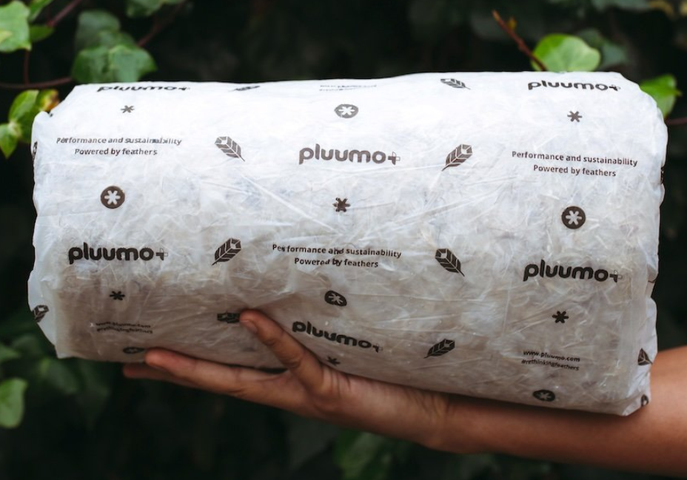
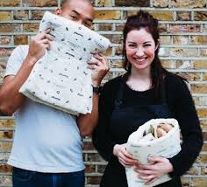
Meet alumni business
2016 Brief: One Man's Waste
Pluumo+ by Elena Dieckmann and Ryan Robinson, Royal College of Art and Imperial College London
PluumoPlus is the world’s first thermal packaging solution created from recycled feathers. This pioneering company, headquartered in London, UK is leading the way in sustainable packaging underpinned by circular economy principles.‘Pluumo’ has gone on to raise over £1m ​in grants and investment.
Design a way to help eliminate the concept of waste by promoting value as a material resource?
with
Notes:
Hear about how Elena and Ryan went about turning their student project idea into a regenerative business:
https://youtu.be/bcF7cVYCBiU?t=3790
Also learn more at https://www.pluumoplus.com/

Slide 14
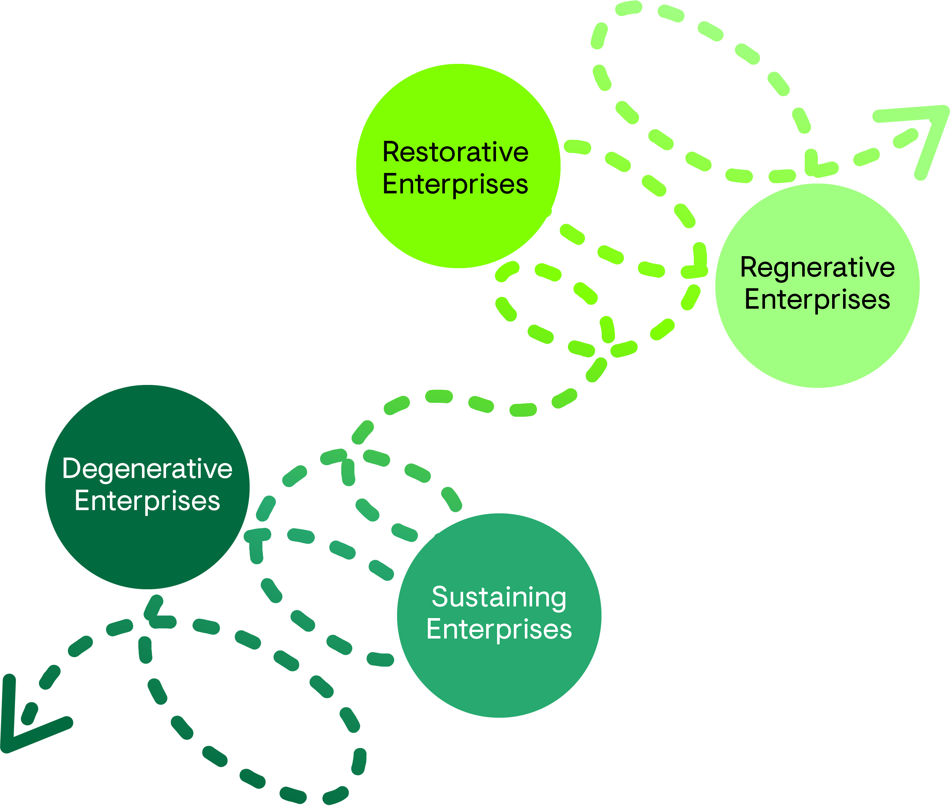
The Vitality Scale
A framework for evaluating business practices
Find out more: https://www.thersa.org/articles/blog/a-vitality-scale-towards-a-regenerative-world/
Notes:
This Vitality Scale (mentioned in workshop 4 when looking at the impact of any ideas) is a framework developed by the RSA and built on the work of Bill Reed at the Regenesis Group, Carol Sanford & Ben Haggards’ Level of Paradigm and others. Businesses, government projects and even individuals may be operating at different levels of this scale for different things e.g. a corner shop might pay their workers a fair living wage but wrap all their products in single use plastic. Let’s explore what each level might look like.

Slide 15
The Vitality Scale
Financial profit as the end, at the expense of social and environmental health.
Notes:
These businesses harm the environment and society. They take resources without giving back, causing long-term damage.
This might include companies with extractive employment practices (e.g. chocolate suppliers who do not properly protect against child labour) or use of natural resources (oil companies who don’t invest in essential safety features leading to loss of wildlife)

Slide 16
The Vitality Scale
Financial profit as the main goal, whilst minimising harmful impact on environment and society.
Notes:
These businesses aim to minimise harm or have a ‘net-zero’ impact. They might focus on addressing problems that exist now but do not aim to have a long-term solution.
This could be companies trying to offset the harm they do in one area with positive works in another (e.g. carbon offsetting that airline companies do by planting trees). It could also be social businesses who are focused on meeting immediate needs (e.g. food banks – they aren’t solving the underlying problem of food poverty but are obviously supporting people with a very real challenge).

Slide 17
The Vitality Scale
Social and ecological restoration as the goal, enabled by financial profits
Notes:
These businesses help repair damage that’s already been done, restoring the health of ecosystems and communities.
Here companies go beyond ‘do no harm’ to active healing. This might be a farm that switches the crops it grows to ones that are better for the local soil and water supply, and introduces re-wilded areas of land that support local biodiversity.

Slide 18
The Vitality Scale
Conditions for long-term social and environmental replenishing as the main aim, with economic prosperity as the means.
Notes:
These businesses actively enhance the systems they interact with, creating positive ripple effects across economy, ecology and society.
Here there are examples of business practices and models that aim to achieve a net positive across all 3 systems. For example, a bioengineering fashion brand that uses bacteria to grow materials for shoes, and employs people in the local area to boost job opportunities, whilst also advocating for a global move to sustainable fashion.

Slide 19
Understanding the Vitality Scale
Activity 1
Part 1
Part 2 (optional) – based on your research
Notes:
For each case study, select a category (degenerative, sustaining, restoring or regenerative) and explain your thinking
You are also encouraged to reflect on the following questions:
What strategies did this business use to have an impact (positive or negative)?
How did they balance profit with social and environmental goals to remain financially successful?

Slide 20
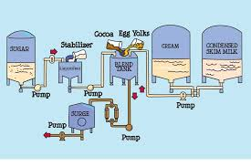
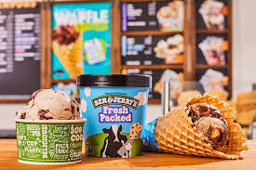
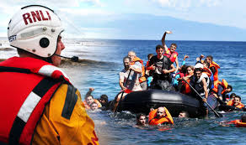
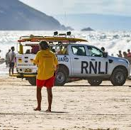
Part 1: Place these case studies on the Vitality Scale (1/2)
[Answers discussed in the workshop]
1. BEN & JERRY’S
Ben & Jerry's make ice-cream using fair trade ingredients and dairy that is sourced from local farms close to their factories. They have a history of social and environmental advocacy and have initiatives promoting regenerative farming practices within their supply chain.
UK charity Royal National Lifeboat Institution (RNLI) provide water search & rescue services. According to their 2020 financial statements, RNLI spent £28.6m on promotional materials and £30.3m on core activities. In 2021, they were criticised for providing funding to organisations educating migrants attempting to cross the English Channel illegally.
2. RNLI
Notes:
For each case study, select a category (degenerative, sustaining, restoring or regenerative) and explain your thinking
You are also encouraged to reflect on the following questions:
What strategies did this business use to have an impact (positive or negative)?
How did they balance profit with social and environmental goals to remain financially successful?
You can find more information at these links:
https://www.benjerry.com/about-us/b-corp
https://rnli.org/footer/faqs/our-work-in-the-channel-faqs

Slide 21
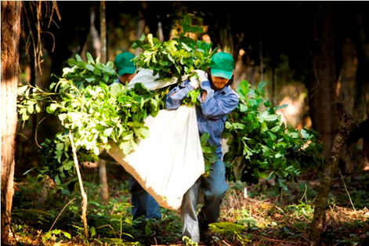
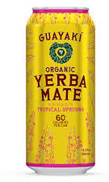
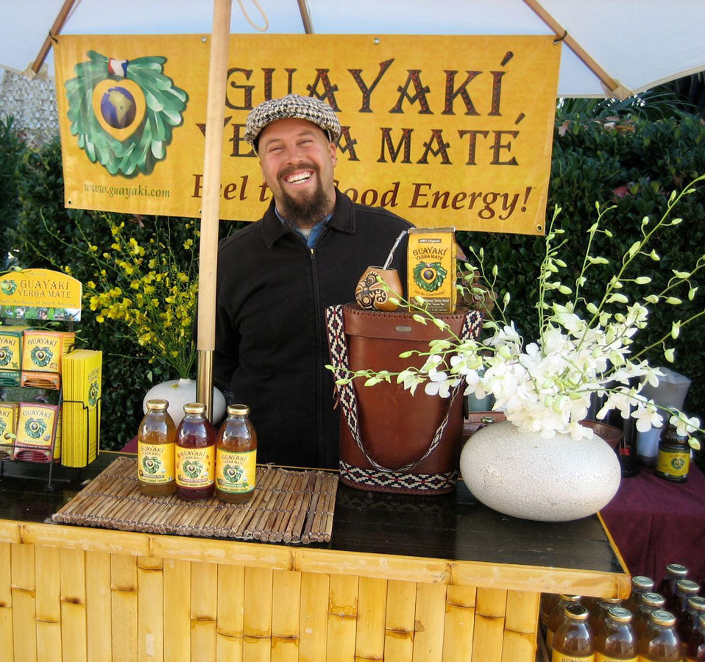
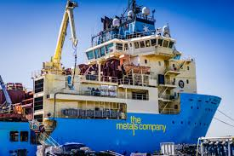
Part 1: Place these case studies on the Vitality Scale (2/2)
[Answers discussed in the workshop]
3. GUAYAKI
Guayaki look to support the livelihoods and well-being of their producers, the communities where they work, and their customers. Focus areas include human rights, livelihoods and well-being, justice, equity, diversity, inclusion, product quality, health, nutrition and working conditions, health and safety.
The Metals Company is developing the world’s largest estimated resource of metals required for electric vehicles and low-carbon energy. They are mining natural materials that lie on the bottom of the ocean floor using machine labour.
4. THE METALS COMPANY
Notes:
For each case study, select a category (degenerative, sustaining, restoring or regenerative) and explain your thinking
You are also encouraged to reflect on the following questions:
What strategies did this business use to have an impact (positive or negative)?
How did they balance profit with social and environmental goals to remain financially successful?
Additional links:
https://guayaki.com/ and https://www.forbes.com/sites/christophermarquis/2024/10/07/beyond-sustainability-guayaks-regenerative-approach-to-business/
https://metals.co/ and https://www.greenpeace.org.uk/challenges/deep-sea-mining

Slide 22
Part 2: Add your own examples to the Vitality Scale
[Optional]
Research enterprises that relate to your selected mission idea and plot them on the Vitality Scale. For example, if your idea is to offer biodiversity corridors to school children, you may want to look at other businesses who provide biodiversity services, or those who work with children and nature in other ways.
The goal is to understand how these enterprises impact society, the environment, and the economy.
Notes:
You can use the research you did earlier (maybe during workshops 2 & 3), refer to examples given in your Brief toolkit, or even dive deeper into your own research.

Slide 23
Activity 1: Add your answers to the Vitality Scale
Part 1 and 2
Notes:
Put the company logos on the scale alongside where you feel they fit.
You can add them more than once, if you feel different elements of their business practice correspond with different parts of the scale. Feel free to add comments to explain your answer.
Also add logos of any additional companies you find through your own research.

Slide 24
What it means to be a regenerative entrepreneur
Notes:
Entrepreneurship isn’t just about starting a business—it’s about having the courage to bring your ideas to life, learning how to adapt, and being committed to creating positive change in the world. In this section, we’ll explore the mindset, qualities, and skills needed to be an entrepreneur, especially if you want to build a venture that doesn’t just make a profit but also helps people and the planet.

Slide 25
Different ways of starting an enterprise
Business
Social Enterprise
Charity
Voluntary project or campaign
Cooperative
What examples do you know of enterprises that fit in these different categories?
How regenerative would you say they are?
Notes:
There are many ways that you could choose to keep your idea going. Do you instinctively feel that some options are more regenerative? In fact, all of these are types of enterprises and all of these can be degenerative or regenerative or anything in between.
As shown on the right side of the image, you might prefer to keep your idea running as a volunteering or campaigning activity or go through the process of setting it up as a charity. At the other end, you might you want to explore a more commercial set-up. There are lots of legal forms that your idea could adopt – in the UK we have ‘Community Interest Companies - CICs’, or ‘Charitable Incorporated Organisations - CIOs’. There are ‘benefits companies’ in the US… distinct to the rise of the B-Corp movement which is more of a kitemark. You might also want to explore co-operatives as a structure, with the Co-op and John Lewis in the UK being well-known examples.

Slide 26
Different ways of starting an enterprise
To decide on a path forward, you might want to think about:
Is this something I want to do for the long-term?
How could I get the money I need? (Something we’ll explore in the next section)
What option(s) am I drawn to and why? What are the benefits and what worries me?
What would it look like if I tried one of the other options?
What do I not know about this and how could I learn more?
Notes:
Before settling on starting a regenerative business, it’s worth exploring the range of approaches available and what each might entail.
For example, you may want to investigate questions like:
What’s the difference between a cooperative and a traditional business?
What are the steps to start a charity in my country, and how do charitable requirements differ from those of social enterprises?
What are the pros and cons of various legal structures, such as sole trader or community interest companies, and what’s required in terms of funding, governance, and compliance?

Slide 27
Exploring entrepreneurial identity
There is no set definition of an entrepreneur – and they can come from all sorts of different backgrounds, sectors and life experiences. You can however learn from others, so let’s explore entrepreneurial traits that resonate with you.
Step 1: Identify an entrepreneur
What makes this person stand out? What qualities or behaviours make them successful?
Step 2: Map their journey
Write a brief description of what this entrepreneur faced and achieved. How did they navigate challenges and stay committed? Focus on specific attributes they displayed.
Step 3: Reflect on the activity
Answer the following reflection questions:
• How has your view of entrepreneurship changed after exploring these identities?
• Do you see yourself as a potential entrepreneur now? Why or why not?
Notes:
Reflect on an entrepreneur you admire. This can be someone you know personally, someone from the case studies you’ve reviewed, or a well-known entrepreneur you follow.
You can do this with more than one entrepreneur and/or share your thoughts with others to compare notes.

Slide 28
Mapping your entrepreneurial identity
What are my top three strengths that will help me as an entrepreneur?
What challenges do I need to address to move forward?
How might I use my strengths to overcome these challenges?
What support or resources could help me with my challenges? How could I go about getting this?
How could I build the courage to tackle the challenges or constraints that I might face on my entrepreneurial journey?

Slide 29
Mapping impact

Slide 30
Nested system framework
Environment
Environmental impact includes how your idea impacts air quality, water quality, waste, energy, biodiversity, land and physical assets, etc.
Societal impact includes impact on people health and wellbeing, their social connections, their sense of safety, housing, education, etc.
Economic impact includes impact on people's wages and living expenses, on the availability of jobs, which industries grow etc.
Society
Economy
Notes:
Next let’s revisit the nested systems framework we explored in the last workshop to see how we can use relationships and flows between systems to build regenerative enterprises.
Remember this framework was used to support you in thinking about impacts on environment, society and economy. In the last workshop you were asked to map how your idea affects all of these ‘layers’, and for each layer, is you idea doing more harm, less harm, undoing harm, or doing more good? If it's not already doing more good, how might you evolve it to do more good?
Consider the different relationships and flows within and between these layers. What are they and what value do they have for your key stakeholders and audiences?

Slide 31
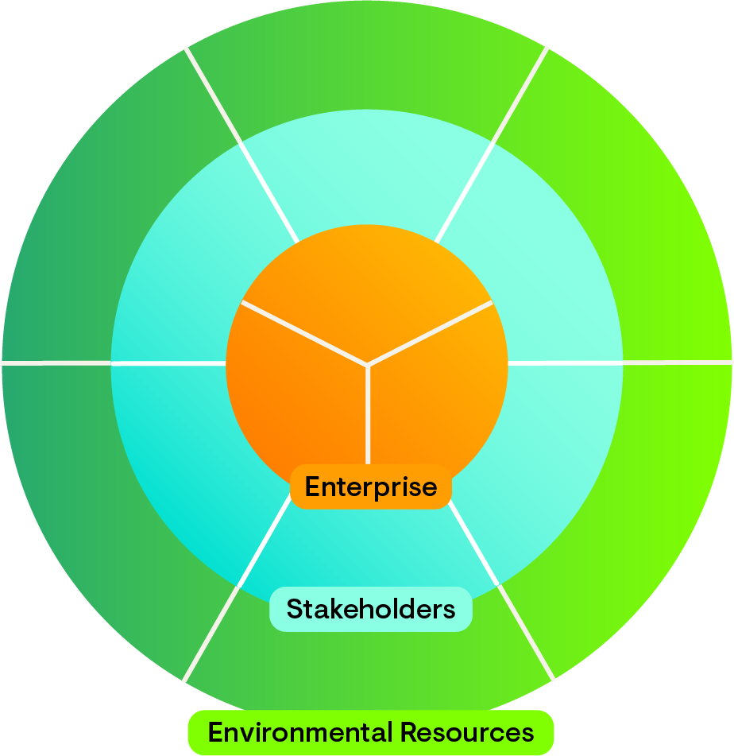
Nested system framework: enterprise perspective
Air
The state
Environmental resources include air, water, energy, land, waste and emissions, land and physical assets.
Stakeholders include communities, employees, owner(s), customers and suppliers.
Enterprise considerations include costs, revenue and surplus.
Energy
Nature
Customers
Owner(s)
Surplus
Revenue
Cost
Suppliers
Employees
Waste / emissions
Water
Communities
Land and physical assets
Notes:
We can use a similar framework to help us think about our regenerative enterprise. We call this the nested impact compass and it helps you understand the following:
What are the flows / relationship of finance, goods and services between each layer?
Are these taking from or adding to each layer / or both?
What is the overall impact of your enterprise on that layer?
Doing more harm,
doing less harm,
undoing harm,
or doing more good?
How might you reimagine your enterprises’ relationships and flows to do more good to the layers?

Slide 32
Example

Slide 33
Notes:
Let’s revisit the example we discussed in the last few workshops. Remember the example was a team looking at the urban cool brief and asking how might they support communities to create cooler, greener and fairer cities in response to climate change. They decided to prototype an idea around biodiversity corridors as school pedestrian routes.

Slide 34
For your idea, what are the relationships and flows between each layer? And are these relationships/ flows taking from or adding to these layers?
 | Taking From | Adding to
Environmental resources | Additional water required to keep new plants and wildlife healthy Risk of introducing species that harm indigenous wildlife | More natural habitats along corridors More pollinators and food for local plants and wildlife Cleaner air in the local area More nutrients in the soil
Stakeholders | Kids who don’t live within walking distance miss out on the experience and get socially isolated from peers | New connections formed between parents, kids and volunteers who maintain gardens New gardening skills developed in volunteers
Enterprise | Local shops who were on the old walking route get less footfall and have reduced profit School funding used to pay for this means less money for other activities | More revenue for local garden stores Volunteers can perhaps better access employment opportunities with their new skills
Notes:
Recall that the:
- PoP: How might we ensure that every child in Bristol has access to safe, cool and green spaces that improve their mental well-being and social interaction?
- Idea: Biodiversity corridors as school pedestrian routes
Using the nested impact compass, we can document these relationships and flows. This table just shows this at a very high level, but you could break it down even further to describe individual relationships between environmental resources and specific stakeholders and your enterprise.
You can use this to think about your desired impact (that you will likely want to capture and report on) and unintended consequences (positive and negative) that you may want to keep an eye on or re-design around. E.g. could the walking route have plant labels that also promote local businesses?

Slide 35
The Triple Layer Business Model Canvas

Slide 36
Triple Layer Business Model Canvas
A tool to help plan your regenerative enterprise
Source:
Joyce, A.; Paquin, R. & Pigneur, Y. (2015): The triple layered business model canvas: a tool to design more sustainable business models
Notes:
The Triple Layer Business Model Canvas (TLBMC) builds on the traditional elements of a business model - customers, revenue, and value proposition - by adding layers that focus on social and ecological impact. This holistic framework provides a structured approach to examine how every part of your business can be aligned with regenerative principles.
The framework explores three integrated layers:
Economic layer: Who are your customers, and how will you deliver value to them while remaining financially sustainable?
Environmental layer: What ecological impact does your business have, and how can it contribute to environmental sustainability and regeneration?
Social layer: How does your business affect society, and how can it build social equity and positive relationships with stakeholders?

Slide 37
Example
Notes:
Let’s look at a worked through example

Slide 38
Coffee machine manufacturers
Marketing
Production & new product development
Logistics
High end restaurant quality espresso at home
Membership club
Office market (business to business – B2B)
Households (business to customer – B2C)
Distribution channels
Patent on system
Brand
Production plants
Website & mail order
Branded boutiques
Call center
Retail (machine only)
Marketing
Raw materials & manufacturing
Distribution & channels
Main: capsules
Other: machines & accessories
Notes:
You can read more about the specifics of this scenario here: https://www.academia.edu/12914336/The_triple_layered_business_model_canvas_a_tool_to_design_more_sustainable_business_models
This will help you critically assess the data behind the numbers and evidence behind any impact claims.

Slide 39
Capsule production (and materials) 13.3%
Coffee preparation
12%
40ml of espresso coffee once daily multiplied by number of consumers over 1 year period
Capsule recycling -2%
Machine use (and production) 27%
Also:
Cup washing
Cup & machine production
Energy for process
Water for process
Coffee farming 25%
Aluminium for capsules 6%
Favouring trains 4.6%
Packaging 3.6%
1/3 carbon footprint from coffee farming
¼ of carbon footprint from use phase
Almost ½ carbon footprint from industrial production
20.7% of carbon footprint savings from 2008 to 2012 with machine redesign

Slide 40
62,000 farmers (84% of production participates in the AAA Sustainable farming program developed in partnership with the Rainforest Alliance)
Autonomous business unit
Multinational public company
Offering world leading nutrition, health and wellness through food and beverages
Improving the quality of life of the supply chain stakeholders in developing countries
Culture of:
individuality with single servings
responsibility through programmes
hosting friends
Caffeine boost
Warmth
Taste
Employee wellness programme
Health & safety measures
60 countries across the world with over 320 storefronts
Education & micro-credit services for supply chain
Potential caffeine dependency
Little nutritional value
Personal and professional growth for supply chain
Transparency from reporting

Slide 41
The template
Activity 2
Notes:
Complete the following slides for your own idea.

Slide 42
Triple Layer Business Model Canvas: Economic
PARTNERS | ACTIVITIES | VALUE PROPOSITION | CUSTOMER RELATIONSHIPS | CUSTOMER SEGMENTS
 | RESOURCES |  | CHANNELS
COSTS |  |  | REVENUE
Notes:
First let’s explore the economic layer. This is based on the standard ‘Business Model Canvas’ and asks you to consider key factors that will make your business financially viable.
This includes:
Customer segments: Who are your customers, and how can your business address their needs sustainably?
Value proposition: What unique value does your product or service offer, and how does it contribute to long-term wellbeing for your customers and communities?
Revenue streams: How will your business generate revenue sustainably? Can you explore reinvestment opportunities to support social and environmental goals?
Costs: What operating costs do you have and how do these change depending on the social & environmental decisions you make? For example, if you want to pay people the London Living Wage, that’s going to be more than outsourcing to AI but it would have a greater social impact and a reduced environmental impact.

Slide 43
Triple Layer Business Model Canvas: Environmental
SUPPLIES & OUTSOURCING | PRODUCTION | FUNCTIONAL VALUE | END OF LIFE | USE PHASE
 | MATERIALS |  | DISTRIBUTION
ENVIRONMENTAL IMPACT |  |  | ENVIRONMENTAL BENEFIT
Notes:
Next let’s explore the environmental layer. This invites you to look at different parts of your production chain (from supplies to making to post use).
Materials and inputs: What resources does your business rely on, and are there ways to source materials that support ecological health?
Emissions and waste: Can you minimize waste or close the loop by reusing by-products? How can your business work toward zero waste?
Restorative impact: Beyond reducing harm, does your business contribute to positive ecological outcomes, like restoring habitats or improving biodiversity?
Here is where it is also worth considering learning from nature:
Resource reuse: How does nature reuse resources to avoid waste? Circularity: Can you create a ‘closed-loop system’ i.e. where any waste becomes a resource that you can use?
Resilience and adaptability: What examples of resilience or adaptability do you notice in ecosystems (e.g., how plants and animals evolve in response to changes)? How do you expect your business might need to evolve if e.g. technology changes or a certain way of making money doesn’t work? How can it be set up to thrive in response to new challenges or opportunities, similar to natural ecosystems adapting over time?
Regeneration: Can your business actively restore ecological or social systems, not only within its direct impact but also by inspiring others to adopt similar practices?

Slide 44
Triple Layer Business Model Canvas: Social
LOCAL COMMUNITIES | GOVERNANCE | SOCIAL VALUE | SOCIETAL CULTURE | END USER
 | EMPLOYEES |  | SCALE OF OUTREACH
SOCIAL IMPACT |  |  | SOCIAL BENEFIT
Notes:
Finally, we should map out the social layer. This might involve the customers you outlined earlier and will also be a much broader community in terms of all those who work with, and are impacted by, your business. This layer prompts you to consider:
Stakeholder relationships: Who are the stakeholders affected by your business, and how can you foster mutually beneficial relationships?
Social equity and fairness: How can your business promote equity within the workplace and community, benefiting marginalized or underserved populations?
Community influence: How does your business contribute positively to the local community, and are there ways it could inspire others toward regeneration?

Slide 45
Activity 2: Complete the TLBMC template
Think through each layer in terms of how it might operate in your business. List out the options you have in areas where you’ve not yet made a decision.
Having filled out the canvas once, are there other ways you could think about running your business? What would it look like if you had to run it entirely with volunteers? How about if you had to make 100x as much money? What about if you partnered with a big charity or business? Or if the local forest was a member of your board?

Slide 46
Linking profit & purpose
Activity 3
Notes:
To help you bring these layers together, let’s now have a think about different forms of existing businesses and how they link profit and purpose.

Slide 47
Enterprises that link profit and purpose
Look again at the Nespresso case study. Select all answers that apply for each question. Answers will be shared during the workshop.
How do they get most of their money? | How do they focus on creating purpose?
Charitable foundations, donations and grants Through owning land (e.g. getting rent) and other assets (e.g. shares, patents) Selling products or… Selling services… (including advertising) …To Government …To Businesses …To Individual customers | Through who they employ Through who is in their supply chain Through the direct work that they do Through campaigning for change Using some of their profit to give to impact projects / charities
Notes:
Through this activity, you will revisit the Nespresso case study and consider the following:
Who are the customers and how does the business get money?
How does this business create positive impact?
How does the money link to impact? Is it directly (i.e. what they sell generates +ive impact and funding) or indirectly (i.e. money is gained in one way and impact is achieved elsewhere)
To take this further, you can also use the business case studies we explored earlier or your own examples that you explored directly relevant to your brief and/or idea.

Slide 48
Reflect and share
Drawing on the case studies you have explored so far, think about:
“What kind of impact do I want my business idea to make?”
“How would I feel comfortable making money? Would I want to have just one approach or different ‘revenue streams’ (i.e. ways of getting funding)?”
“How can my venture inspire others toward regenerative practices?”
“Are there specific tools, methods, or strategies I could adopt from the example businesses to improve my business’ social, ecological, or economic impact?”

Slide 49
Action planning
Activity 4
Notes:
In this final activity, you’ll develop a practical action plan that outlines the next steps for your entrepreneurial journey. Building an action plan is essential—it provides a roadmap that keeps your goals clear, identifies resources you’ll need, and helps anticipate and overcome challenges along the way.

Slide 50
1. Dream big
Think about where you’d like to see your idea in a year from now. What achievements would make you feel proud? These goals could be about reaching new audiences, launching a product, or creating meaningful community impact.
Example:
"Our vision was for everyone in Bristol to recognise our logo in the street and know that it stood for community natural spaces, volunteer opportunities and materials that rebuilt natural habitats."
Notes:
You can have multiples things you want to achieve – across the 3 layers for example.
Reflect on the goals you’ve listed. Are they clear, motivating, and meaningful? Imagine yourself having achieved them—do these goals feel impactful and worth celebrating? Consider how each goal connects to your personal values and mission.
Feel free to spend a little more time refining these goals until you’re confident in them.

Slide 51
2. Set SMART goals
Let’s transform your big dreams into actionable, realistic goals using the SMART method:
Specific: What exactly will success look like?
Measurable: How will you know when you’ve reached it?
Achievable: Is this something you can realistically accomplish?
Relevant: Why is this goal important now? How does it relate to your purpose?
Time-bound: What’s a reasonable timeframe to achieve it?
Notes:
Break down your big dreams into underlying goals that you can track progress against. Does each one feel like a realistic yet challenging target? Think about the measures of success—can you clearly see when you’ll reach each goal? And does each one contribute to your longer-term vision?

Slide 52
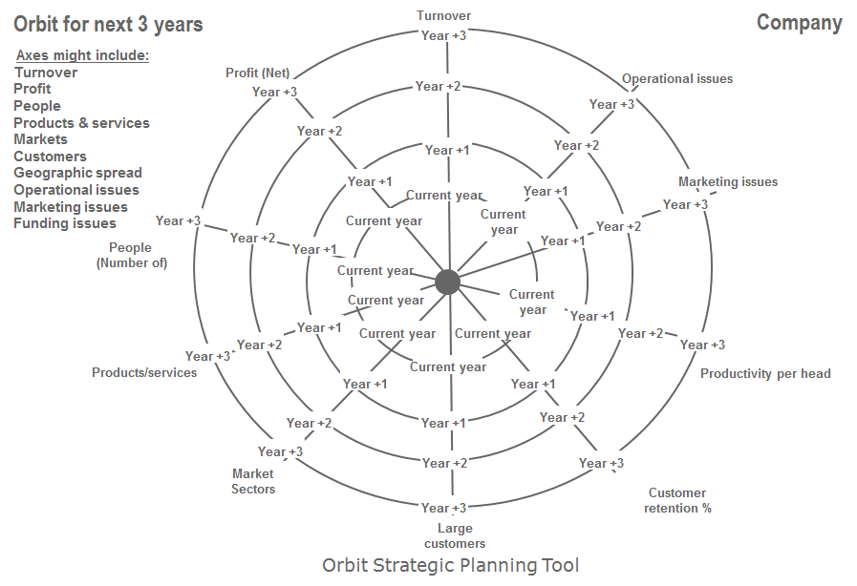
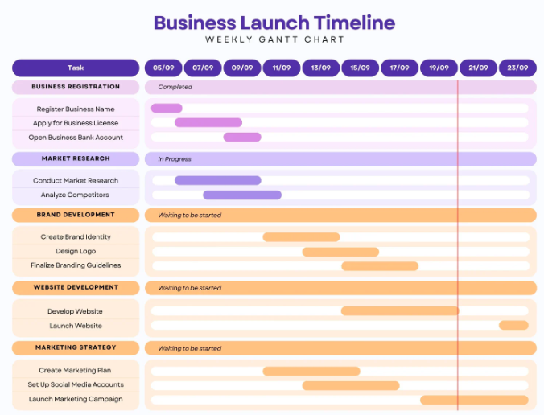
3. Map out underpinning activities
https://sigbi.org/stourbridge/files/2016/07/Slide-1.pdf
Notes:
Let’s organize your goals on timeline, and for each of the goals that are further than 6 months away, think of short-term actions you can make within the first 6 months to build momentum. Does the pacing feel realistic and achievable, or are there areas where you might need to spread out goals? Consider whether you have enough time to see progress, make adjustments, and celebrate small successes along the way.
Now, let’s break down your 6-month goals into monthly activities. Identify key milestones or steps for each month, along with the resources, skills, or partnerships you’ll need. Are your steps small and specific enough to keep momentum? Do you have the resources you’ll need for each one, or should you seek support from mentors or partners?
You can use tools like the Orbit Strategic Planning Tool (which we will say more about in the workshop) or a timeline / Gantt Chart.

Slide 53
Next steps
Submit your idea!
Go to the RSA Spark webpage and click on the link to complete the submission form.
Submissions close 30 June 5pm (UCT)
Email rsaspark@rsa.org.uk if you need help or have questions.
Come back to the content we covered today to help you strengthen your idea prior to submission.
Notes:
Our submission portal is now live! You can find the link to the form and a read-only version of the form on our website here: https://www.thersa.org/design-for-life-our-mission/capabilities-for-life/rsa-spark/#takingpart

Slide 54
RSA Spark Entrepreneur Award
If you enjoyed today’s exploration of turning your idea into an impactful business, then consider whether you want to apply for the RSA Spark Entrepreneur Award.
You will get:
A 4-month online peer learning journey from September 2026 to January 2027
An experienced business founder as a ‘Guide’
£1000 grant funding (with opportunity to bid for more once you graduate)
To apply, you need to submit an idea to one of the RSA Spark live briefs and opt in to being considered for one of the eight spaces.

Slide 55
Assessing growth (survey 2)
To chart a course forward, you must first know where you stand
Capability | Statement
Critical Thinking | I can assess different options and select the best for myself and my community.
Courage | I can overcome my worries to step up for actioning something I strongly believe in.
Composure | I have the confidence to plan and take the next step.
Participants who attend the workshop and complete the workshop surveys will obtain an ‘Explorer’ digital badge
Notes:
We will share the link to the end of workshop survey during the workshop. Please note this survey needs to be completed in order to receive a digital badge.
Congratulations on completing this workshop.
The last activity it to complete the survey, reflecting on whether you feel more confident in the three capabilities and what you still want to do better. Participants who have completed the baseline survey and end-of-workshop survey will get an Explorer digital badge.

Slide 56
Additional Resources
Read the RSA’s blogs about the Vitality Scale and Regenerative Enterprise part 1 and 2
CNN Great by Design – Can Mongolian herders change high fashion? Watch the interview here
Biomimicry case studies showing businesses that have successfully applied biomimicry principles in their operations.
A video from the Ellen MacArthur Foundation discussing nature's blueprint for building prosperity , i.e. showing how nature’s efficient processes can inspire innovative, regenerative solutions.

