Slide 1
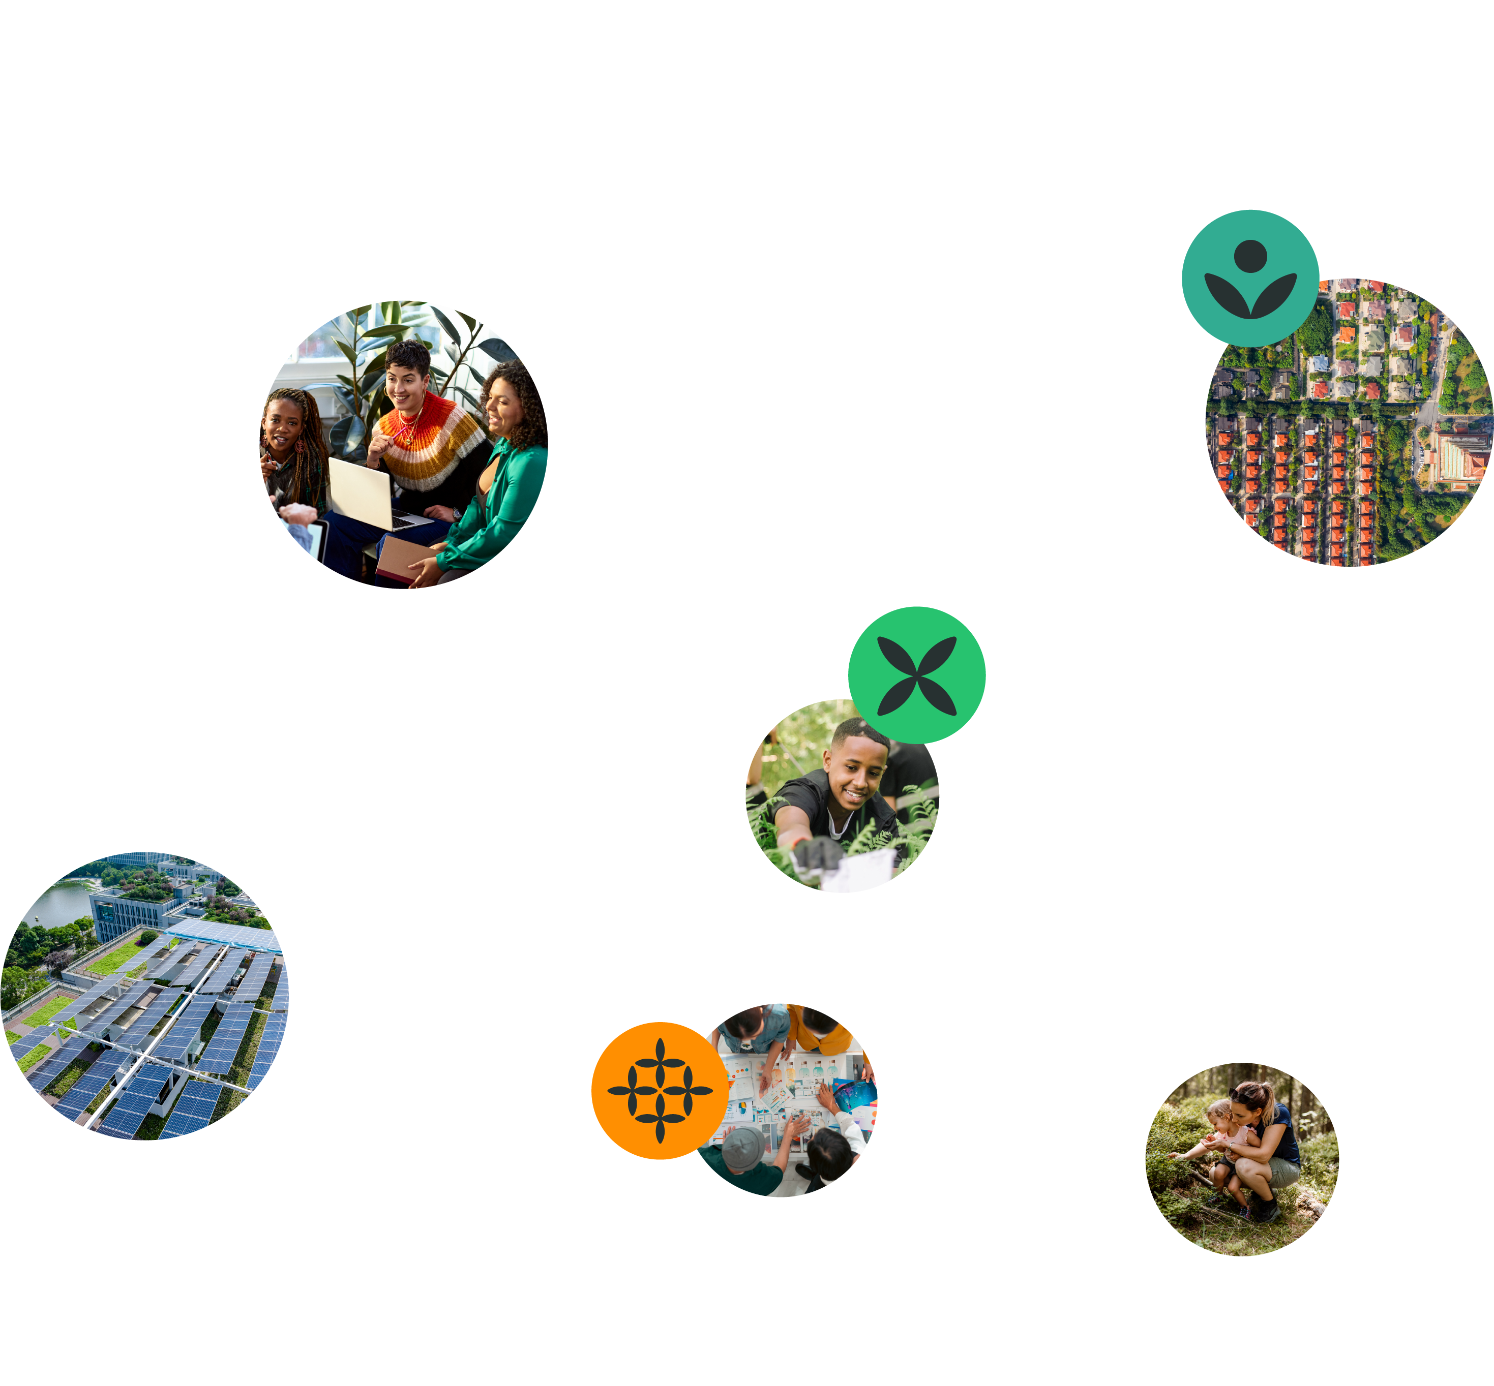






Explore Diverse Perspectives
Learning Workshop 2
26 March 2025

Slide 2


What are the learning workshops on offer?
Discover your purpose
March 2025
Explore diverse
perspectives
March 2025
Envision futures
April 2025
Test your impact
May 2025
Explore enterprise
May 2025
Connect with your strengths and with your energy for change as you reflect on the world as it is, the world as it needs to be, and the brief that you care most about.
Capabilities:​ Care, Citizenship, Composure
Shape your vision for change and a diversity of ideas that respond to your chosen brief, while carefully considering which ones are the most opportunistic.
Capabilities:​​ Creativity, Courage, Collaboration
Consider what and how you might test your most promising ideas and how they can have the greatest impact.
Capabilities:​​ Creativity, Change, Communication
Explore the business and economic viability of your idea while delivering positive social and environmental impact.
Capabilities:​​ Courage, Change, Composure
Explore with different points of possibility, thinking about who you should work with and what you can do to better understand the context of your chosen brief.
Capabilities:​​ Care,
Curiosity, Critical Thinking

Slide 3
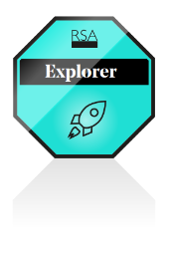
Laying foundations (survey 1)
To chart a course forward, you must first know where you stand
Capability | Statement
Care | Understand other people think and feel differently to me and still connect with them.
Curiosity | Know where to look for answers and see people, animals and even plants as teachers.
Critical thinking | Look at lots of different information and ideas before deciding what to think or do.
Participants who attend the workshop and complete the workshop surveys will obtain an ‘Explorer’ digital badge

Slide 4

Changing your mindset
Two powerful approaches that focus on recognising and leveraging the strengths and resources within us and our communities:
abundance thinking
asset-based community development (ABCD)

Slide 5

Activities

Slide 6

Please read carefully
This is a template.
Before you start working on this activity, please save a copy of this document to your own computer before working on it.
To download the template:
Click on File
Hover on Make a copy and click on Entire presentation
Give your document a new name (optional)
Navigate to and select a location to save your document under Folder
Click Make a copy
Now you’re ready to begin!
You can respond in the slides or in the speaker notes beneath each slide.

Slide 7

Mapping the System
Activity 1

Slide 8

Instructions
In this activity, you are asked to think about your chosen brief. Focus on the how might we question and consider:
What are some of the various parts or factors involved?
How might they be connected?
Create a map to capture this.
For example, you can consider:
The living things who are affected by the brief.
The living things who you could learn from.
Your context: your place, the natural environment and the policies that affect these.

Slide 9
Guidance (continued)
For all students
We encourage you to create a map using any medium you prefer. We have provided a basic template and examples to guide you, however, you can choose to sketch this in a notebook or write it as a list.
There are four key concepts to think about as you map your system:
Interconnectedness
Hierarchy of systems
Feedback loops
Leverage points
Explanations and examples are provided on the following slides.

Slide 10
Guidance (continued)
Interconnectedness: Everything is connected. Changes in one part of a system can have ripple effects throughout the entire system. Understanding these connections allows us to anticipate the broader impacts of our actions.
Hierarchy of systems: Systems are organised in hierarchical levels. For example, cells make up tissues, tissues form organs, and organs constitute organisms. Recognising these levels helps us understand how small changes at one level can influence higher levels.
Feedback loops: Systems are regulated by feedback loops, which can be positive (amplifying changes) or negative (maintaining the status quo). Identifying feedback loops helps us understand the dynamics of a system and how it maintains balance, or experiences change.
Leverage points: These are strategic points within a system where a small change can lead to significant impacts.

Slide 11
Guidance (continued)
Finding and acting on leverage points as ‘points of possibilities’ allow us to create effective interventions. For example, consider possible strategic points for improving community health at four different levels:
Individual level: Focus on educating individuals about healthy lifestyle choices.
Family level: Promote family-based health initiatives, such as cooking classes or fitness programs.
Neighbourhood level: Develop local resources, like community gardens or parks, that support healthy living.
Community level: Advocate for policies that improve access to healthcare and nutritious food.

Slide 12
Guidance (continued)
Students participating in Spark as a group
We encourage you to work together to create a map, drawing on the knowledge and experiences of all members of the team.

Slide 13
Template
Planet
(natural environment)
How might we…
People
(community)
Place
(physical, digital or virtual location)

Slide 14
Example

Slide 15
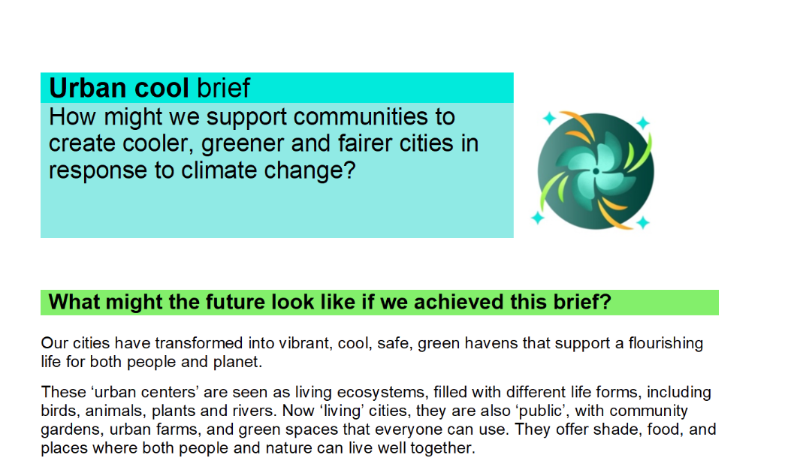
Notes:
Consider a team looking at the urban cool brief and asking how might we support communities to create cooler, greener and fairer cities in response to climate change.

Slide 16
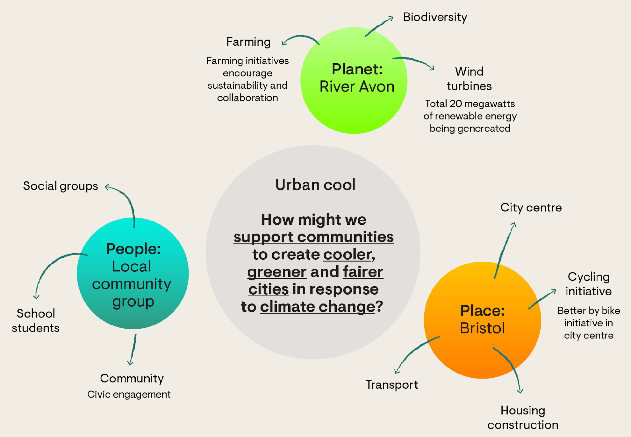
Notes:
First, they need to identify the different parts of the brief and how it relates to them. Perhaps they want to look what it means for their community and environment in Bristol.

Slide 17
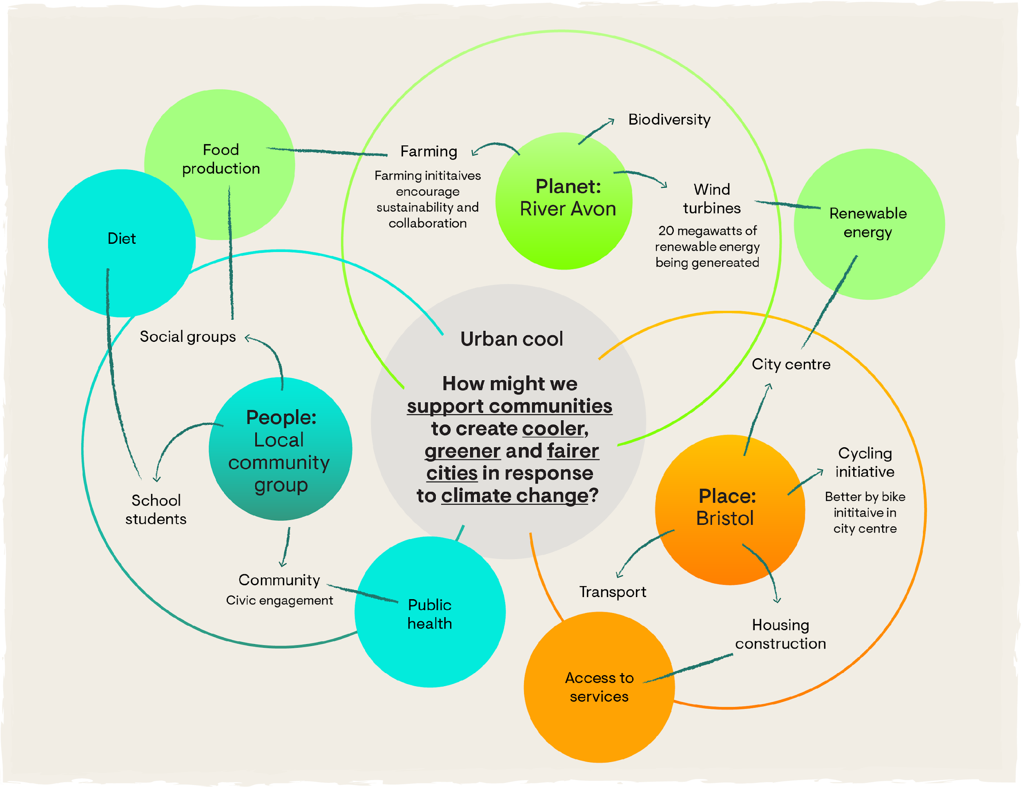
Notes:
Next, draw connections between these parts to show how they interact and depend on each other.

Slide 18
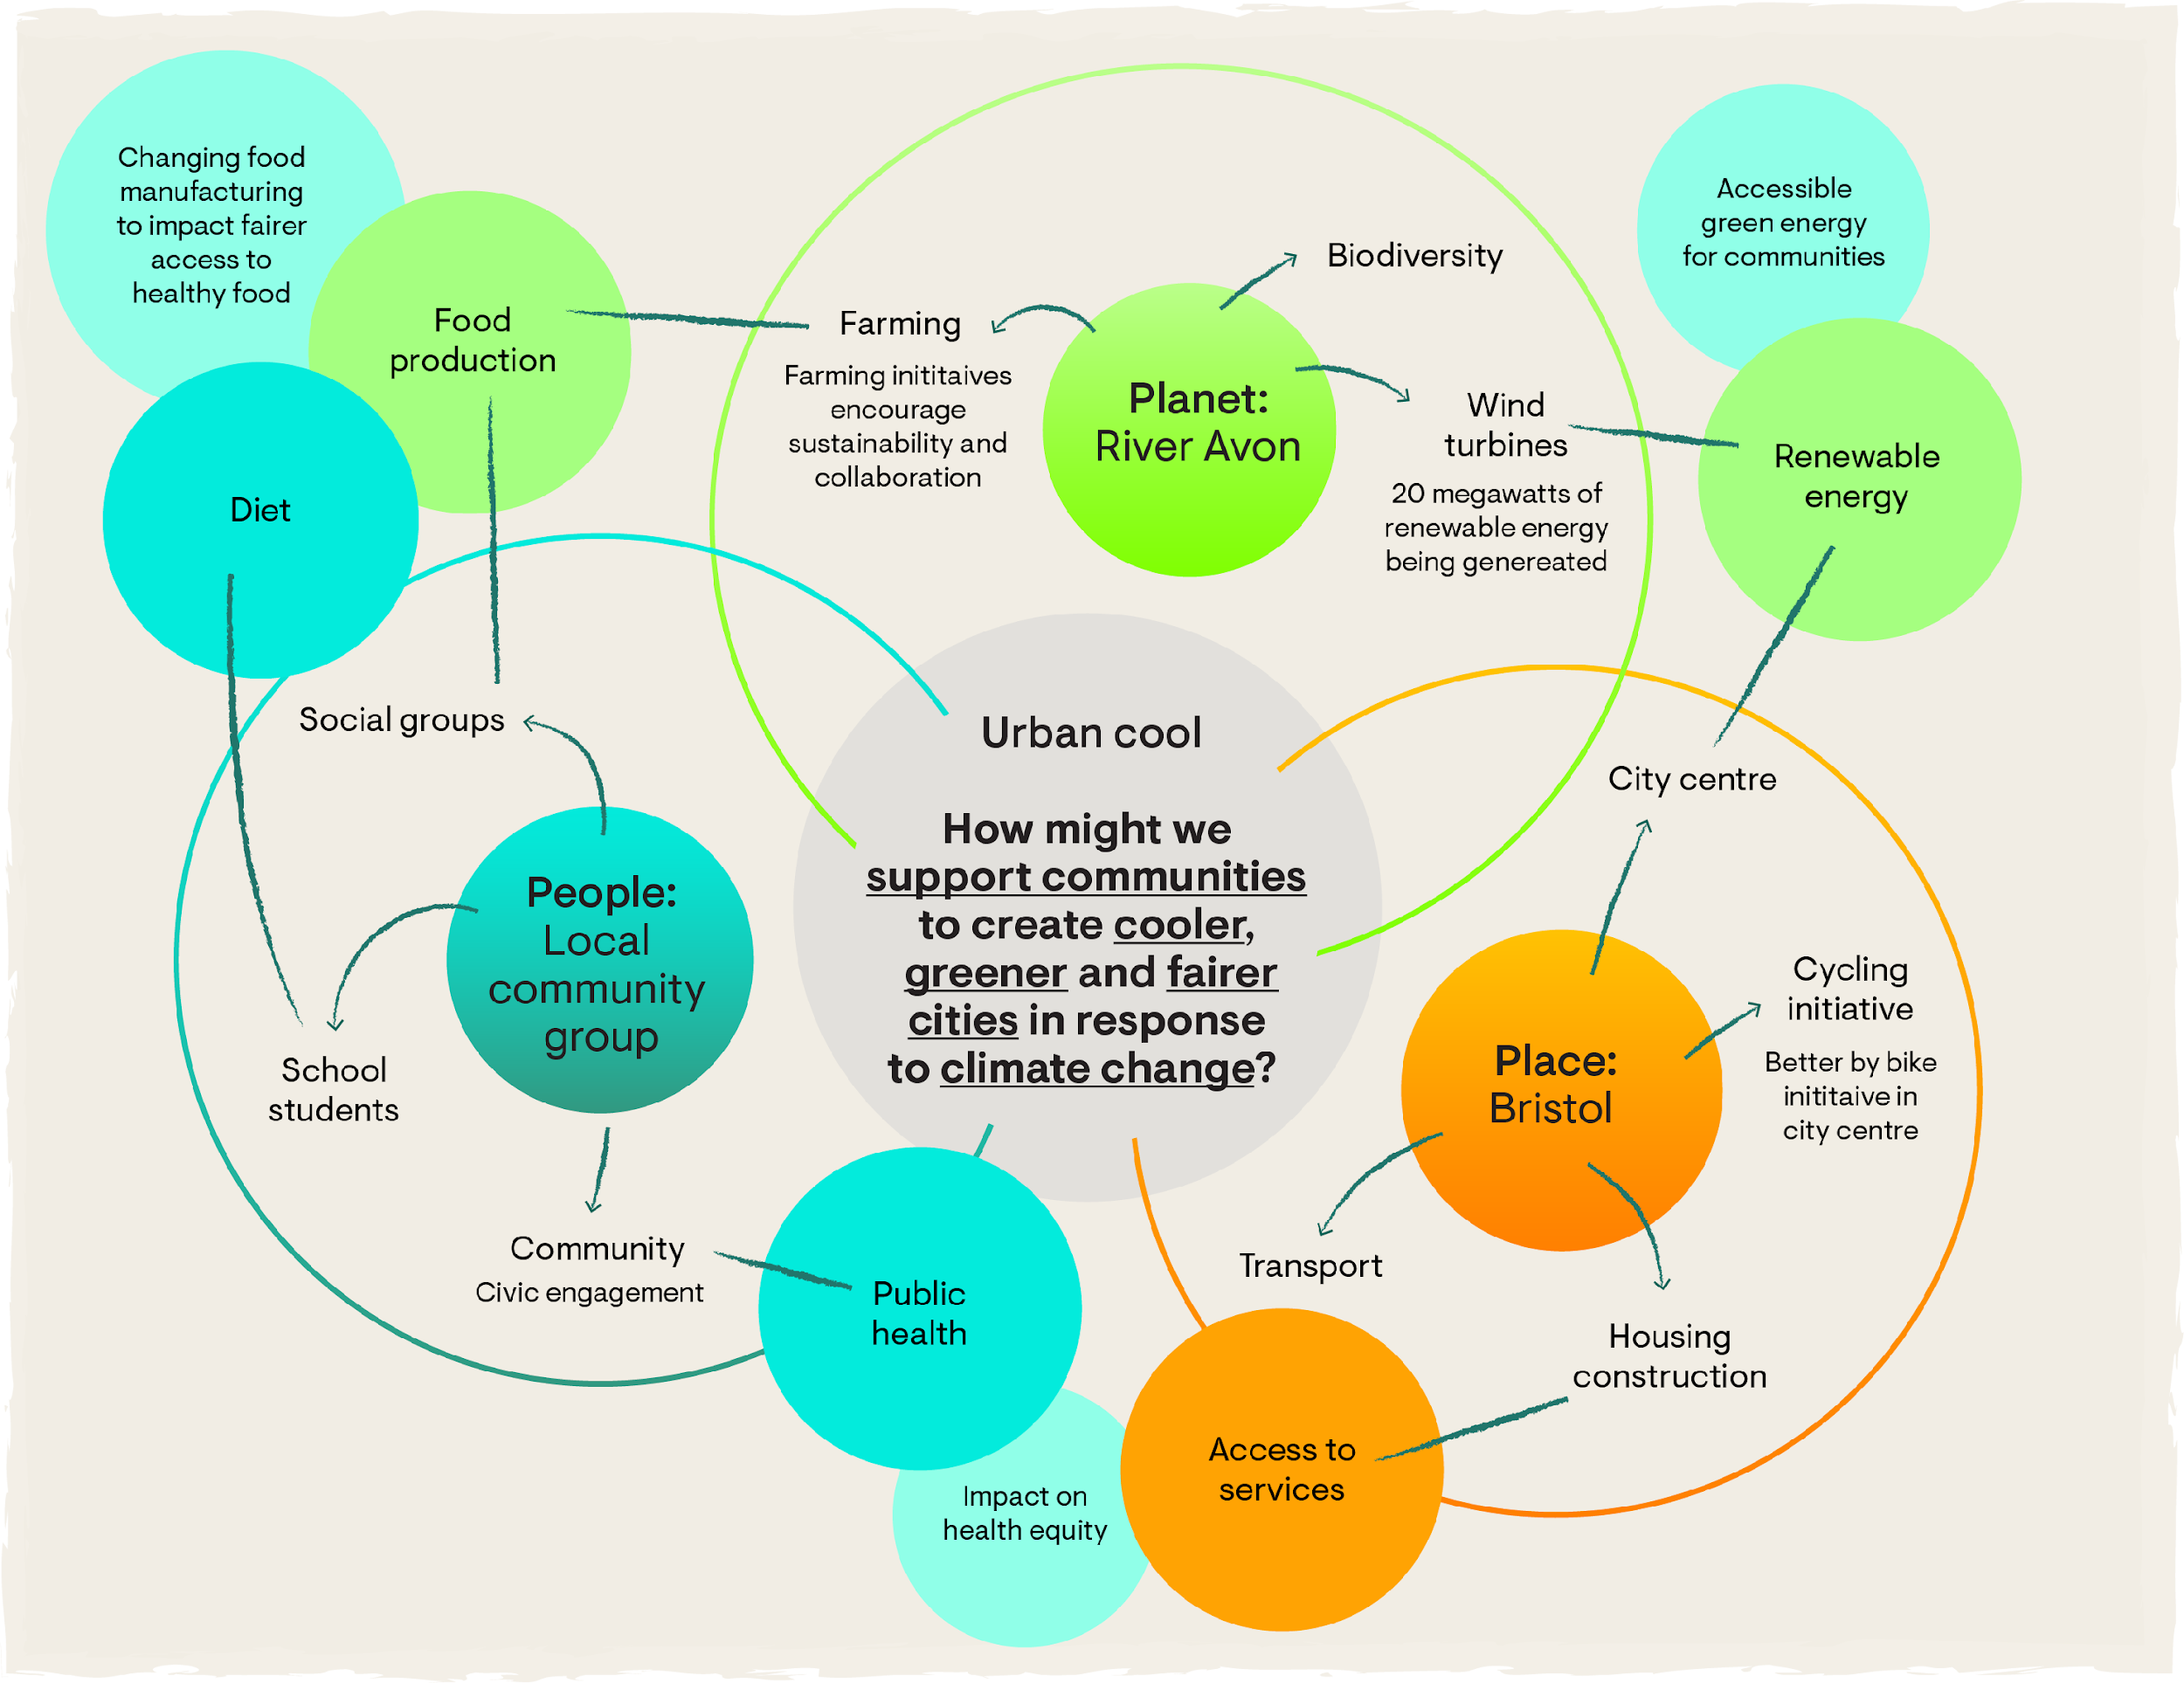
Notes:
Finally, think about how changes in one part might affect the others.

Slide 19
Reflection

Slide 20
Reflect (optional)
Reflect on this activity:
What was easy?
What was difficult?
How can this approach help you conduct better research and come up with more effective ideas?
If you feel comfortable, share your reflections with your team and peers.

Slide 21
Finding Points of Possibility
Activity 2

Slide 22
General guidance
For all students
While doing your research, remember the following:
Look at the toolkit in your mission brief and review the resources provided.
Use the resources at your fingertips: go online, visit your local library and speak to different people
Be aware of bias!
Students participating in Spark as a group
We encourage you to work together to create a research plan and craft points of possibility, drawing on the knowledge and experiences of all members of the team.

Slide 23
Instructions
This activity has two parts:
Develop a research plan: Consider what research resources you have available. Plan to use primary and secondary (desk) research.
Narrow down points of possibility (PoP): Based on what you know now (keeping in mind that this may change once you encounter other perspectives), practice crafting PoP statements and think about what you’d want to know in order to select a focus area.

Slide 24
Part 1

Slide 25
Guidance
For all students
We encourage you to create a research plan for your chosen Spark brief. We have provided an example to guide you, however, you can choose to structure your plan differently.
Take as long as you need for your research. We recommend taking at least 4 days on this activity:
2 days on desk research
at least 2-3 days for interviews / observations

Slide 26
Planning considerations
Consider the following as you develop your research plan:
Where you can do secondary (desk) research - looking up information online, in books and in articles
Where your time and effort is best spent doing primary research (interviews and observations)
Your methodology and timeline, e.g.
  Secondary (desk) research (0.5 days)
  Primary research prep: Setting up interviews and focus groups (0.5 days)
  Primary research: Interviews and/or focus groups (2 days)
  Additional secondary (desk) research - if required (0-1 day)
  Analysis and PoP questions (1 day)
Your audience/stakeholders
Your interview questions
Your roles and responsibilities (if you are working as a team)

Slide 27
Secondary (desk) research
Use the 'How might we' question in your mission brief as a starting point to guide your research.
Read the ‘Background’ and ‘Inspiration’ sections of your selected brief. What more can you discover through secondary research? For example:
  What relevant ideas are already being implemented in your local area or environment?
  Who are the people most affected by your brief? Who are the target community you are focusing your project on supporting?
  Who is already working on topics related to your brief?
  Who are the people or organisations that can help make changes in your brief area?
Once you feel like you know enough about how your brief relates to your target community and/or place, move to the next step: interviewing others.

Slide 28
Primary research: logistics and guidance
Arrange to speak with at least six people who may provide valuable information based on your research.
  These could be community members, experts, or people affected by the issue you are focusing on.
  Some briefs may even affect your friends and family, so you could speak with them too.
  Remember to choose diverse individuals so you can get different points of view.
As you conduct your research using your questions and the prompts above, here are some more resources to guide you along the way.
  The RSA Spark fieldwork and research guide
  A wiki for community-led design.
  A guide to help you make observations and hold conversations with different people.

Slide 29
Primary research: interview questions
Based on your secondary research, create questions that you want to ask all the people you interview. Remember to include open-ended questions where possible. Examples might include:
How is this mission topic directly affecting you/ your immediate environment?
What are some points of hope and points of pain for you around this mission topic?
What does your life/your community/ this place look like
What advice would you give to someone trying to make a positive change in this area?

Slide 30
Example

Slide 31
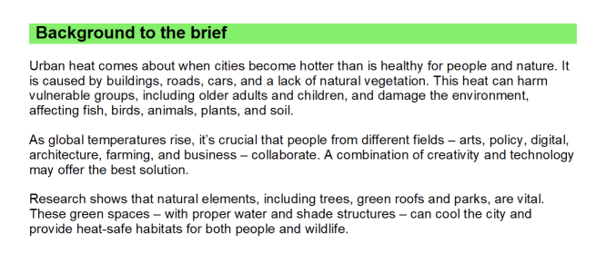
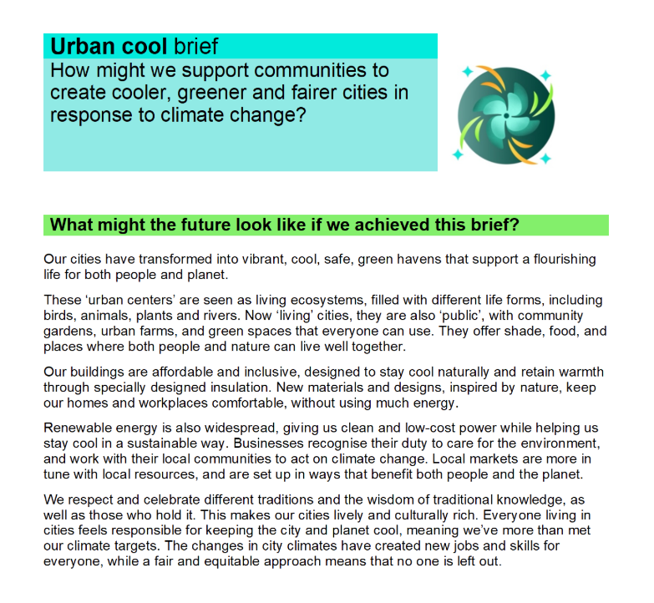
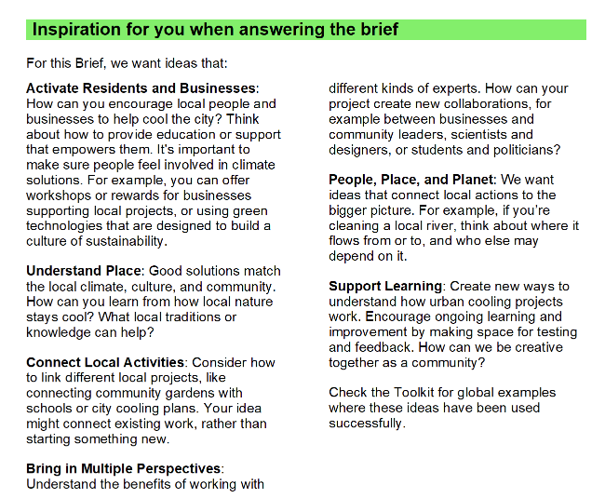
Example

Slide 32
Notes:
Let’s think this through using the Bristol example.

Slide 33
 | _{Audience/stakeholder/space} | _{Questions}
_{Interview} | Students (primary, secondary & uni) – minimum 2 per group | How is climate change affecting you, your place, your community and your planet? How could you, your community and place be supported to respond to climate change in such a way that makes Bristol a cooler, greener and fairer city? What are the things that support these actions (enablers)? What are the things preventing these actions (barriers)?
 | Community group representatives – minimum 1
 | City council representatives, preferably within communities, public health, and/or growth & regeneration directorates (e.g. management of place) – minimum 1
 | Local farmer whose water supply links to the River Avon – minimum 1
 | _{Local dietician – minimum 1}
 | Relevant experts (e.g. green urban planning, biodiversity, renewable energy) – minimum 1 per area of expertise
_{Observe} | Public green spaces along the river – minimum 2, 30 minutes | What living beings are in these spaces? _{When do they use these spaces?} _{How do they use these spaces?} Who is missing from these spaces? What needs are met? What needs are not met? For example, where is there shade? Where is there water? Where is there greenery? Where are people hanging out? How does the use of this space change over time? How could this space change in response to climate change? How would this affect the living systems that depend on this space? How could these spaces be cooler? Greener? Fairer? What are the enablers and barriers?
 | Public spaces in the city centre and around medical centres/hospitals, minimum 4, 15 minutes
 | Cycle paths connecting green spaces and the city centre
 | Main street: the local market, restaurants and grocery store, 30 minutes watching the street
 | Rooftops and sidewalks (while observing public spaces)
 | Renewable energy sites: minimum 1 site

Slide 34
Part 2

Slide 35
Narrowing your focus
Use your insights to create ‘points of possibility’ (PoP) questions.
These describe strategic points in your system where a small change can lead to significant impacts. These are not solutions, but opportunities where your efforts could have meaningful impact.
These PoP questions should reflect ways to address the opportunities or challenges you identified. They can start with “How might we…?” or “What if…?”.
Remember to keep this PoP question specific and realistic for your local community or the place you can have a direct impact on.

Slide 36
Example

Slide 37
Example
How might we support communities to create cooler, greener and fairer cities in response to climate change?
Research found that students with access to green spaces reported a 30% lower incidence of mental health issues compared to those in areas without access to green spaces.
“We know that extreme heat lowers a child’s ability to learn. But our school can’t afford aircon.”
“My closest park is 30 minutes away and it isn’t safe for my son and his friends.”
Public health risks are exacerbated by climate change (e.g. obesity due to reduced physical activity)
The city is investing in expanding its cycle infrastructure from the city centre into growing suburbs
How might we ensure that every child in Bristol has access to safe, cool and green spaces that improve their mental well-being and social interaction?
How might we provide safe and green opportunities for commuting and physical recreational activities (like walking, jogging or cycling)?
Notes:
We will provide a template which you can use.

Slide 38
Refection

Slide 39
Reflect (optional)
Reflect on this activity: What questions and topics do you think are important to explore in your research?
If you feel comfortable, share your reflections with your team and peers.

Slide 40
Next steps

Slide 41
Next steps
To prepare for the next step of the creative process:
  Sign up for the workshop: 30th April
  Engage deeply with your brief and audience by:
    Refining your system map
    Actioning your research plan
    Crafting points of possibility
    Selecting your focus
  Refine your story of me, us & now (optional)
  Reflect on other perspectives (optional)
Envision Futures
April 2025
  Reminder: Submissions open on the 20th May

Slide 42
Assessing growth (survey 2)
Capability | Statement
Care | Understand other people think and feel differently to me and still connect with them.
Curiosity | Know where to look for answers and see people, animals and even plants as teachers.
Critical thinking | Look at lots of different information and ideas before deciding what to think or do.
Participants who attend the workshop and complete the workshop surveys will obtain an ‘Explorer’ digital badge

Slide 43
Optional activities

Slide 44
Revisiting the story of me, we & now
(optional activity)
Create a public narrative that connects you, your team, and your community to a Spark brief.
Community
The story of me is a personal story that demonstrates a connection to a Spark brief.
The story of us is a collective story that highlights the shared purpose, goal, or vision of your team in connection to the Spark brief.
The story of now describes the aspiration of a community or place, to make change happen through a call to action.
Story of we
Story of me
Purpose
Urgency
Story of now
Source: Marshall Ganz. 2009. What Is Public Narrative: Self, Us & Now (Public Narrative Worksheet). Working Paper.
Notes:
In the last workshop, we introduced an optional activity to help you develop a public narrative. This method allows you to combine your personal experiences with listening to, and reflecting on, the experiences of others, and is used to bring people together around shared values and a purpose. This method involves telling three interconnected stories: the ‘story of self (me)’, the ‘story of us (we)’, and the ‘story of now’. This approach is simply described as: “Here’s who I am, this is what we have in common, and here’s what we’re going to do about it.”
If you have done this activity, we encourage you to refine it based on what you learn from your audience and stakeholders. Remember to look at what values you have in common and what direction you agree on.
You will be able to use this narrative in your RSA Spark idea submission, and you can also use it as a personal statement for education, job and funding applications.

Slide 45
Reflections (optional activity)
How did abundance thinking change your perspective on the issues you care about?
What did a nested systems perspective reveal about your mission brief?
During your research, what was an insight that surprised you the most? Why?
Which PoP are you most excited about?

Slide 46
3-2-1 activity
Three things you learned
Two things you’re curious about
One thing you don’t understand (yet)
Notes:
To close out this session, let’s do a 3-2-1:
Three things you learned
Two things you’re curious about, and
One thing you don’t understand (yet)

